Slide 1
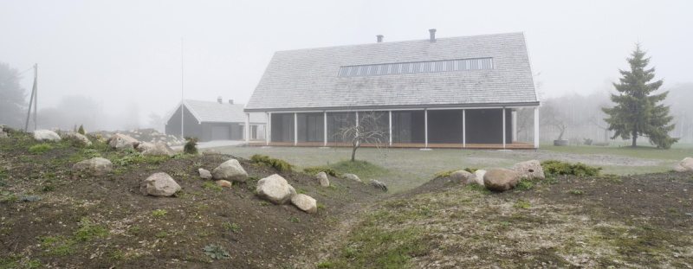
Prosumerism Training material
EFFECT4buildings
Jānis Ikaunieks
Vidzeme planning region
2nd Jun 2020

Slide 2
Prosumer
Prosumer:
electricity consumer producing electricity to support his/her own consumption and possibly for injection into the grid.*
*G. Masson (IEA PVPS), J. I. Briano and M. J. Baez (CREARA)
Notes:
Prosumer is electricity consumer that is producing energy to suport own consumption and has posibility for injection into grid

Slide 3
Content
Prosumerism Guide
Annexes on EFFECT4buildings:
1 Guideline for Solar energy (strategic) planning
2 Guideline for Step-by-step to become a prosumerist
3 Guideline for Procurement of solar energy
4 a Guideline for Prosumerism calculation tool
4 b Prosumerism calculation tool
4 c Prosumerism calculation tool. Example Gulbene.

Slide 4
Guideline for Solar energy (strategic) planning

Slide 5
Local legislation on becoming Prosumer
Country | Legal basis | Generation/consumption | Power Capacity cap reference
DK | In legislation | Consumer installation | 50 kW PV panels, 11 kW CHP
EE | In legislation | Microproducers | Max 3,68 kW (single phase) and 11 kW (triple phase)
FI | In legislation | Small scale production | 2 MW Nominal output
 | In legislation | Micro scale production | Max 50 kW
LV | In legislation | Self-producer | Connection ≤3x16 A (3,7 kW for one phase, 11,1 for three phase)
NO | In legislation | End-user | <= 100 kW
PO | In legislation | Prosumer | 40 kW connected to grid; rated up to 110 kW
SW | In legislation | Small generation installation | >= 43,5 kW fuse 63 ampere; < 50 kW no energy tax

Slide 6
Country specific information on support schemes
 | Sweden | Estonia | Finland | Latvia | Denmark | Poland | Norway
Quota system
Grants/Subsidies
Loan guarantees
Energy tax reduction
Energy tax exemption
Feed-in tariff
Premium tariff
Tenders
Tender based premium scheme
Net-metering |  |  | Capacity ≤100 kVA | Yearly | Hourly
Other |  |  |  | Income tax |  | Exchange scheme

Slide 7
Description of the tools
1. | Solar maps and atlases | Provide basic information necessary for PV projects Do not provide detailed simulation of PV installation Usually free of charge | Photovoltaic Geographical Information System (PVGIS) GLOBAL SOLAR ATLAS IRENA GIS tools
2. | Web/online-based simulation tools | Allow for designing and sizing PV systems on maps (Some include 3D support) Allow defining parameters of solar panels or selecting components from a database Some include pre-set load profiles to estimate more precise energy yield Some are available free of charge, some as a free sample and some are available only for a charge | SISIFO HelioScope SOLARGIS PVP calculator
3. | Downloadable simulation software | Often provides the most precise estimation of solar energy yield Usually includes map or GIS support, PV sizing, component database, load profile database and 3D support Usually available only for a charge A certain level of expertise and knowledge is required in order to use it | PV*SOL PVComplete iDistributedPV Pvsyst BlueSol POLYSUN Solar Pro
Notes:
Very briefly main information about tools:

Slide 8
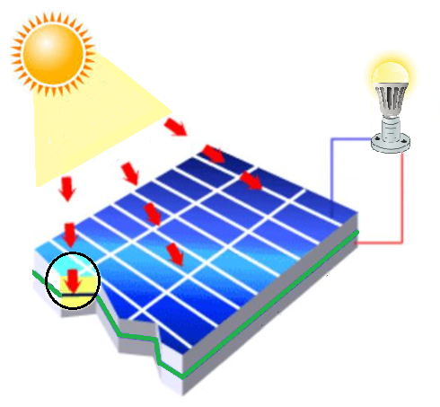
PV panels
Photovoltaic effect → direct conversion of sunlight to electricity
photons
current
Electron
flow
-
-
+
+
n-type
Hole
flow
junction
p-type
Notes:
Photovoltaic systems basic principle .
Photovoltaic means the direct conversion of light into electrical energy (photo=light and voltaic=generating voltage). This is achieved using specific semiconductor material like silicon, gallium, cadmium, etc.
Therefore photovoltaic technology is used to convert light energy into electrical energy. This technology has been developed on the basis that some semiconductor materials such as silicon generate voltage and current when exposed to light. Taking a crystalline cell as example
For explaining the working principle of a photovoltaic cell, the example of a silicon cells is shown. In a silicon material «impurities», called doping atoms, are appositelly introduced intro the crystal lattice. These atoms have either one electron more or one electron less compared to the silicon crystal. Silicon doped with an extra electron aton are colled n-type; silicon doped with a missing electrin atom are called p-type.
In n-type marerial the electron can freely move in the crystal and therefore transport an electric charge. In p-type there is basically a «hole» for every doping atom added in the material. This hole can be filled in by other electron, but then creating another hole somewhere else.

Slide 9
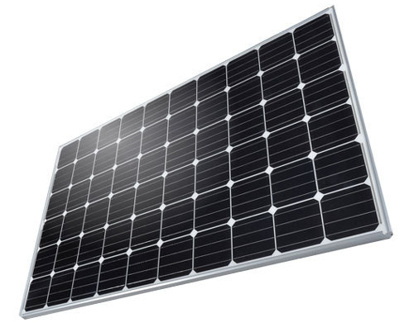
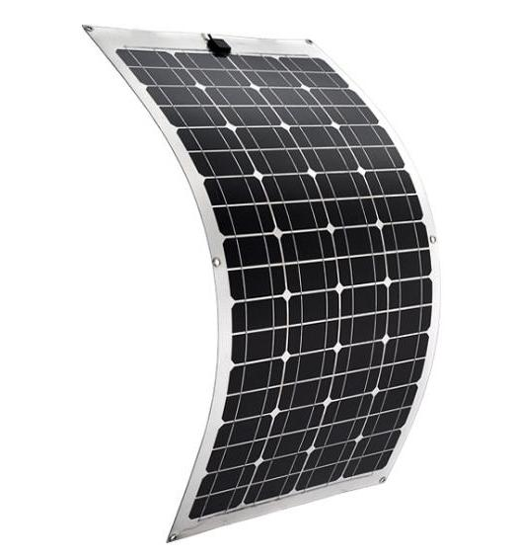
Main PV panel technologies
Polycrystalline
Crystalline silicon cells
12%-16%
Monocrystalline
Hybrid cells
15%-24%.
Thin film silicon
Amorphous
Thin film cells
Cadmium-teluride cells
Microcrystalline
7%-13%
Copper-indium diselenide cells
Notes:
On the market there are several sort of solar cells, from crystalline silicon cells (monocrystalline, polycrystalline) to thin layer cells. These are available in different sizes, appareance, colour and efficiencies.
In general crystalline Silicon compared to Thin Film PV Modules presents
Crystalline Silicon are the most mature PV technology, presenting high efficiencies and therefore typically need lower space requirements. This solution is preferred for high power requirement, with limited space for instllation
Thin film have a superior temperature coefficients, but slighly lower efficiencies. However they have a better low level light behaviour, high performance ratios. In general they need higher space requirements. This solution is prefered where there a not particular installation space requirements, the location of the installation presents low or diffuse light conditions and/or high ambient temperatures.

Slide 10
Guideline for Step-by-step to become a prosumerist
Notes:
Prosumer is electricity consumer that is producing energy to suport own consumption and has posibility for injection into grid

Slide 11
Project implementation process
Planning
2. Harmonizing
3. installation and connecting to the grid
For power plants
Submission of an application to Sadales tīkls
Receipt of technical regulations for connection
Signature of an agreement for the development of an electrical installation building project
Choice of designer, submission of consent
Signing a connection agreement and paying invoices
Construction merchant performs connection construction
Submission of an application regarding the readiness for inspection
Inspection of the construction of a power plant
A successful test act must be submitted
Signature of an act, receipt of an authorization
Connecting to the grid
Assess the orientation of the roof or wall and the availability of sunlight
Identify the potential for using solar PV for a given site
Define your electricity consumption profile
Determine the optimum capacity of PV system
Determine the size of the required system and possible technical solution
Carry out an economic assessment of the project
Prepare project documentation
Obtain a permit from the Ministry of Economics for the installation of generating equipment
Submit an application to the Sadales Tikls
Receive technical connection regulations
Signing a connection agreement
Notes:
The project starts with planning aimed at assessing the cost effectivness and feasibility of the project. The planning includes the assessment of the available area in relation the the installation of the PV system. It is necessary to identify the optimal system orientation , the size of the area available and the potential for PV solar power. When compared to the current energy consumption profile, it is possible to determine the optimal capacity of the system. Then in consultation with service providers, it is possible to identfy the optimal technology and the required dimensions. Once the potential and the cost of the system is determined, an economic assessment can be carried out to establish the profitability of the project, including the time of repayment. When everything has been determined, it is necessary to prepare the project documentaion.
After planning there comes harmonising the project with local authorities and DNO and the installation and connecting it to the grid. Installing a PV system and establishing a connection to the grid must always be harmonised with local authorities as well as DNOs. The required permissions and connection procedures depend on the type of system, whether the system is a microgenerator or power plant.
The effect4buildings tool is useful directly at the Planning stage.

Slide 12
Guideline for Procurement of solar energy
Includes basic recommendations for procurement of Photovoltaic systems:
General scope
Quality and Environmental
Electrical installations
Equipment for electricity production
Marking, testing and documentation
After final inspection

Slide 13
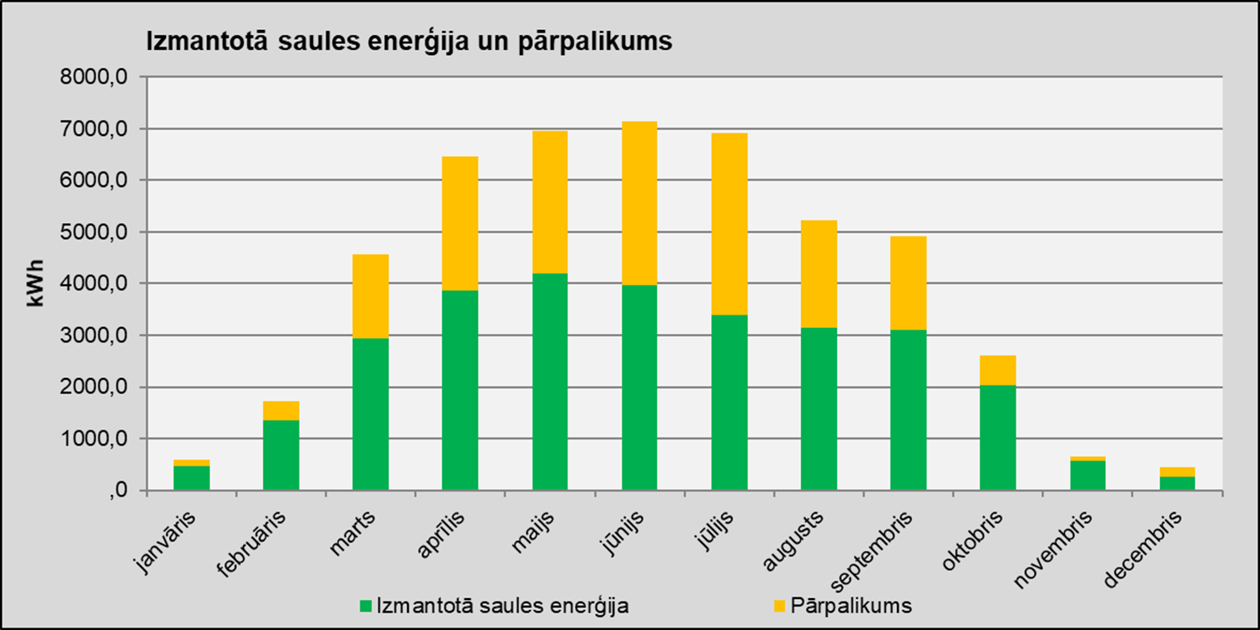
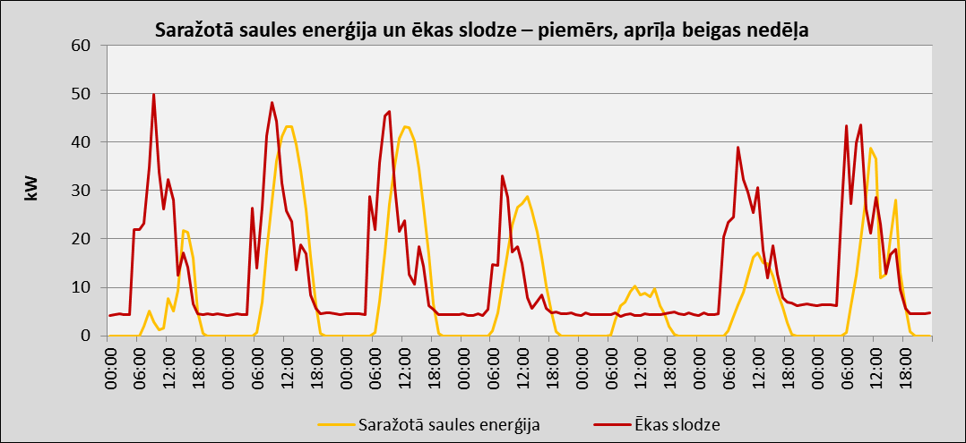
Guideline for Prosumerism calculation tool
Notes:
Prosumer is electricity consumer that is producing energy to suport own consumption and has posibility for injection into grid

Slide 14
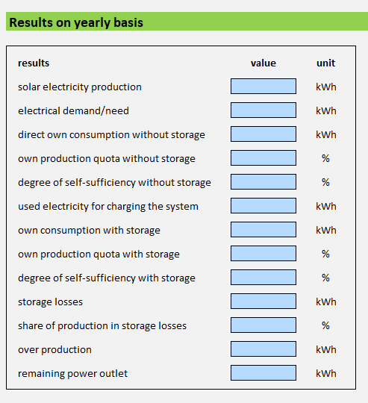
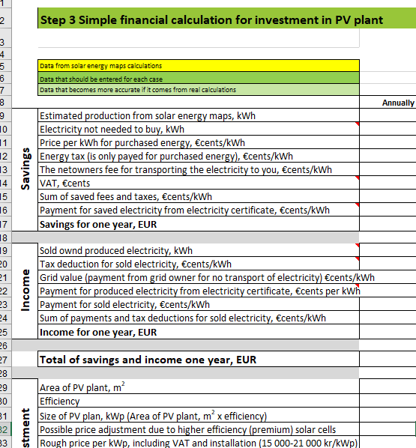
Step 1
Step 4
Data input
Results
Input the values of:
PV system
Electricity consumption
Storage system
Step 2
Find out how much electricity your roof can produce
By using solar maps and tools that are public supported or provided by companies promoting solar energy.
Step 3
Simple financial calculation for investment in PV plant

Slide 15
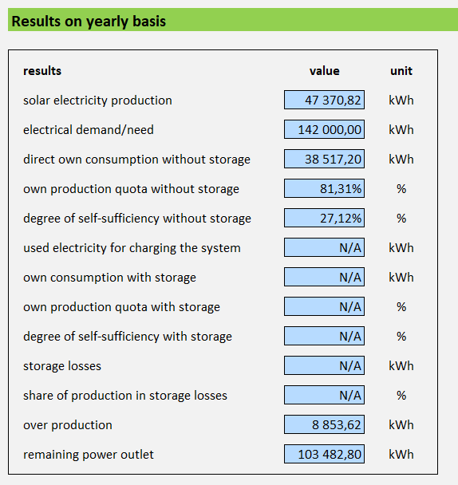
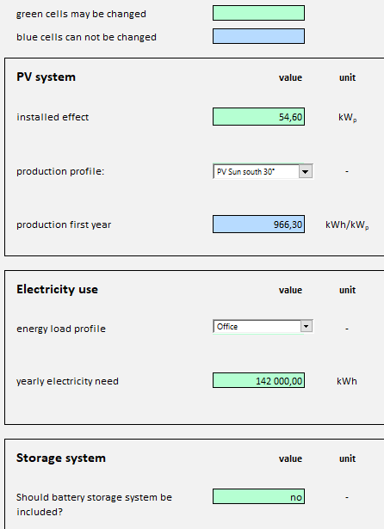
Required information for calculations?
1. Information needed for energy production calculations:
Notes:
Information needed for energy production calculations:
Solar system capacity
PV systems production profile
Energy load profile
Annual current electricity consumption
Storage system parameters
Once you have identified and entered the parameters above, you can find monthly and annual results in the results section for:
Solar electricity production
Electrical demand/need
Direct own consumption without storage
Own production quota without storage
Degree of self-sufficiency without storage
Used electricity for charging the system
Own consumption with storage
Own production quota with storage
Degree of self-sufficiency with storage
Storage losses
Share of production in storage losses
Over production
Remaining power outlet

Slide 16
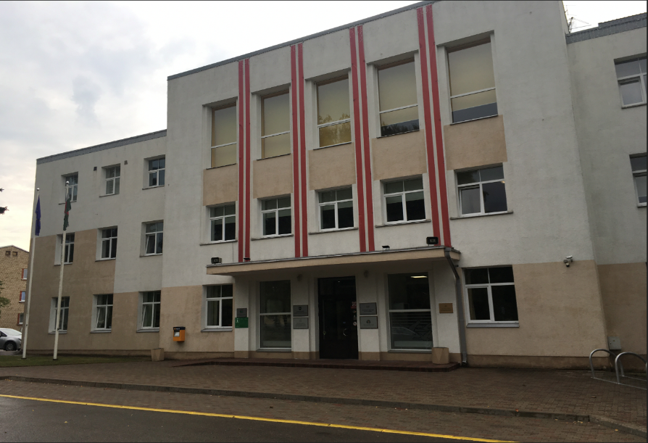
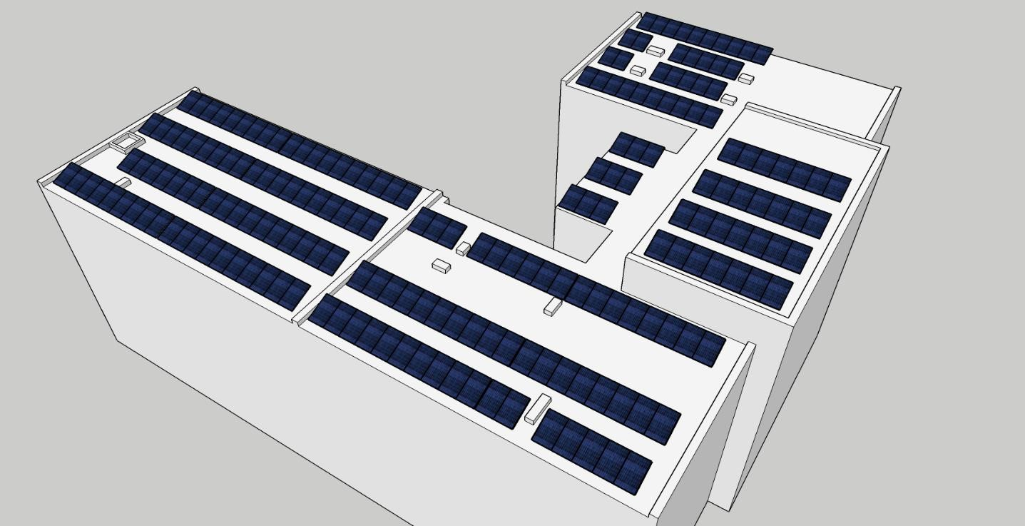
Prosumerism calculation tool Gulbene example
City council building: 2249,7 m²
Electricity consumption in 2018: 145 MWh/year
Roof size: 920 m²
Notes:
Gulbene’s municipality plans to install a solar power plant on the local government administration building. The solar power plant must produce at least 49,60 MWh of electricity per year for the first 5 years of operation. The total power of the system must be at least 54,60 kWpeak but not more than 75 kW. The building consumes about 142 MWh of electricity during the year.

Slide 17
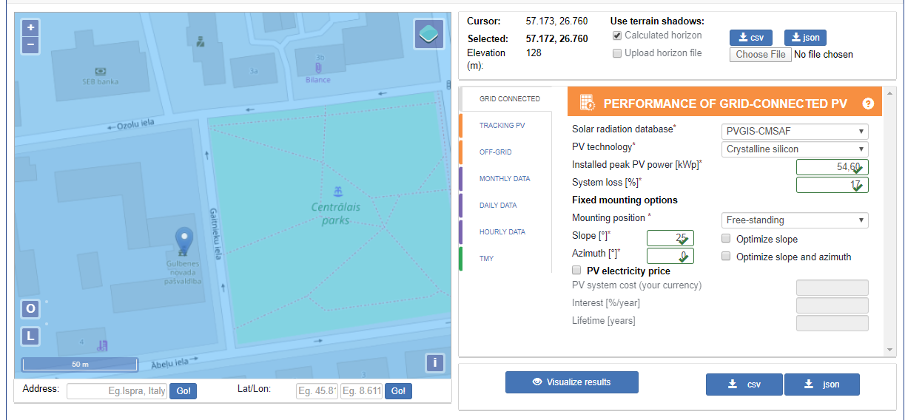
Estimating energy generation – PV GIS
For an estimation of the energy yield this are the first variables:
Location (Ābeļu iela 2, Gulbene)
PV technology (Crystalline silicon)
Installed peak PV power (54,60 kW_{peak})
Slope, Azimuth (25˚, 0˚)
Mounting position (Free-standing)
System loss (17%)
Meteorological database
Parentheses () show the value for Gulbenes project
New version at:
http://re.jrc.ec.europa.eu/pvgis.html
Notes:
Ekas pārvaldnieks var izmantot pieejamos tiešsaistes rīkus, piemēram, PV GIS, kas ir ES tīmekļa datu bāze. Šādus rīkus iespējams izmantot, lai iegūtu pirmo norādi par saules enerģijas PV sistēmas iespējamo saražoto enerģijas apjomu. Tālāk šo informāciju var izmantot, lai aprēķinātu projekta rentabilitāti, par ko tālāk var informēt ēku īpašniekus.
Saražotās enerģijas novērtējumam nepieciešams ievadīt šādas vērtības:
Ēkas atrašanās vietu (Ābeļu iela 2, Gulbene)
Izmantoto PV tehnoloģiju (Crystalline silicon)
Paneļu slīpumu, azimutu (25˚, 0˚)
Montāžas variantu (Free-standing)
Zudumu koeficentu/ Efektivitāti (17%)
Meteoroloģisko datu bāzi
* Iekavās () norādīta Gulbenes projekta vērtība

Slide 18
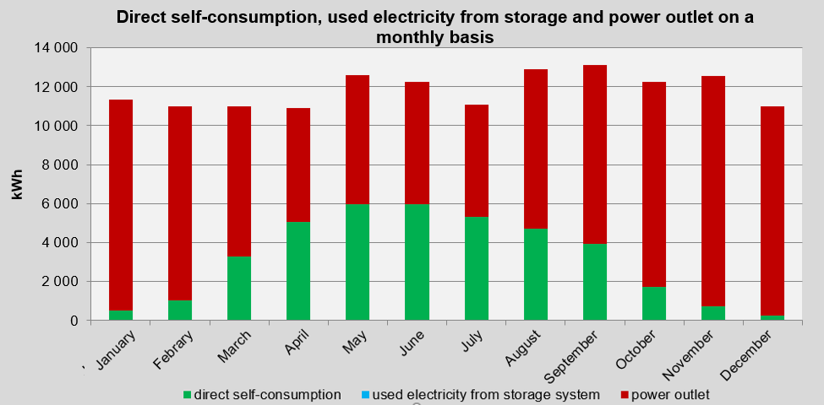
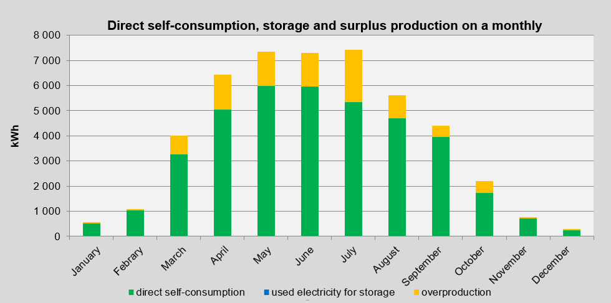
Notes:
As can be seen in the graph on the left, comparing the consumption load profile of the building to the production profile of the PV system, it is noted that direct consumption ranges from 254,57 kWh in December to 5 980,34 kWh in May, comparing these values to the total energy needed for the building, it can be concluded that the level of selfsufficiency is lov, only 2,31% in December, in July 48,6%. This means that on avarage, the syste, is able to provide only 26,93% of the energy needed for the building.
On the other hand, the chart on the right shows how the energy produced by the system breaks down. It can be seen that every month part of the energy produced is not consumed, namely overcapacity, in December it is only 1.90 kWh, whereas in July 2 093,15 kWh.
This problem can be improved by introducing a system for storing non-consumed energy.

Slide 19
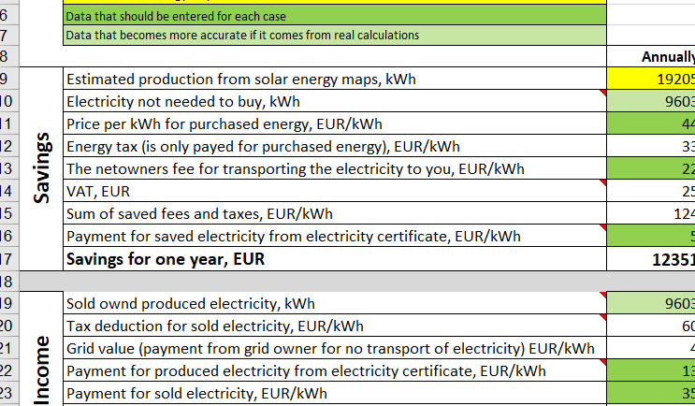
Financial calculations using the EFFECT4building tool
Notes:
Input data for financial calculations for each country is different. Energy price, tax and other values depend on each countries policies. Regarding scenario No. 1 for Gulbene, as a result of 38 517 kWh of direct electricity consumption, which was not required to be procured, it is possible to save EUR 5 933 per year through planned PV system. The share of own-production results in overproduction of 8 853,62 kWh, which can be sold for EUR 531 a year. When taking in consideration rough system installation costs of EUR 40 109, the internal rate of return is 0,2 and the pay-back-time is 6,2 years.

Slide 20
Comparison of the results of all scenarios
 | Scenario No. 1 | Scenario No. 2 | Scenario No. 3 | Scenario No. 4 | Scenario No. 5 | Scenario No. 6
Capacity [kW_{p}] | 54,6 | 54,6 | 75 | 40 | 54,6 | 54,6
Area [m²] | 321 | 321 | 440 | 235 | 321 | 321
Production profile: | D 30˚ | D 30˚ | D 30˚ | D 30˚ | Di 15˚ | D 30˚
Is there a storage system, if yes, its costs. | No | Yes, (4 780 EUR) | No | No | No | No
Solar electricity production [kWh] | 47 371 | 47 371 | 65 069,81 | 34 704 | 43 633,88 | 47 371
Consumption [kWh] | 38 517 | 46 241 | 44 904,67 | 31 515 | 37 150,56 | 38 517
Degree of self-sufficiency [%] | 27,12 | 32,03 | 31,62 | 22,19 | 26,16 | 27,12
Total investment cost [EUR] | 80217,9 | 80217,9 | 54 978 | 29 363,3 | 40109 | 40 108,95
Savings [EUR] | 5 933 | 7122,7 | 6 917 | 4854 | 5 722 | 5 933
Income [EUR] | 531 | 0 | 1 210 | 191 | 389 | 531
Financial aid,% of total costs | 0 | 0 | 0 | 0 | 0 | 50
Internal rate of return | 0,1 | 0,1 | 0,1 | 0,2 | 0,2 | 0,2
Pay-back-time [year] | 12,4 | 12,6 | 15,9 | 11,6 | 13,2 | 6,2
Notes:
The table summarises the results obtained for all scenarios. The repayment time is the smallest in scenario 4, when the system capacity was reduced and the necessary funds also decreased. On the other hand, the largest is in scenario 3, when capacity was increased. Scenario 2 has the highest degree of self-sufficiency since a storage system was installed that provides storage of unused energy for later periods. Unfortunately, due to the high costs of the storage system itself, it increases slightly the repayment time.
In the case of Latvia, grants and subsidies are available, which makes it easier to set up PV systems, as shown in the table they can significantly reduce project costs and the time it is repaid.

Slide 21
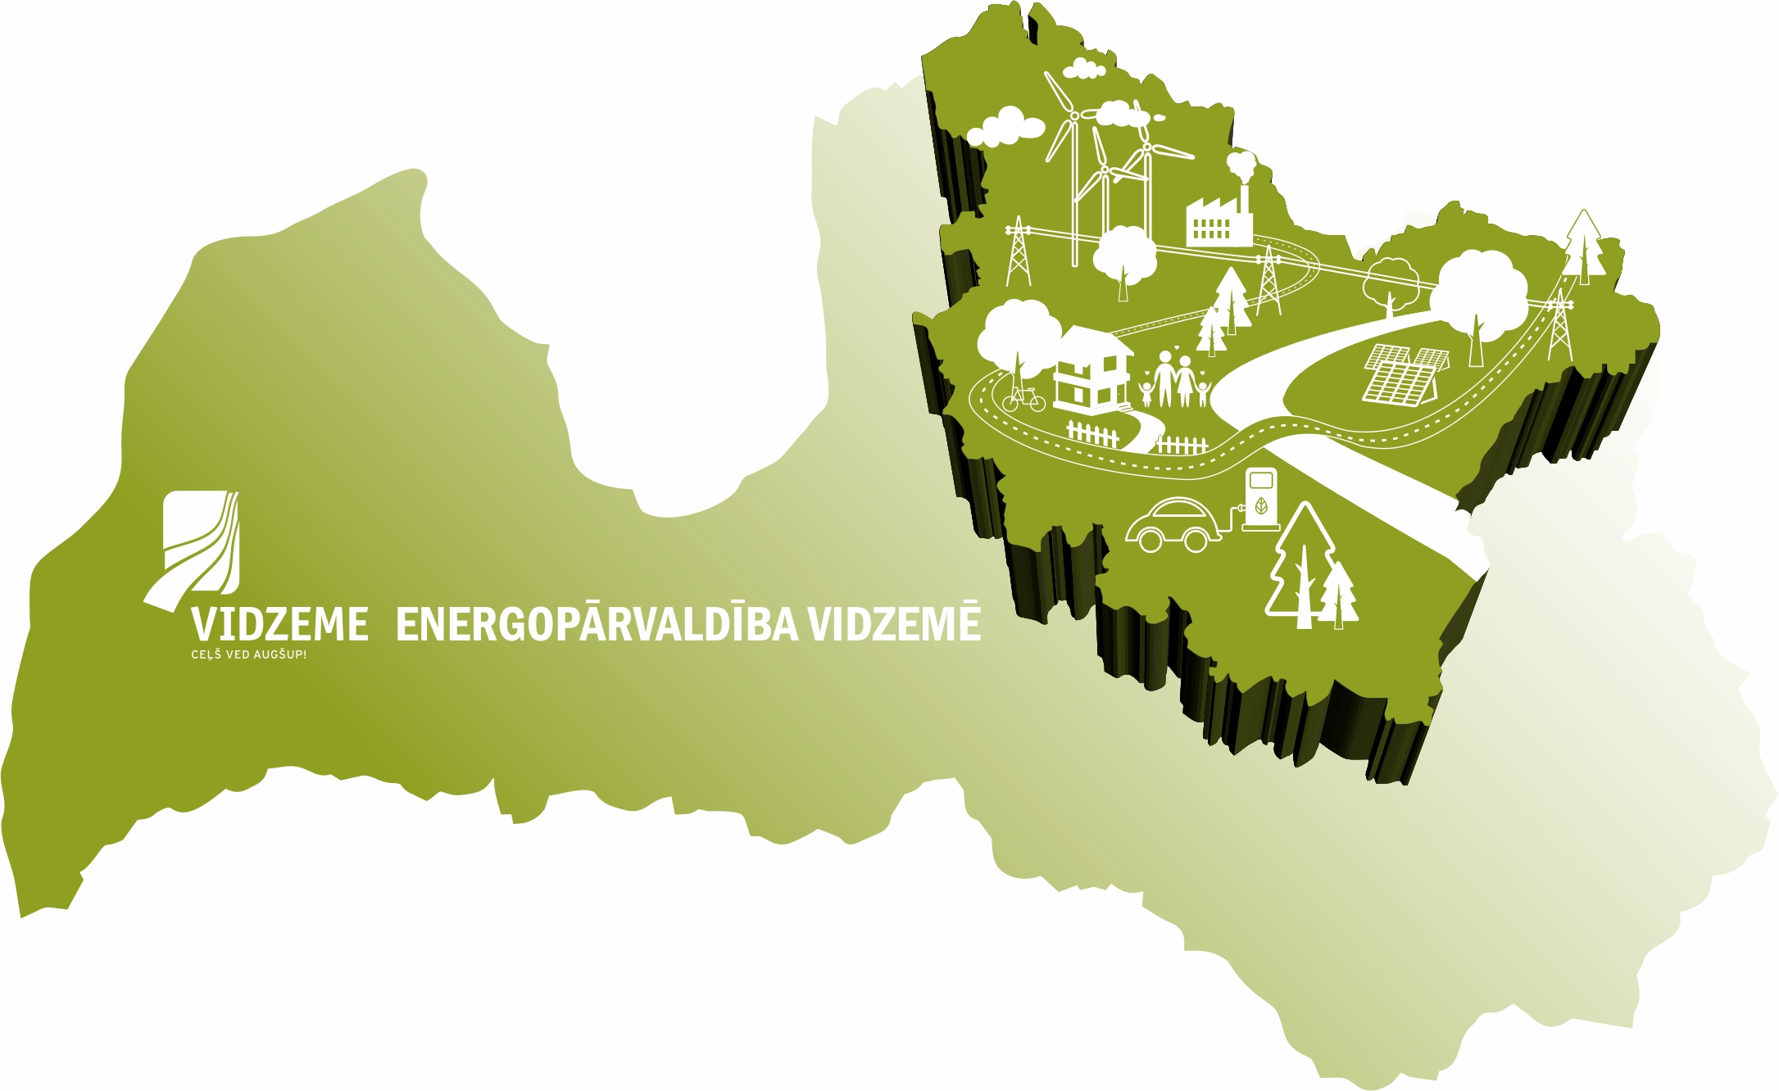
Kontakti
EFFECT4buildings
Jānis Ikaunieks
Energoefektivitātes eksperts
Vidzemes plānošanas reģions
Mob.: 26349224
E-pasts: janis.ikaunieks@vidzeme.lv
www.vidzeme.lv

