Slide 1
GREEN LEASE CONTRACTING Training material
EFFECT4buildings
Add a organisation logo.
Note: The Union Emblem (EU flag) shall have at least the same size (height or width), as this logo.
Name, Organisation
Event
Location, Date

Slide 2
Components in training material
Guide
Power Point
Contract template
Contract guideline
Notes:
GLC Training Material – content of presentation.
Training material is composed around a masterclass programme – all our material could be used to complete a masterclass.

Slide 3
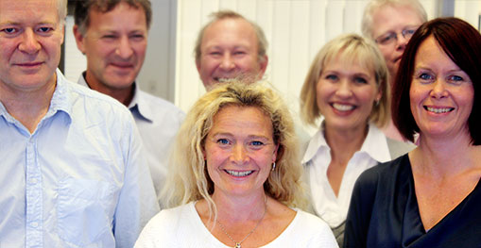
Example: The target group
Key public decision makers
Building owners
Property managers
Operations managers
Tenants
Copyright: NEE
Notes:
Target group
Public building owners
Property managers
Operations and maintenance managers
Tenants
Technical personnel – technical experts and maintenance personnel?
Trainer
About yourself and your background
Your prior knowledge and experience from green Lease contract

Slide 4
Workshop class programme (½ day)
Title | Description and materials
Welcome and purpose of the day | The purpose and the participants introduce themselves (10 min)
Green leasing contracting | GLC presentation (15-30 minutes) Case presentation, if accessible or knowledge sharing (15-20 min)
BREAK | (15 min)
Exercise | Introduction to training case Exercise 1: Purpose and objectives (30 min) Exercise 2: Create a contract (60 min)
BREAK | (15 min)
Exercise | Exercise 3: Evaluation of the contract (30 min)
Final remarks | What have we learned? (15 min)
Notes:
Programme in 3 periods - The timeframe is 3 – 4 hours:
First period: Why green lease contracts. Understand problem and solution. + Case presentation, if accessible (15-20 min)
Invite a case to share experiences from successful or challenging cases.

Slide 5
Example Agenda EPC training
1. Aim of GLC training
2. About GLC
The GLC
Added value
An GLC project example
3. Recent market status
Success factors and barriers
4. Main development needs
5. Partnership contracts
6. New implementation model for GLC
7. The tangible GLC toolbox
Guideline and presentation
Templates and model documents
8. Summary and conclusions
Notes:
This is the agena structuring the training in the order I have found most practical. Changes might occur. Under each point I will present some examples of content. As the material is not yet finished there might be some overlapp in my presentation of examples..

Slide 6
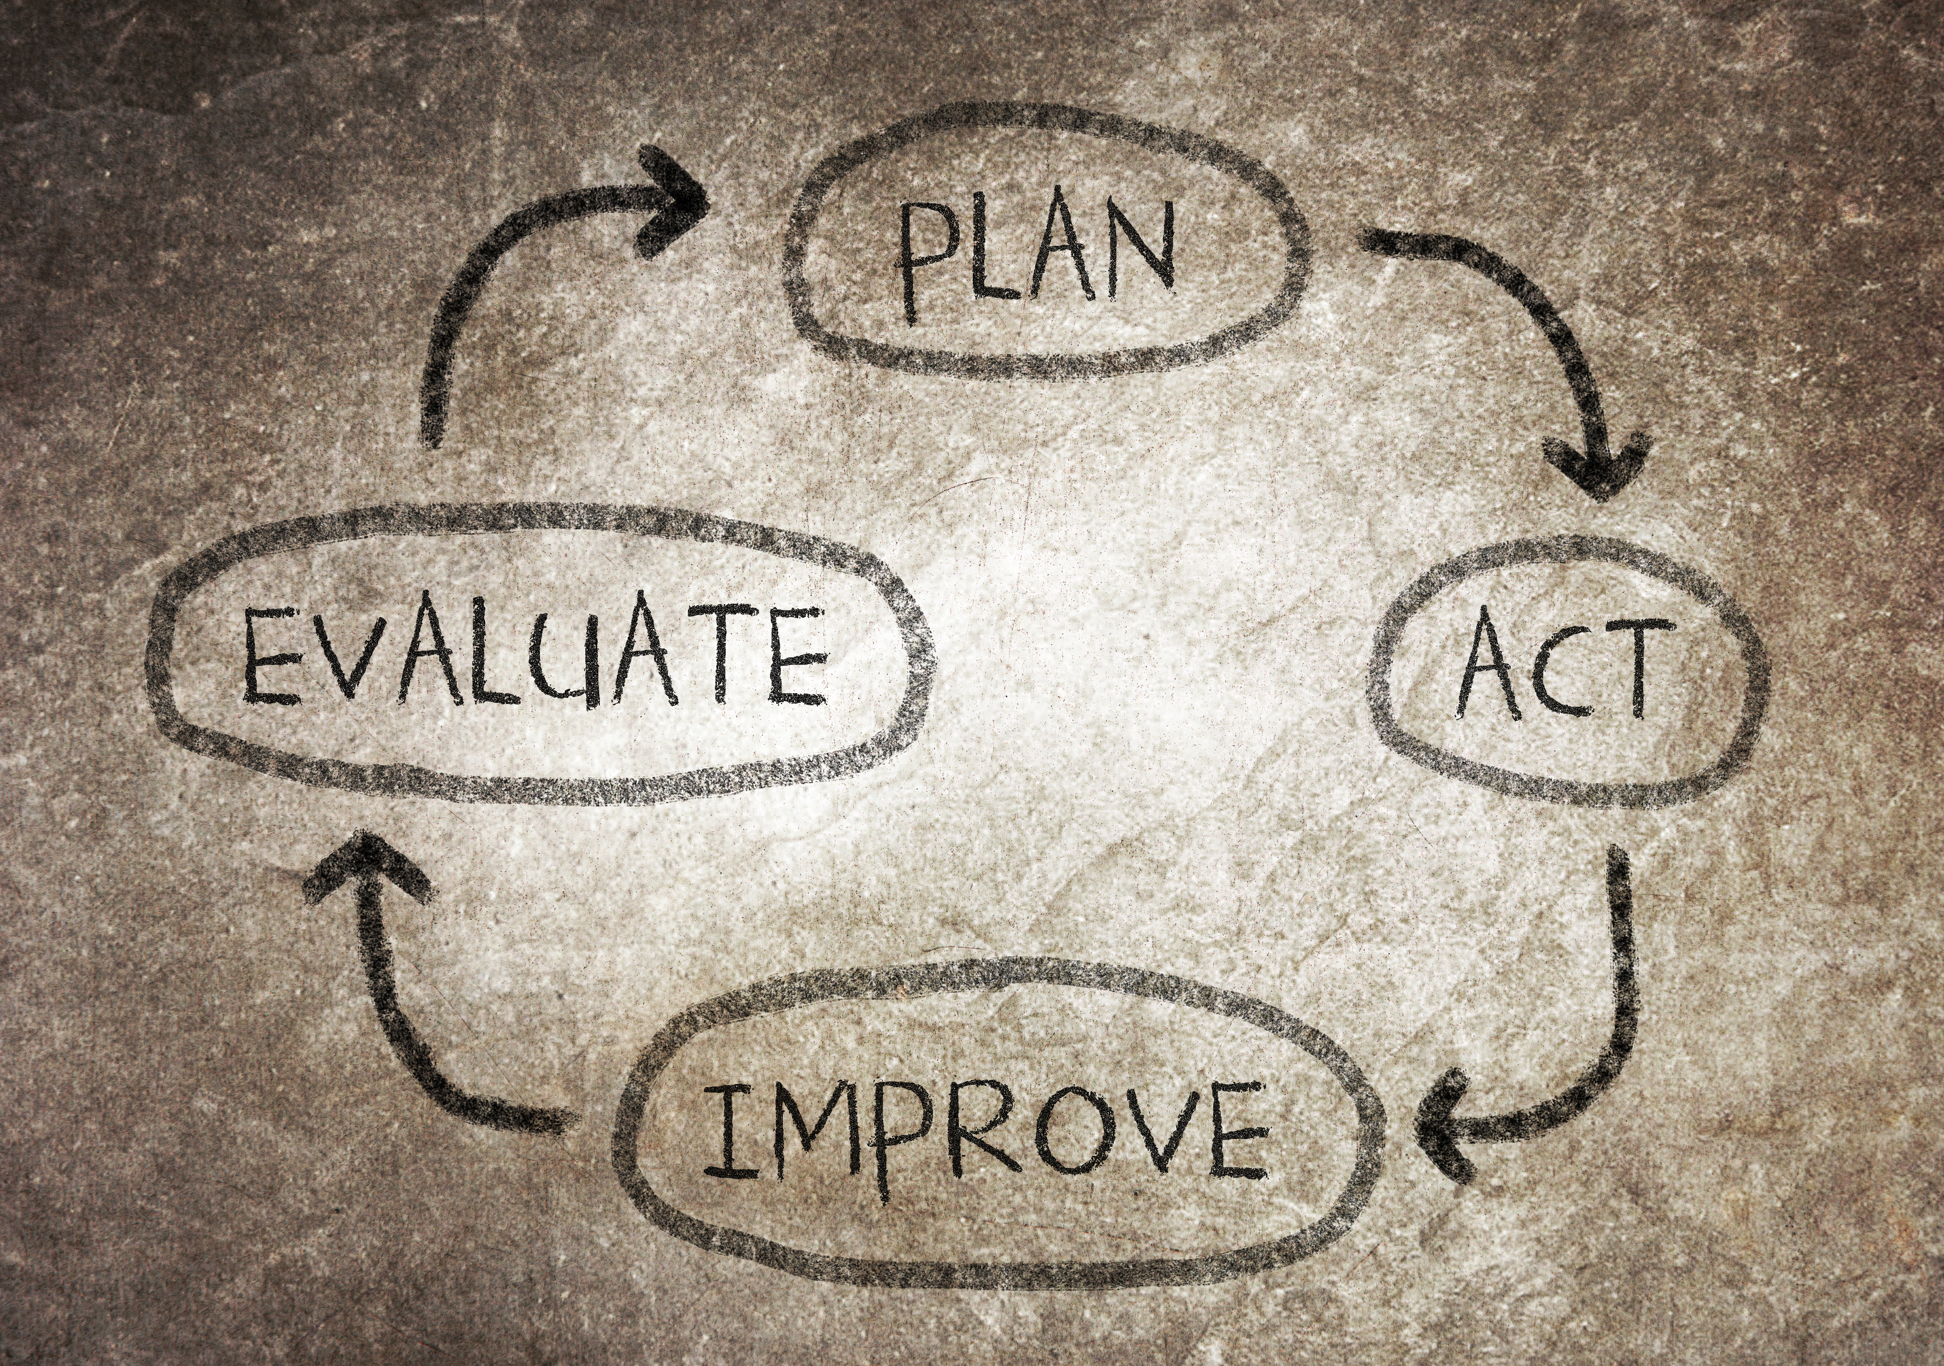
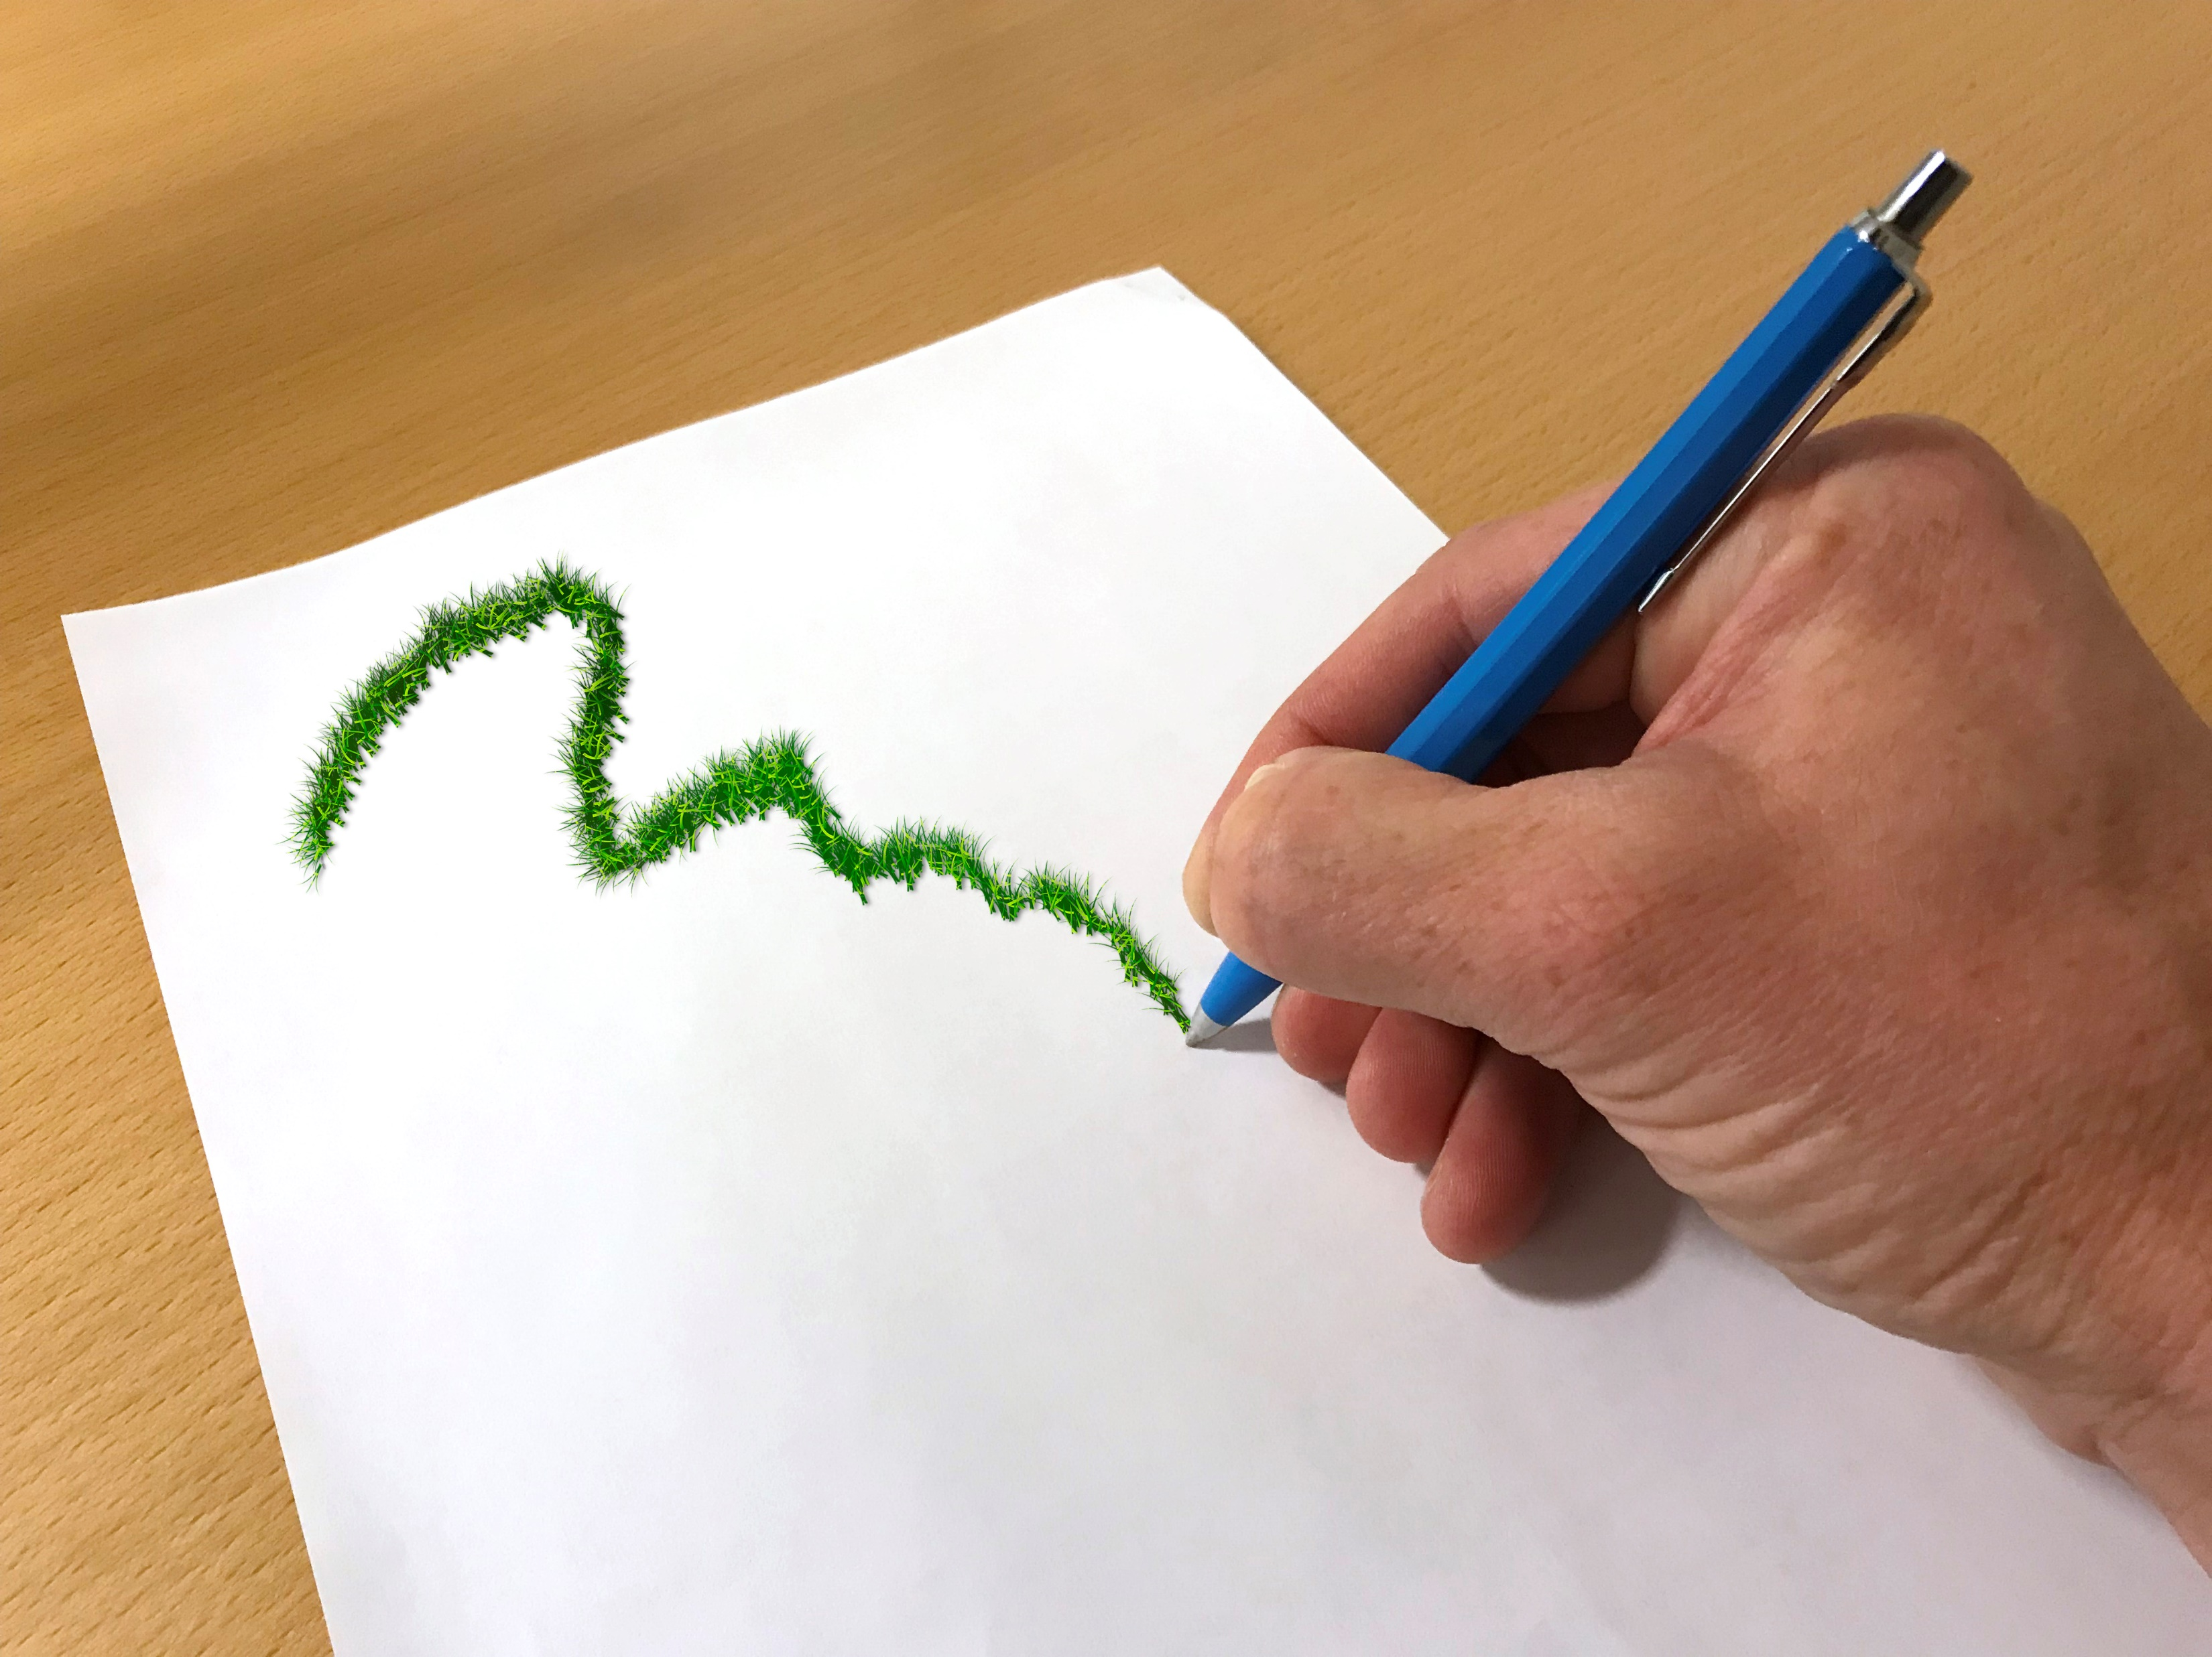
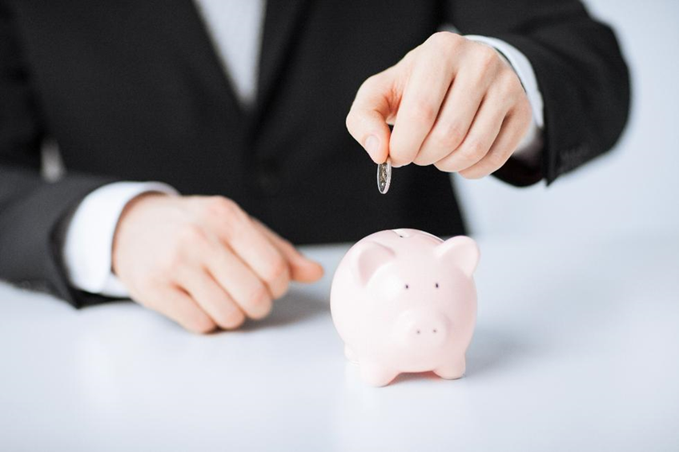
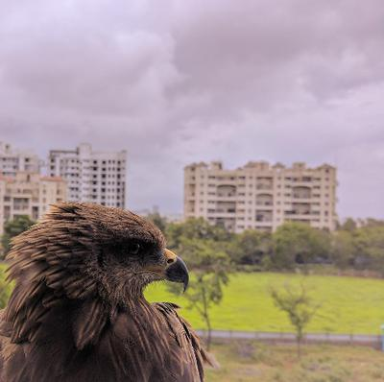
Notes:
The Green Leasing Method it’s a living process that is going to change over time
The foundation is the Green Leasing Contract, where the practical work is based on the contract as a platform and tool.
Green leasing contracts helps the landlord and tenant to create a dialogue about how environmental impact can be reduced
The main purpose of the contract is to focus on the property's environmental impact, which includes the businesses that are active on the property.
Energy savings but also other things that are good for the environment like recycling
By lowering energy and increase recycling the involved parties can save money

Slide 7
Goal
Motivation
Incitement
Meetings
Follow-up
Notes:
Its important to have well planed target when your aiming to be able to reach the goal.
The goal should be easy to understand and both parties must agree on it.
Motivation is key to success because the green leasing method will demand some effort from both parties.
Incitement can be used as a motivator for ex financial.
Meetings is very good for keep the communication alive and share knowledge about the building.
this can contribute to even more savings of energy and resources
Follow-up is probably the most important step in this method and often the one that are neglected.
Follow-ups gives an understanding on what have been done, how it went and what can be improved

Slide 8
Energy
Knowledge
Environment
Financial
Communication
Collaboration
Notes:
Green leasing gives
Lower Energy use
Better knowledge how the building operates
The environmental benefit can be grate
Saved energy and resources result in many saving that can be split by the participant
Communication build a stronger relationship between landlord and tenant with the building and business in center.
The better the collaboration is the more energy can be saved.

Slide 9
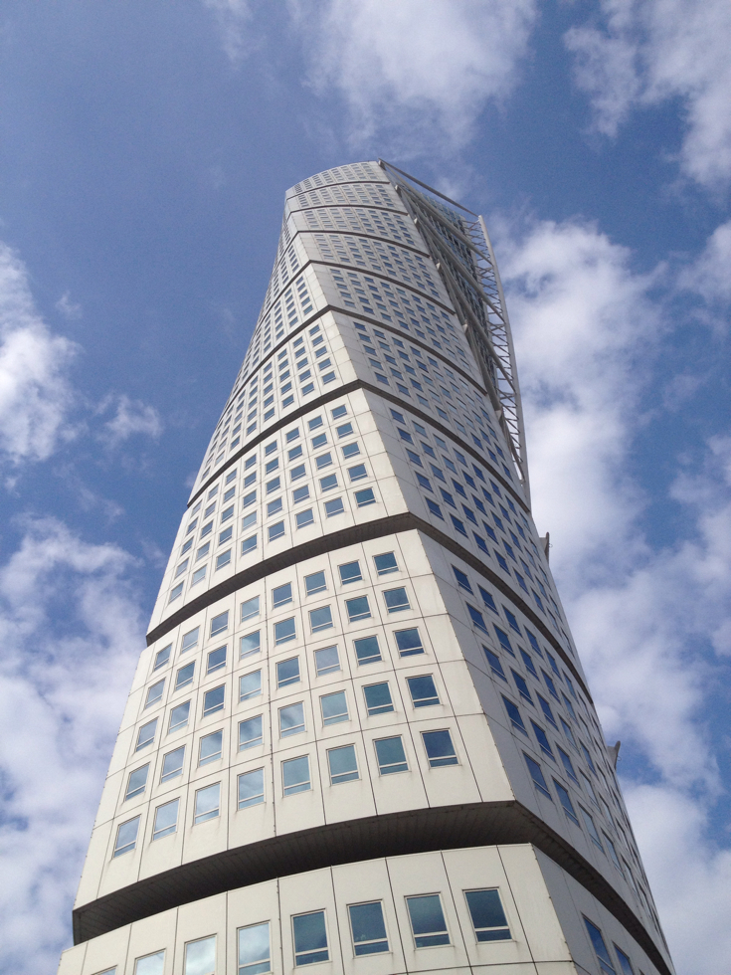
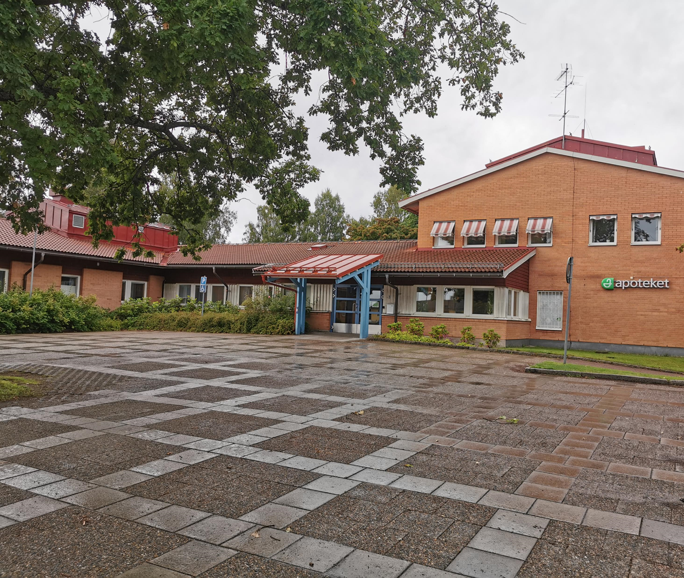
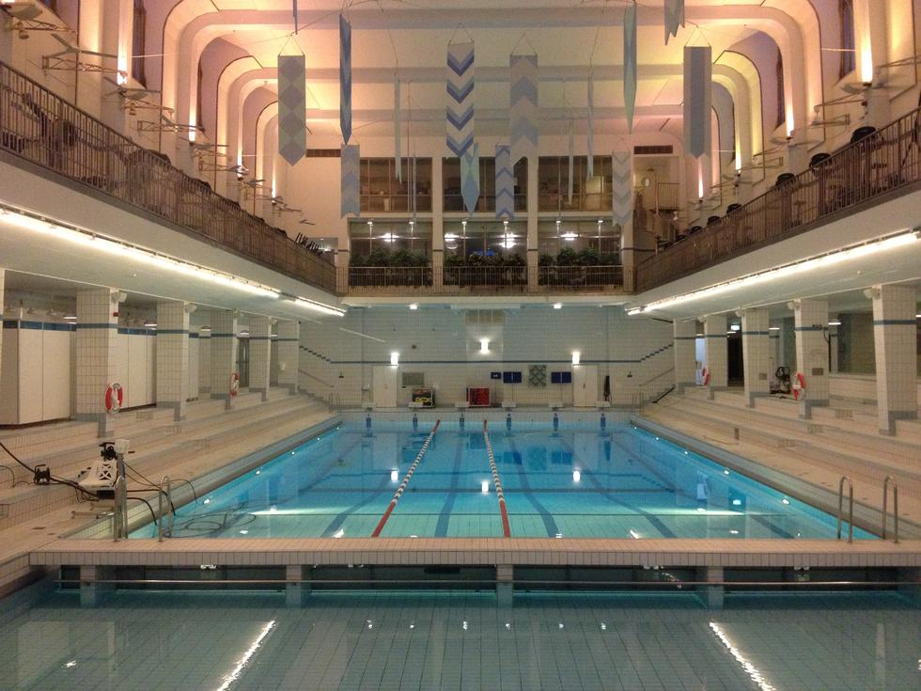
All Buildings
Notes:
Green leasing contracts can be used in every building and business.
School is a very good because her you can combine the contract with education
Offices can be positive if they want to have a greener image and some time the tenant demands it.
Residential building can have it for changing the behavior in use of energy. Here can recycling be of importance.
Health care centers use a lot of electricity so it can be profitable to help each other to make the building and business more adapted.
Swimming halls use a large amount of energy and its good if landlord and tenant together can find a way to lower the energy use.

Slide 10
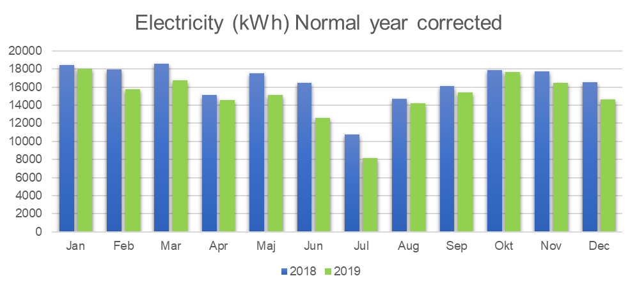
Notes:
Example:
A municipality in Sweden signed a contract with a school.
Aim: Lower energy use in building
Goal: Save 10% energy year one
Motivation: A split 50/50 on the profit was use as an incitement.
Result: 5% energy saving

Slide 11
Different ways of Training
Knowledge sharing
Inspire at events
Workshops
Test of toolkit
GLC
Notes:
Training material can be used in many different contexts

Slide 12
Exercise 1: Purpose and objectives 30 min
Purpose of exercise: To map and define situations a green lease contract can be used.
Participants: Building owners, property managers, operations managers, tenants.
Notes:
Purpose: To map and define situations a green lease contract can be used. Show in how many different scenarios a green lease contract can be used.
Steps:
In smaller groups (4-6 p)
Brainstorm how many different contracts they can created (many as possible).
Each group pick a few different scenarios and define obstacles and opportunities.
The groups present their conclusions to the other groups.

Slide 13
Exercise 2: The Contract 60 min
Purpose of exercise: Create a Green lease contract.
Participants: Building owners, property managers, operations managers, tenants.
Notes:
Purpose: Create Green lease contract
3 steps:
In smaller groups (4-6p preferable not the same groups as exercise 1). Use the guideline and contract as training material.
Each group choose 2 scenarios
Create contract from the scenarios
Present the contracts to the other groups.

Slide 14
Exercise 3: Evaluation 30 min
Purpose of exercise: How do we make it Work
Participants: Building owners, property managers, operations managers, tenants.
Notes:
Purpose: Create Green lease contract
3 steps:
In smaller groups (4-6p preferable not the same groups as exercise 1). Use the guideline and contract as training material.
Each group choose 2 contracts
Obstacle and opportunities with the contracts.
Present the findings to the other groups.
Open discussion about reflections from the workshop

Slide 15
Highlighted tools in GLC toolkit
Short guide to help decision process (several tools and cases combined entails workshop material)
PowerPoint to help the visual
Template for green leas contract
Guideline for implementing green leas contract
Example templates for green leas contracts
Notes:
Present and test tools if you lack experts.

Slide 16
GLC - Relevant material from other sources
Green leas contract – toolkit (in Swedish)
https://www.fastighetsagarna.se/fakta/fakta-for-fastighetsagare/energi--miljo/gront-hyresavtal/
Better Buildings Partnership – Green Lease Toolkit
http://www.betterbuildingspartnership.co.uk/green-lease-toolkit
Web course: Learning more about GLC (in Swedish)
https://www.energimyndigheten.se/nyhetsarkiv/2018/ny-webbutbildning-lar-dig-mer-om-grona-hyresavtal/
Green Lease – Green Building alliance
https://www.go-gba.org/resources/green-building-methods/green-leasing/

Slide 17
Contact
EFFECT4buildings
Full name
Organisation
Institution/Company
Phone:
E-mail:
Homepage
Notes:
Target group
Public building owners
Property managers
Operations and maintenance managers
Technical personnel – technical experts and maintenance personnel
Tenants
Trainer
About yourself and your background
Your prior knowledge and experience from green Lease contract

