Slide 1




Green Lease Contracting
EFFECT4buildings
Add a organisation logo.
Note: The Union Emblem (EU flag) shall have at least the same size (height or width), as this logo.
Name, Organisation
Event
Location, Date

Slide 2

Green Lease Contracts
EFFECT4buildings
Highlight the buildings environmental impact

Slide 3

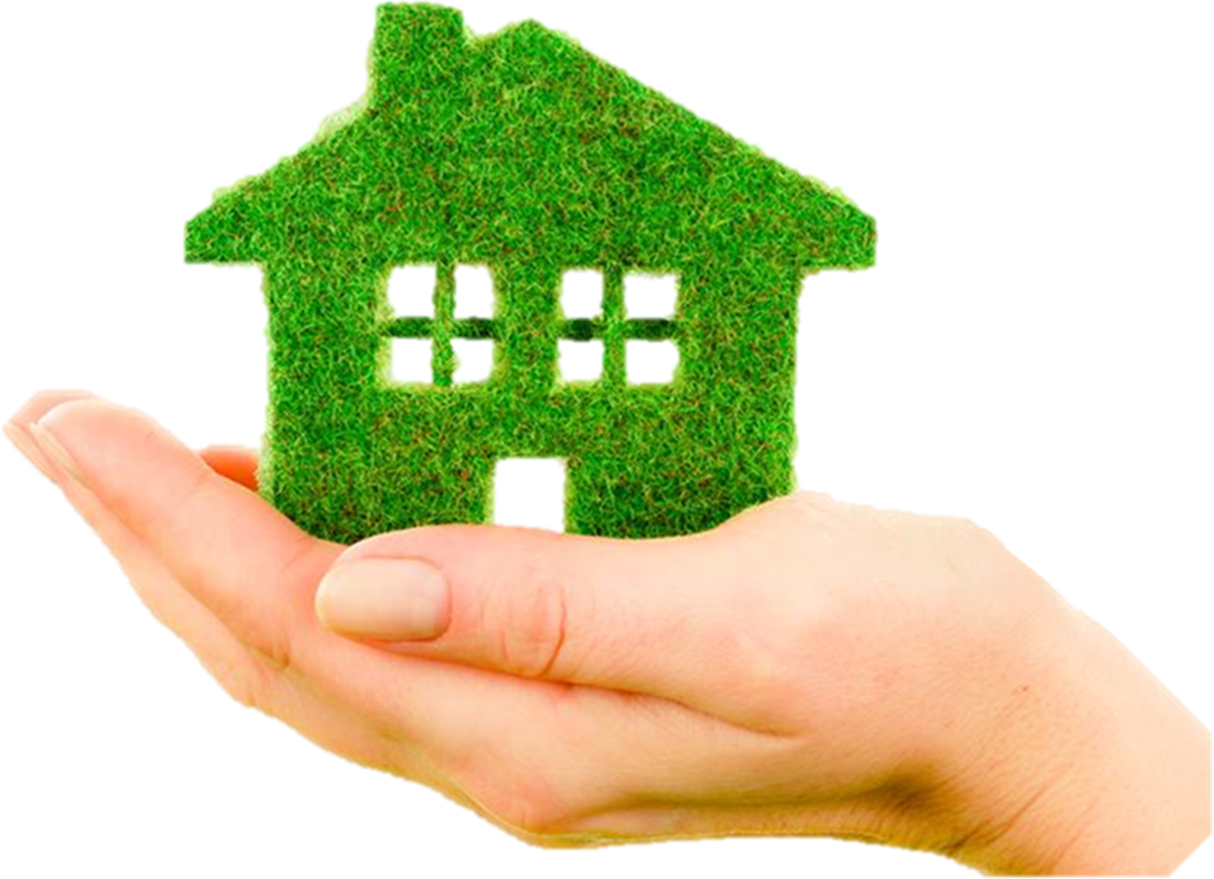
Notes:
To achieve energy and climate goals of the municipality, demands are placed on the municipality tenants.
The manager is responsible for the use of energy and greenhouse gas generation in the municipality's properties.
The demands for increased efforts to be green come from political parties as well as from municipal officials.
Specific dates for climate-neutral management are being sought, a process that is beginning to be expressed in so-called roadmaps

Slide 4
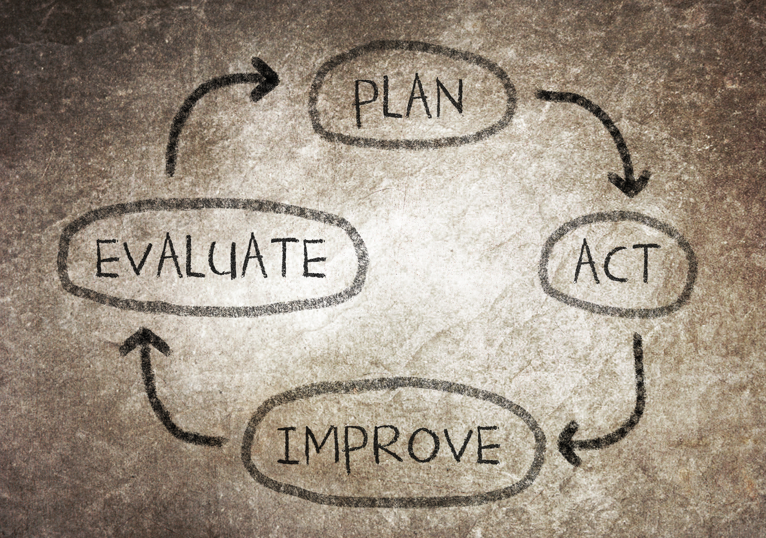
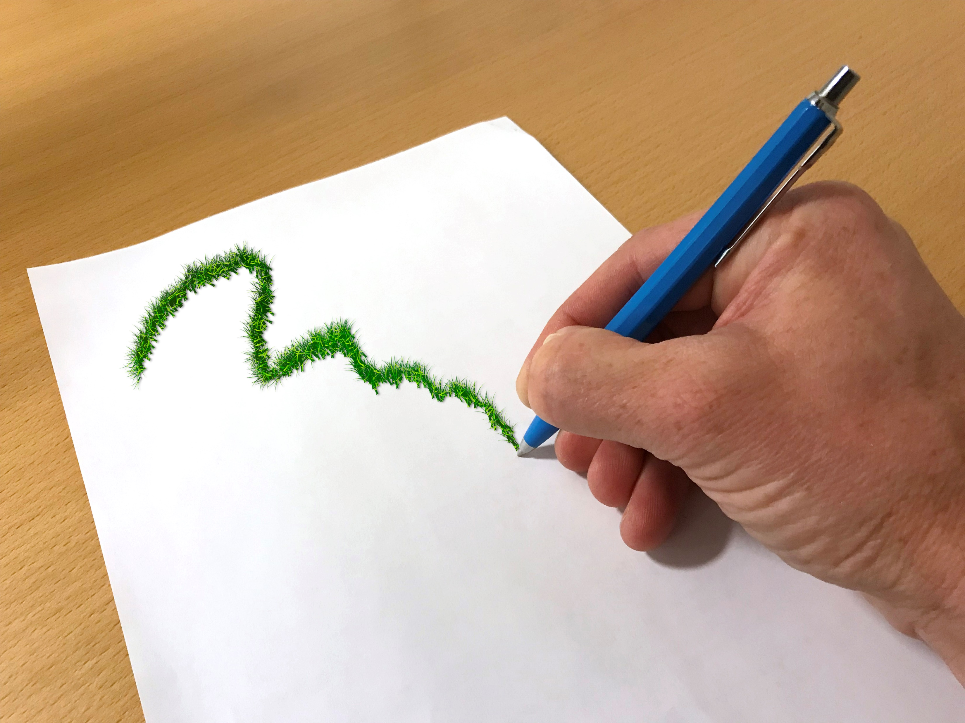
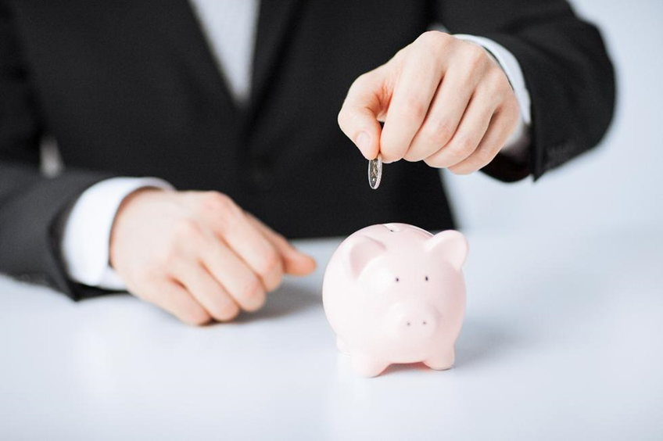



Notes:
The Green Lease Method it’s a living process that is going to change over time
The foundation is the Green Lease Contract, where the practical work is based on the contract as a platform and tool.
Green lease contracts helps the landlord and tenant to create a dialogue about how environmental impact can be reduced
The main purpose of the contract is to focus on the property's environmental impact, which includes the businesses that are active on the property.
Energy savings but also other things that are good for the environment like recycling
By lowering energy and increase recycling the involved parties can save money

Slide 5

Goal
Motivation
Incitement
Meetings
Follow-up
Notes:
Its important to have well planed target when your aiming to be able to reach the goal.
The goal should be easy to understand and both parties must agree on it.
Motivation is key to success because the green lease method will demand some effort from both parties.
Incitement can be used as a motivator for ex financial.
Meetings is very good for keep the communication alive and share knowledge about the building.
this can contribute to even more savings of energy and resources
Follow-up is probably the most important step in this method and often the one that are neglected.
Follow-ups gives an understanding on what have been done, how it went and what can be improved

Slide 6

Energy
Knowledge
Environment
Financial
Communication
Collaboration
Notes:
Green lease advantages
Lower Energy use
Better knowledge how the building operates
The environmental benefit can be grate
Saved energy and resources result in many saving that can be split by the participant
Communication build a stronger relationship between landlord and tenant with the building and business in center.
The better the collaboration is the more energy can be saved.

Slide 7

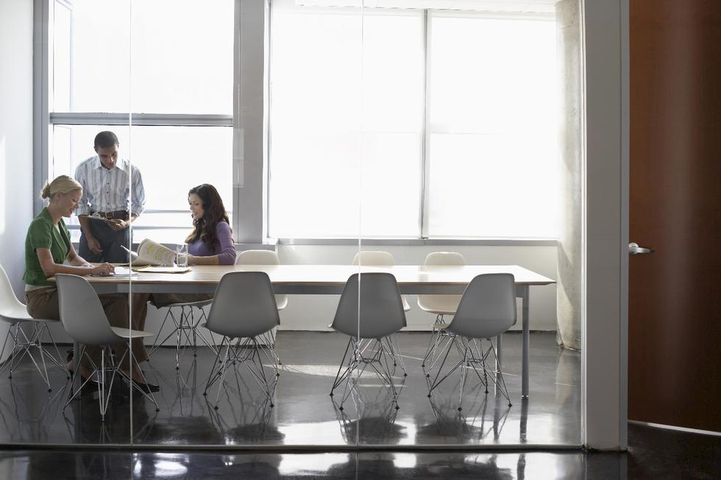
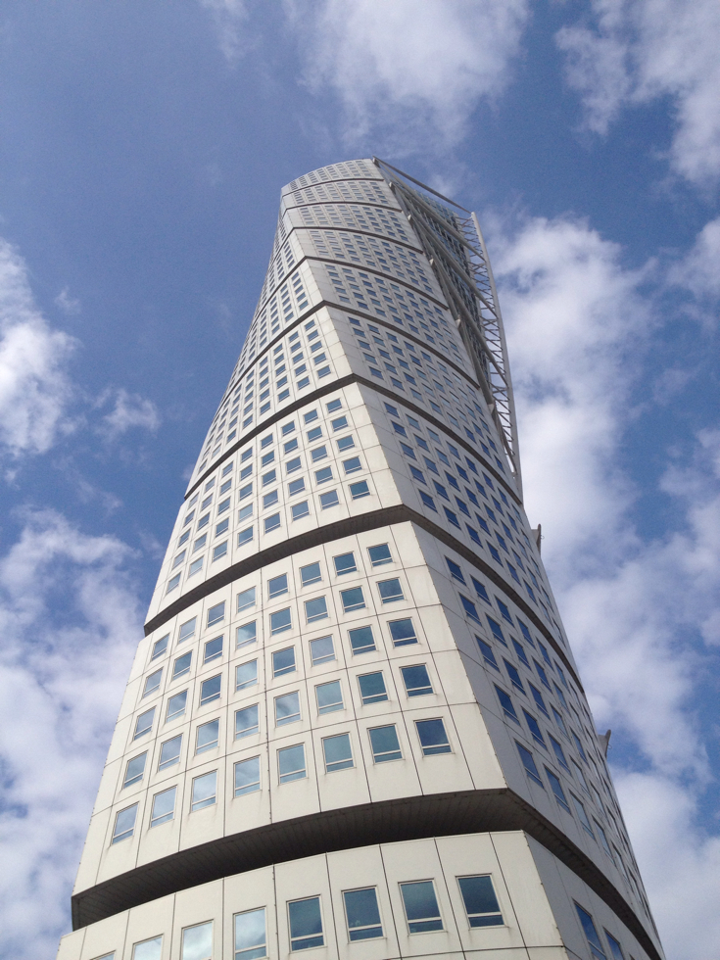
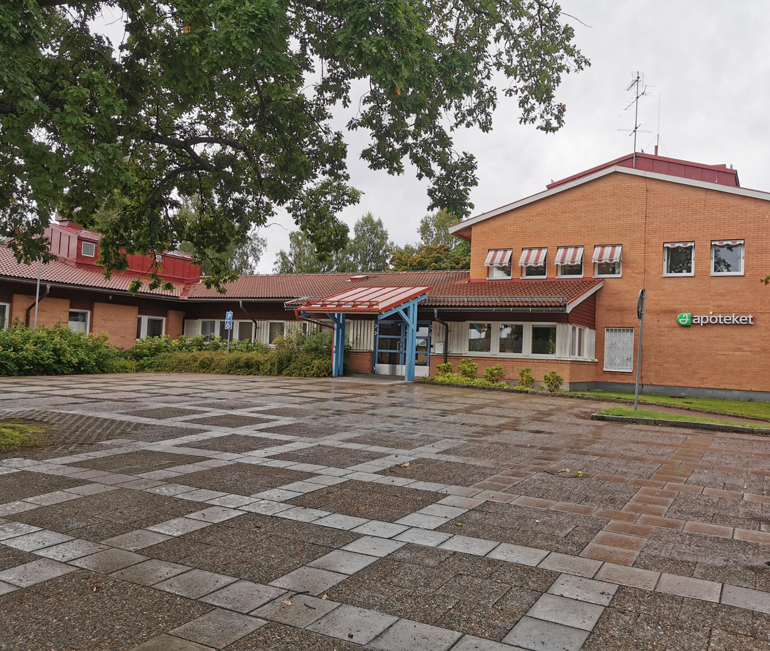
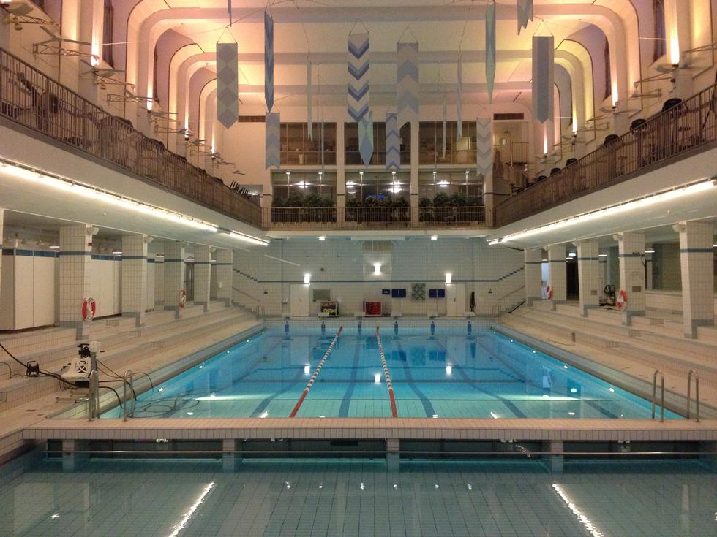
All Buildings
Notes:
Green lease contracts can be used in every building and business.
School is a very good because her you can combine the contract with education
Offices can be positive if they want to have a greener image and some time the tenant demands it.
Residential building can have it for changing the behavior in use of energy. Here can recycling be of importance.
Health care centers use a lot of electricity so it can be profitable to help each other to make the building and business more adapted.
Swimming halls use a large amount of energy and its good if landlord and tenant together can find a way to lower the energy use.

Slide 8
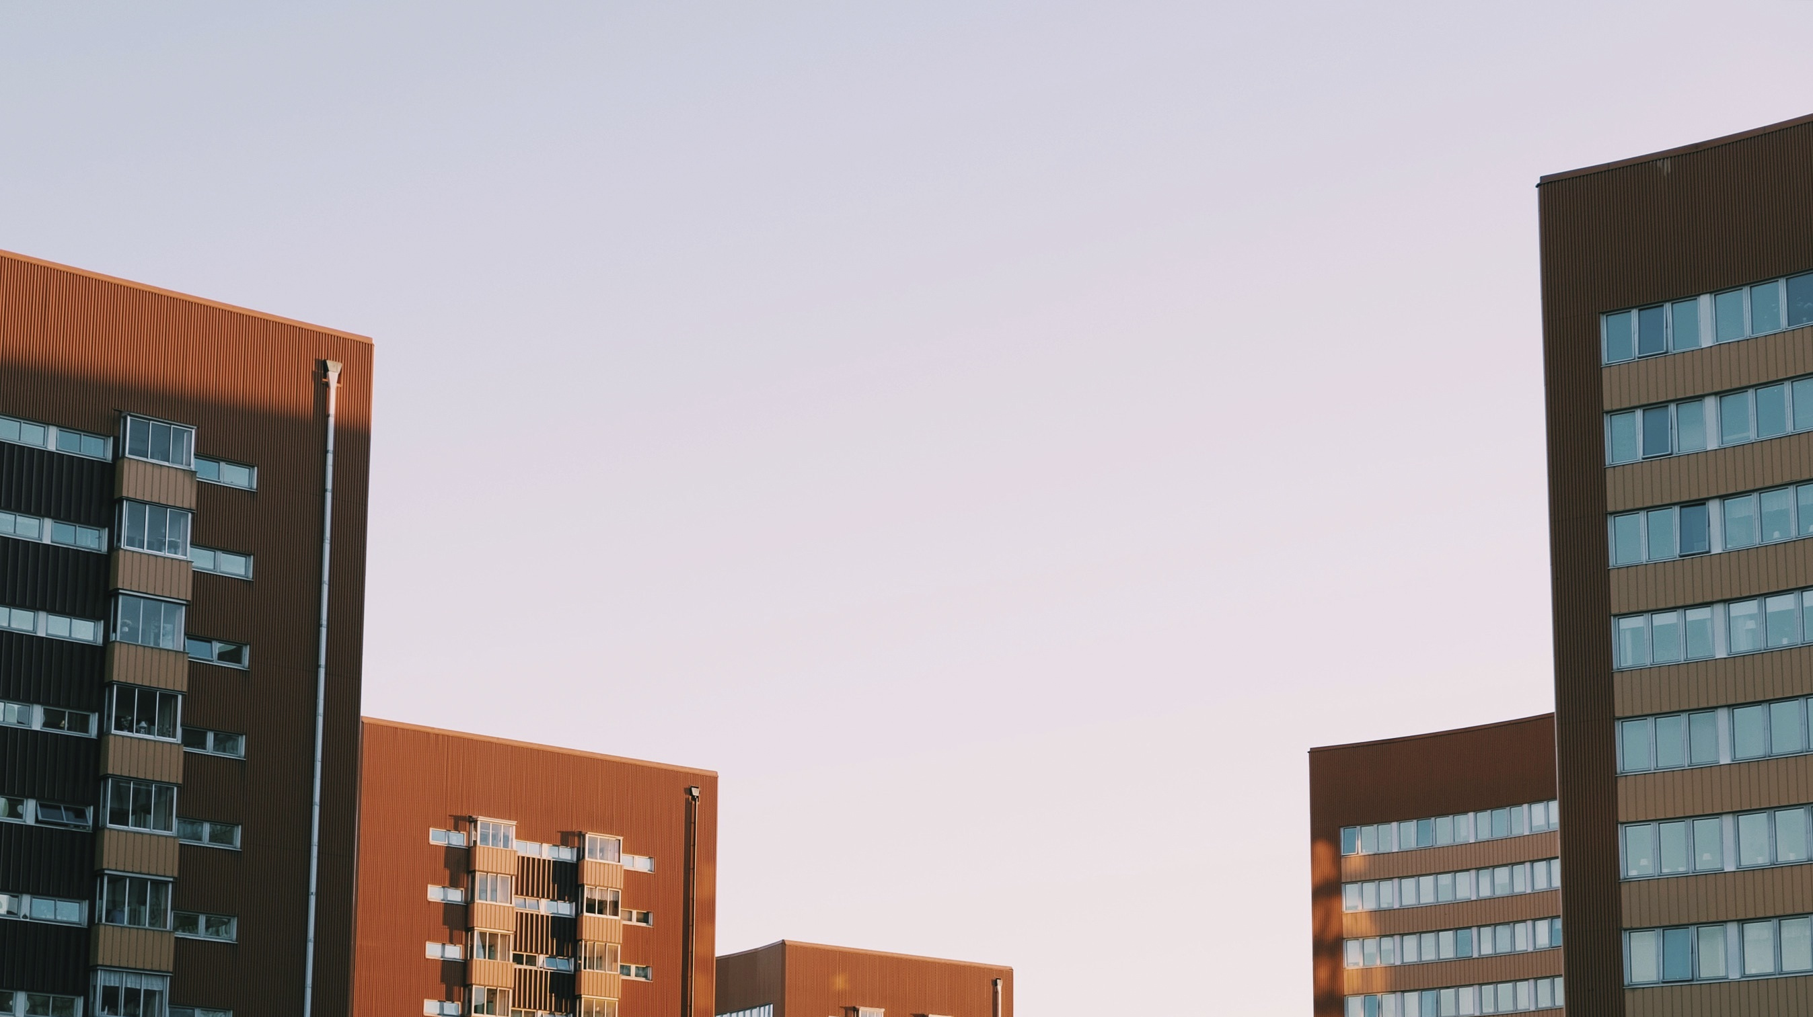

Resources
Time
Financial
Business
Commitment
Green Lease method
Contract
Environment
Knowledge
Requirements
Notes:
Green leasing method that continues several components to work.

Slide 9
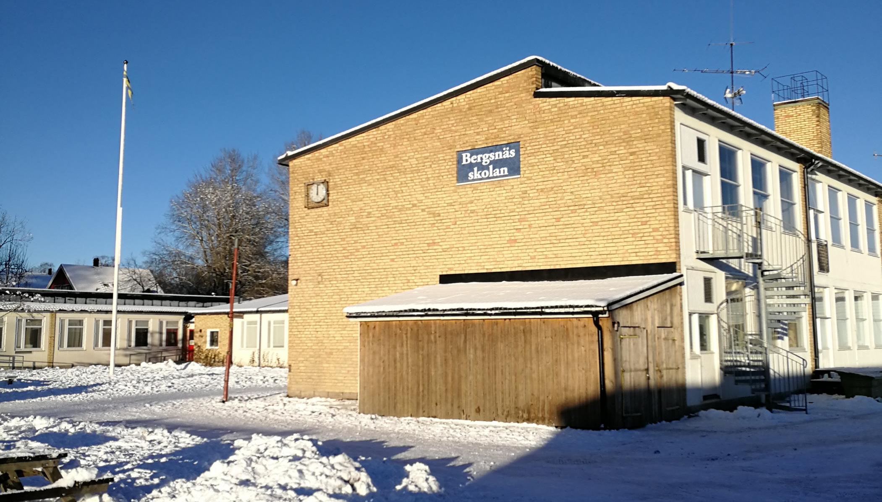
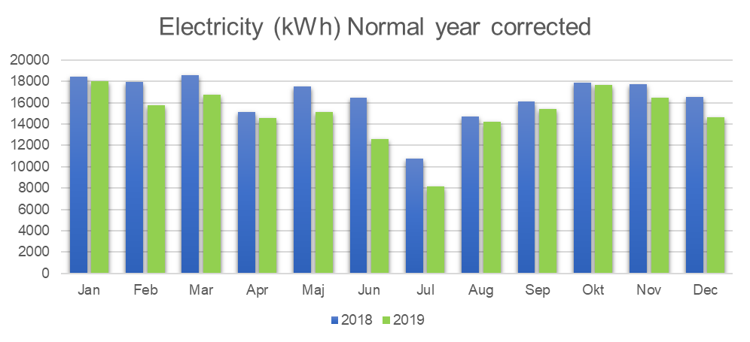
Notes:
Example:
A municipality in Sweden signed a contract with a school.
Aim: Lower energy use in building
Goal: Save 10% energy year one
Motivation: A split 50/50 on the profit was use as an incitement.
Result: 5% energy saving

Slide 10

Dalarnas sustainable building cluster
för Wood- construction- and real estate industry
Benny Magnusson (benny@byggdialogdalarna.se)
EFFECT4buildings
Notes:
Byggdialog Dalarna är en ideell förening med fokus att ligga i fronten av hållbar utveckling.

Slide 11
Contact
EFFECT4buildings
Full name
Organisation
Institution/Company
Phone:
E-mail:
Homepage

