Slide 1
FINANCIAL CALCULATION TRAINING MATERIAL
EFFECT4buildings
Name, Organisation
Event
Location, Date

Slide 2
Agenda Financial calculation training
1. Justifying of Financial calculation
2. Aim of Financial calculation training
3. Target group
4. Financial calculation tools
Excel-based tool
Calculation methods
Tool
Web-tool
Calculation methods
Tool
5. Training/workshop themes
6. Summary and conclusions

Slide 3
Agenda Financial calculation training
1. Justifying of Financial calculation

Slide 4
1. Justifying of Financial calculations
Target of financial calculations is to get for better understanding of energy efficiency investment profitability.
Building managers need more varieties and better ways of calculating the profitability of investments.
The main purpose of financial calculations are facilitate decision making to actually implement energy efficiency investments

Slide 5
Agenda Financial calculation training
2. Aim of Financial calculation training

Slide 6
2. Aim of Financial calculation training
Overall Goal
Strengthen general knowledge on financial calculation methods
Increase using of financial calculation tools, when compare energy efficient measures in buildings
Present two Financial calculation tools
Available tools and material (toolbox)
Increase awareness of tools and toolbox!
Notes:
Training building managers, energy auditors and other to evaluate diverse options for decision making process to actually implement energy efficiency investments.

Slide 7
Agenda Financial calculation training
3. Target group

Slide 8
3. Target group
Building owners
Building managers
Operations and maintenance managers
Technical personnel – technical experts and maintenance personnel
Should facilitate:
Key public decision makers
Administrative decision makers
Financial decision makers
Technical decision makers
Notes:
For example building manager
- who are planning energy efficiency investments
- who are trying to calculate and compare the profitability of different measures
- who should be able to present and prepare plans for decision makers
- who should be able to clarify and justify further questions set by decision makers and other stakeholders

Slide 9
Example Agenda Financial calculation training
4. Financial calculation tools
Excel-based tool
Calculation methods
Tool
Web-tool
Calculation methods
Tool

Slide 10
4. Financial calculation tools
EFFECT4buildings-project has developed two financial calculation tools
Excel- based tool
Web- based tool
facilitate to compare energy efficiency measures
Both include in also Guidances/guidelines, which explain method details
Guidelines can be used as an additional supporting material, when studying and sharing information regarding calculation method for stakeholders.
Notes:
Both are understandable and useful alternative financial calculation tools, which are easily available for building managers to study the profitability of different energy efficiency investments and other signified aspects.
Excel based financial calculation tool combines the different kind of calculation methods making it possible to use for deeper analyse and for comparing different calculation methods.
Web-based and it include also Training material/ Guide for different calculation methods.

Slide 11
Agenda Financial calculation training
4. Financial calculation tools
Excel-based tool
Calculation methods
Tool
Notes:
The main purpose of financial calculation tool is to facilitate decision making to actually implement energy efficiency investments.
Visual charts provided by tool are easy to pick and include as support material to presentation, which can be introduced to decision makers and other stakeholders.

Slide 12
Calculation methods/example case
Discount rate Value of money decreases in time (inflation) We prefer having money today over getting it later The rate between our valuation for todays money over next year’s money.
Cash flow The sum of costs and profits for each time period
NPV, net present value Sum of all future discounted cash flows is called net present value
IRR, internal rate of return The discount rate that makes investments net present value to 0.
Notes:
At first could be presented ”Guideline for financial calculation methods” (2. Tool)
Calculations with net present value and internal rate of return give more fair answers on what investments to choose, than pay-back-time.
To get a full and correct comparison between different solutions, more parameters that are included in the excel calculation tool should be used.

Slide 13
Tool 1 Excel based Financial calculation tool
Several calculation methods for comparing alternative energy efficiency measures:
1) make it easier to compare different possible solutions
2) visualize the benefits of energy saving measures
3) facilitate energy efficiency decision making
Results presented in numbers and as visual clear charts.
Notes:
For training of using tool itself, the first step could been ” Guideline for Excel based Financial calculation tool ” (1. tool)
1) Easier: Building managers need more varieties and better ways of calculating the profitability of investments. 2) Visual: Furthermore there are also other partners and stakeholders (for example decision makers), who should understand results easily in quite a short time for example in the meeting.
3) Faciliate: The main purpose of financial calculation tool is to facilitate decision making to actually implement energy efficiency investments.
-> For this purpose the most relevant results are also presented as visual and clear charts.

Slide 14
1.st page of tool
Notes:
On the first page is ”Guidance for using tool”
Step by step instructions for using the tool

Slide 15
2.nd page of tool
Notes:
On the second page be filled
-Basic information of the building
-Inputs of energy efficiency measures (which are wanted compare).

Slide 16
2.nd page of tool (continued)
Estimations for energy/water price changes in future
- > sensitivity analysis
Notes:
On the second page be filled
-Basic information of the building
-Inputs of energy efficiency measures (which are wanted compare).
Options: Estimations for energy/water price changes in future
- > sensitivity analysis

Slide 17
2.nd page of tool (continued)
If you have for example financed the measure with debt, this is its interest rate
Estimate cost due to bad indoor air quality, if quality will became better due to the measure.
Observe: this value affects only to ”Payback time 2”
Present and future money will be comparable, when future money has been discounted.
Notes:
Finance interest rate: If you have for example financed the measure with debt, this is its interest rate
Discount rate: Present and future money will be comparable, when future money has been discounted.
Non energy benefits: Estimate cost due to bad indoor air quality, if quality will became better due to the measure.
Observe: this value affects only to ”Payback time 2”

Slide 18
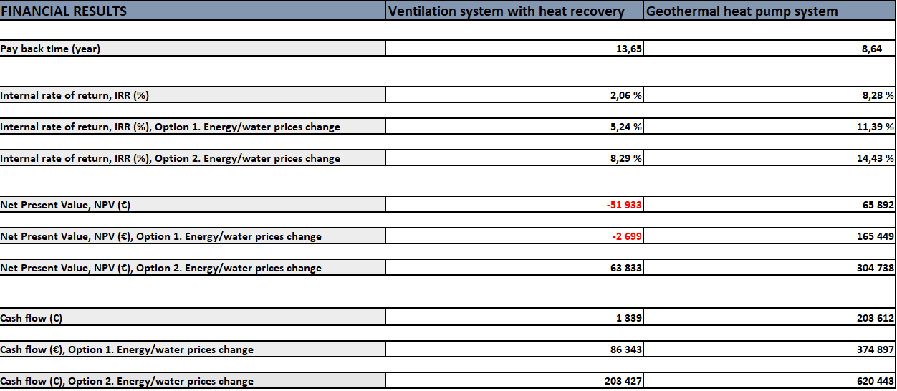
2.nd page of tool -> Results
Results, that include in also the effects of non-energy benefit
Reduction of CO2-emissions compared to situation before measure
Fluctuations in results depending on energy price developments
Notes:
Main results are presented numbers and/or charts
Payback time
Net Present Value
Cash flow
Internal rate of return
CO2-emissions reduction.
In addition
Energy / water price changes in future have been estimated for two different yearly price changes to - > Makes it possible to compare the profitability of measures in different scenarios - > Sensitivity analysis
Negative results are on red colour.
Non- energy benefits: Results, that include in also the effects of non-energy benefit
CO2: Can be also seen how many percent CO2-emissions have been reduced compared situation before measure.
Sensitivity analyse: Comparison of results, when prices change in future (two different estimation) or they will not change in future.

Slide 19
Net present value charts
Notes:
Same kind of charts also for Cash flow, Pay back perion and Reduction of CO2 emissions
The results of the second procedure are shown with dashed lines - - - -, which make reading easier, especially in the center chart where both measures are in same chart.
In these example cases:
Green line presents a situation where energy prices will not increase in the future
Purple: Prices will increase by 3% per year
Grey: Prices will increase by 6% per year

Slide 20
Agenda Financial calculation training
4. Financial calculation tools
Web-tool
Calculation method
Tool
Notes:
Simplified web-tool

Slide 21
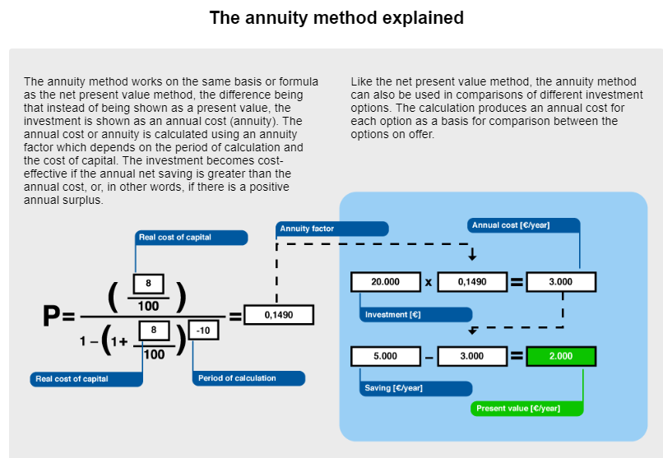
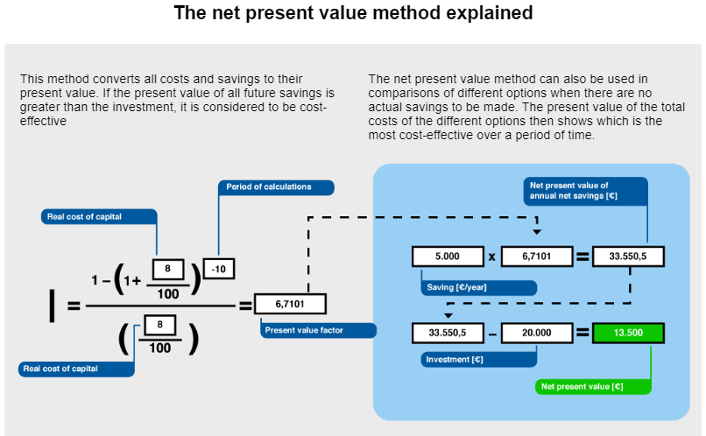
Web-tool: Calculation methods https://energi.jahopp.com/energy.html
Notes:
The web tool describes the different calculation methods in pedagogic graphs.

Slide 22
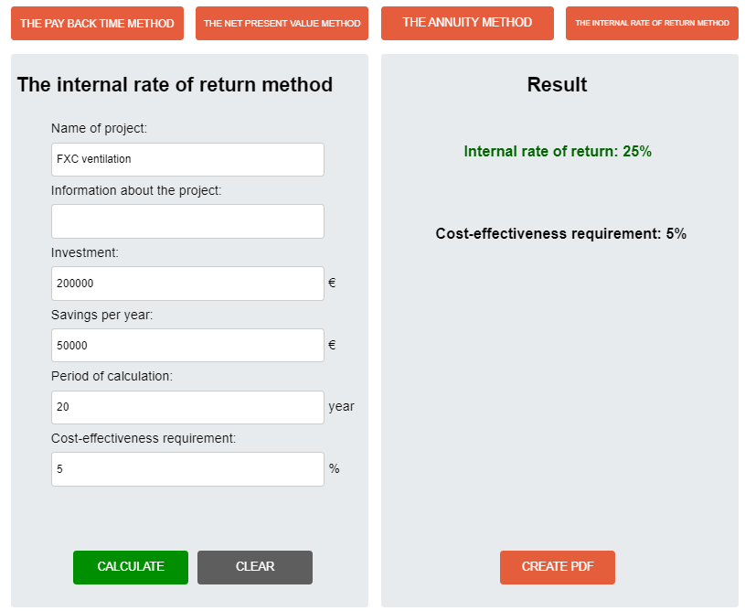
Web-tool https://energi.jahopp.com/energy.html
Notes:
Simplified web-tool The web tool for financial calculations of profitability is presented at EFFECT4buildings web site.
There you can easily calculate individual investments with the different calculation methods, to get a rough estimation of profitability.

Slide 23
Agenda Financial calculation training
5. Training/workshop themes

Slide 24
5. Training/workshop themes
Training with example cases: - Either real or imaginary cases
Easier to understand:
different financial calculation methods, when seen how different inputs affects to the results.
change of results, if energy/water prices change in future etc.
effects of Non-energy benefits to the Payback time 2
etc

Slide 25
An exercise E.g.: Compare results of different calculation methods with each other
Notes:
By using different financial calculation methods, results will be different on what solution is the most profitable.
The table simplify the conclusions of analyse, showing that pay-back-time is not taking in consideration the technical lifetime of the investment.
When using net present value method, investments with longer lifetime will benefit.
In many cases the use of internal rate of return will show that many more measures is profitable than when using only pay-back-time.
When planning new EE investment, it is beneficial to calculate life cycle costs of investment. Life cycle costs could be estimated with cash flow analysis by simply calculating all costs and benefits during the investments life cycle. For the investments with long life cycle, it is beneficial to use discounted cash flows, which called Net present value (NPV).
Alternative economic method is Internal rate of return (IRR). Internal rate of return is the discount rate, which makes investments net present value to 0. IRR is the very useful method for decision makers to estimate profitability of investment.
These methods are particularly suitable for choosing different kind of technical solutions for energy efficiency in buildings that may have different initial investment costs, different operating, maintenance and repair costs, and possibly different technical lifetime. Complementary calculation methods should been implemented as a standard also for ESCOs presenting for example energy audits.

Slide 26
Exercise: Purpose and objectives +50 min
Purpose of exercise: Understand why different calculation methods are used and how calculation tools work
Participants: Responsible leader/decision maker, project leader/building manager and other relevant stake holders

Slide 27
Training material/Tools
EFFECT4buildings Guide to Financial calculation tool www.effect4buildings.se Annexes:
1a Guideline for Excel based Financial calculation tool
1b Financial calculation tool in excel format
1c Financial calculation tool in excel format. Example.
2 Guideline for Financial calculation methods.
3 Presentation of measures in energy audit. Example.
5 Financial calculation tool, web format, online. https://energi.jahopp.com/energy.html

Slide 28
Other materials that can be used in trainings
NPV - IRR - Payback Period- training video
Notes:
See more on ProjectPlace →

Slide 29
Agenda Financial calculation training
6. Summary and conclusions

Slide 30
6. Summary and conclusions
Discussions…
Questions…
What did you learn?

Slide 31
Contact
EFFECT4buildings
Full name
Organisation
Institution/Company
Phone:
E-mail:
Homepage

