Slide 1





EPC PRESENTATION AND TRAINING MATERIAL
- New implementation model for EPC
- Tools for start-up of EPC projects
EFFECT4buildings
Liv R. Lindseth, Inland County Council
EPC seminar for public building owners
Hamar, May 2020
Notes:
EPC training kit – intended as basis for a training, a seminar or other presentations of EPC and the new implementation model with contract-based partnership in phase 1 – the analyses phase.
This can be translated and use – all of it or parts of it – when arranging trainings among the target group - local and regional public building owners.
Parts and slides intended only for trainers are marked with «For trainers»

Slide 2

Agenda
EPC training
1. Aim of EPC training
2. About EPC
  The EPC model
  Added value compared to inhouse solutions
  An EPC project example
3. Recent market status
  Success factors and barriers
  4. Main development needs
  5. Partnership contracts
  6. New implementation model for EPC
  7. The tangible EPC toolbox
  Guideline and presentation
  Templates and model documents
    8. Summary and conclusions
Notes:
This is the agena structuring the training in the order found most practical. You are free to use parts of the presentation.

Slide 3
Agenda
EPC training
1. Aim of EPC training

Slide 4
Aim of EPC training
Increase awareness of the benefits of EPC in public sector
Enable customers/building owners to initiate and start an EPC project
Strengthen general knowledge on EPC
            EPC project process
            Recent market status,
            Strengths, weaknesses and development needs
Present new improved implementation model for EPC
            Novelty aspects
      Available tools, templates and material (toolbox)
Notes:
In accordance with the overall goals of development of the EPC tool in the Interreg project EFFECT4buildings.

Slide 5
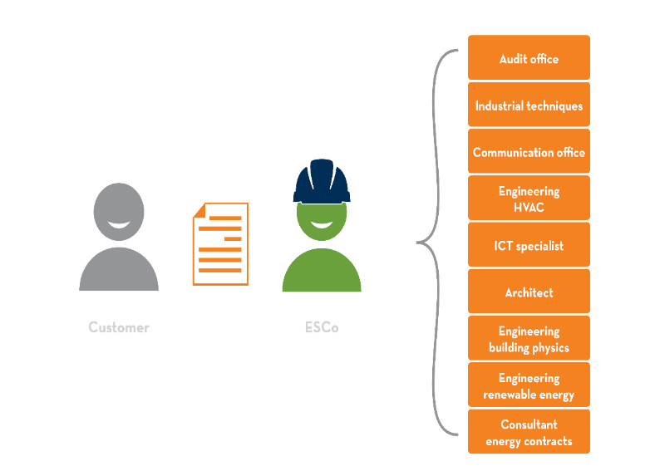
Stakeholders and players
EPC Customers
  Those interested from public/private sector – building owners/property managers
Energy service companies (ESCO)
  Energy service suppliers, suppliers of EPC projects
Subcontractors
  suppliers of EE installations and components, liable to an ESCO, not in direct contact with the client
Consulting companies (EPC Facilitators)
  Assistance with preparation of projects on the client side, organization of tenders, monitoring and verification of savings for clients
Other interested parties
  Financial institutions
  Energy authorities/grant schemes
  Local, regional, national authorities

Slide 6
Agenda
EPC training
2. About EPC
  The EPC model
  Added value compared to inhouse solutions
  An EPC project example

Slide 7
For trainers
How to present EPC to customers
You should address:
What is EPC?
What EPC can do for the customer/public building owner
The main benefits of EPC
How EPC works
Practical examples of EPC projects and scenarios
Main challenges and how to overcome them
Present solution: (new/adapted implementation model + associated toolbox)
Notes:
To trainer:
The customer = building owner
Also a summary and an overview of EPC and it’s benefits
Some of these point may also be relevant for other tools and instruments
To be clear on the use of these terms – ESCO is the energy service company that supplies the EPC – the energy performance contract that is a model implementing EE measures with guaranteed results. In this project the main focus is the public market and public building owners constituting the customers.
The EPC model is a well-tested and successful tool making public building owners and local and regional authorities reach their energy and climate targets at a faster speed than without EPC.

Slide 8

For trainers
The target group
Key public decision makers
Administrative decision makers
Financial decision makers
Technical decision makers
Copyright: NEE
Notes:
Target group
Public building owners
Property managers
Operations and maintenance managers
Technical personnel – technical experts and maintenance personnel?
Trainer
About yourself and your background
Your prior knowledge and experience from EPC

Slide 9
For trainers
What can EPC do for customers/decision makers?
Administrative decision makers
Added external know-how without added staff costs
Climate and energy issues (political and general goodwill, reaching C&E goals)
Financial decision makers
Economic arguments
Political arguments
Marketing issues
Technical decision makers
Added improvements of technical quality and performance
Added access to technical know-how
Copyright: NEE
Notes:
To trainers:
Your target group(s)
• Modernise the technical systems of your buildings through a specialised Energy Service Company (ESCO)
- Bring a new model to install energy efficient measures and the possibility of funding through the future benefits
• Enjoy guaranteed cost savings through reduced energy consumption with no or little own investments
• Strongly reduce the CO2 emissions of your buildings
Target group
Public building owners
Building managers
Operations and maintenance managers
Technical personnel – technical experts and maintenance personnel?
Trainer
About yourself and your background
Your prior knowledge and experience from EPC

Slide 10
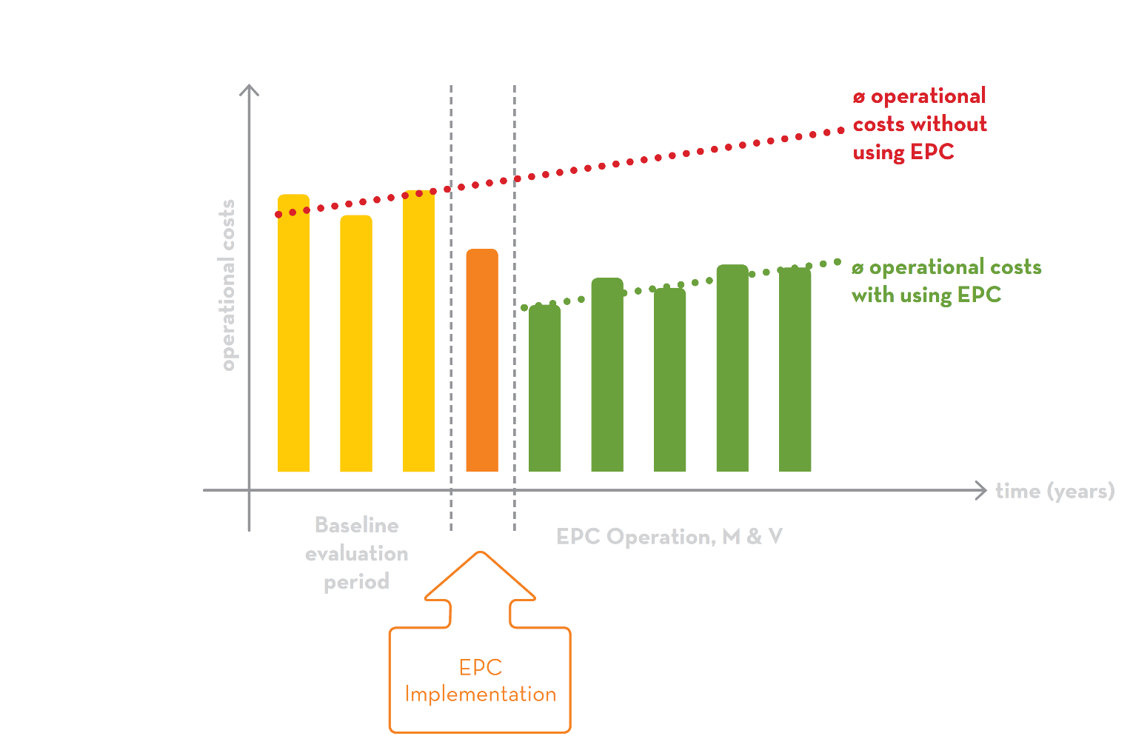
About Energy Performance Contracting, EPC
  The model
Implementation of EE measures with guaranteed results
Energy savings cover investment costs
Outsourcing of technical and financial risk
Turnkey enterprise
Can include financial support scheme
  Advantages for building owner
  The guaranteed results (no cure no pay)
  Low risk
  Many EE measures in short time
  Upgrading of building mass
  Increase competence
  Bonus tool
Energy performance maintaining contracts
Notes:
EPC is a model for implementation of Energy Efficiency (EE) measures with guaranteed results in public or private buildings. Figure 1: The EPC model
In EPC projects, energy savings are used to cover the costs of the investments. Both technical and financial risk is hence outsourced to an Energy Service Company (ESCO), also called the EPC supplier (or supplier).

Slide 11
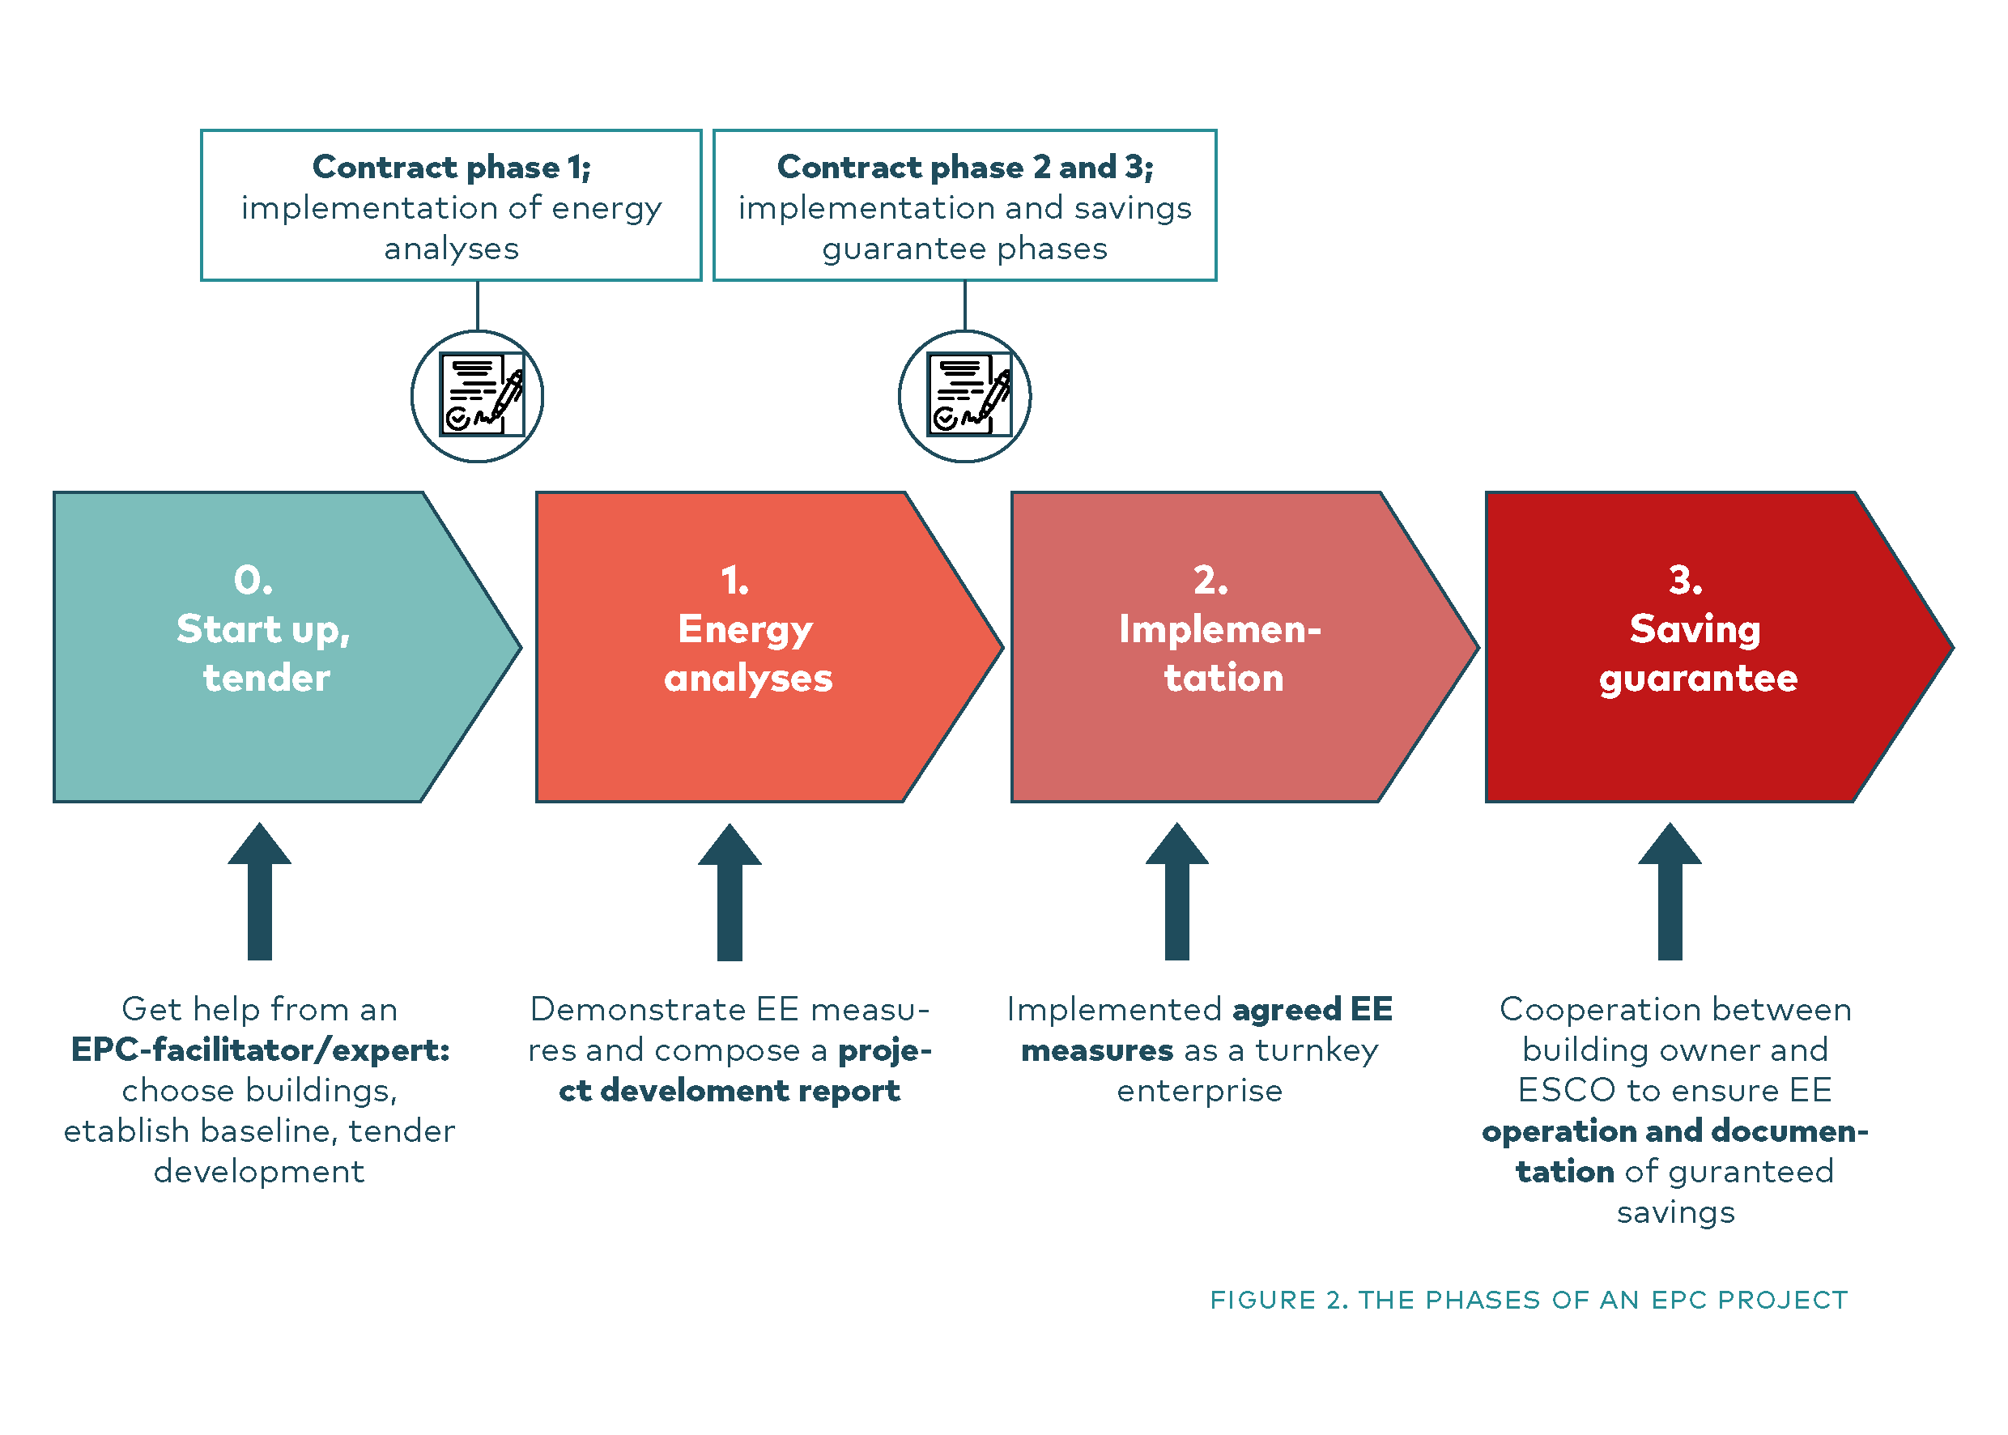
The traditional phases of EPC
Notes:
A standard EPC model has a turnkey contract for the whole duration of the project from Phase 1 through phase 3.
Phases for implementation are:
Phase 0: Start-up, Preparation and tender phase - Assistance from EPC-facilitator; selection of building pool, baseline, tender preparation.
Phase 1: Energy analyses and project development phase - Find measures, prepare development report, investment, operation costs and savings are guaranteed. Find savings to match prior estimate.
Phase 2: Implementation and construction phase
Phase 3: Energy saving guarantee phase - Measurement and verification. Energy audit to establish final energy savings each year
The latter making EPC projects different from other typical turnkey projects, as the project include guaranteed savings for an agreed number of years after all energy efficiency measures are implemented.

Slide 12
EPC project process – the standard phases
1. Preparation of the project (phase 0)
  Create ownership in own administration
  Selection of EPC implementation model
  The EPC tender process
  Selection of supplier
3. Conclusion of contract phase 1
  Energy Analyses - Phase 1 implementation
4. Conclusion of contract phase 2 and 3
  Project implementation - Phase 2 implementation
5. Energy saving period
  Monitoring and assessment – Phase 3 guarantee
Notes:
Hidden. Can be used if needed. Not sure where/if this should be included – Tools to help you though the whole process -

Slide 13

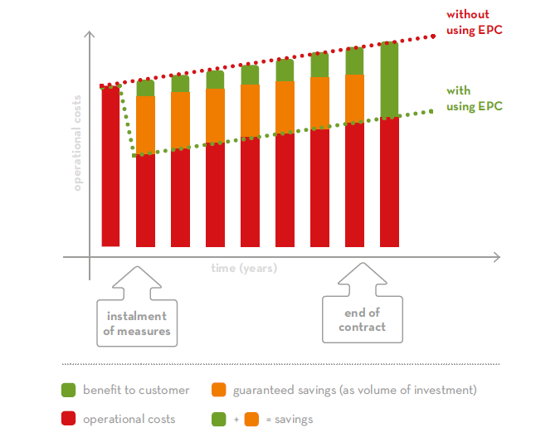
ESCO and EPC
A useful tool in the race to reach global energy- and climate goals in time
Deliverers energy saving results at a higher rate and speed than traditional EE projects
Secure public investments
  Contract based guarantee of savings
Notes:
The EPC model is well-documented and tested in many EU countries and in the Nordic countries for the last 10-15 years. The model has during the last few years been implemented in a large number of public buildings in an emerging Polish EPC market, but is yet not well known in Estonia, Latvia and Lithuania.
Several studies, e.g. by the Nordic Council of Ministers concludes that EPC is beneficial for the building owners, but there is still a large saving potential and possibilities for further development. The most common barriers for growth are the complexity of the concept, “heavy” procurement process, lack of knowledge, lack of good practice examples and documented results, lack of trust and active facilitators.
To reach goals on climate and energy, the use of EPC in the building sector needs to increase since the model is designed to reach these targets at a higher rate and speed than many other energy efficiency tools and instruments.

Slide 14
Main Benefits of EPC
Guaranteed implementation of EE measures within set time limit
Long-term reduction of energy consumption
A single supplier implements the project from start to finish
The supplier and the customer share the same motivation – energy saving
Option of having the project financed by the energy service supplier (if profitable)
All measures financed by the resulting savings
Significant reduction of CO₂ emissions
Outsourcing of risks
Possible outcome: Improved comfort levels and modernization of technical systems
Notes:
Cost neutral – small and/or poor municipalities may start a project without having investment costs up front –
Third part financing might be an option in some countries

Slide 15
Why EPC?
Notes:
This is statistics: Assessment carried out by Enova - based on 252 energy saving projects initiated by Norwegian municipalities from 2010 to 2016. The numbers were collected from Enovas grant programs. 208 of these were traditional projects, while the remaining 44 were EPC projects.
80 % of the municipalities implementing EPC reached their energy reduction goals, while only 13 % of the municipals using traditional projects did the same.

Slide 16
EE measures after mapping work
Notes:
Norwegian statistics, the Norwegian energy agency Enova SF

Slide 17

For trainers
Specific customer needs
Specific needs in customers building stock
  Maintenance needs
  Modernization needs
  Saving potentials
  Other needs, such as indoor comforts (MSC model may be applied partially or in full)
Point out win-win scenarios
  Tailored for the customer
  Realistic example of measures
  Specific saving potential over
  the envisioned duration
Added values
  One partner to deal with
  Common interests and expectations
  Customer can focus on core business
Copyright: NEE
Notes:
In your training you should point out and prepare arguments addressing specific customer needs!
*Multi Service Contract = alternative option when energy saving is not priority

Slide 18
For trainers
Main Possible Challenges
Organisational
Technical
Legal
Traditional roles and responsibilities
Presenting EPC is often presenting change management
Be aware, prepare and overcome
Notes:
To trainer:
Present change management – be able to present changes – usually perceived as negative – as an opportunity for the better
To be aware of possible challenges means you can prepare for them and overcome them.
E.g.: How does one secure knowlegde is not lost when ESCO withdraw? Create a new organisational structure, upgrade knowlegde in operation staff, clear definition on responsibilities in EPC.
How does one secure quality of ESCO deliverables?
Upgrade in-house technical knowlegde to be able to assess and define demands for EPC contractor.
Picture copied from Google.
Public versus private sector

Slide 19
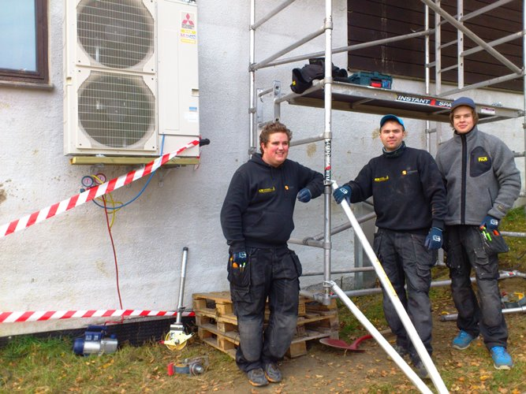
For trainers
EPC project Example(s)
Use good, comparable examples
One case from Denmark (optional
One case from Norway (optional)
  Include example from own country
Best practise example
Experienced success of others sell
If they can – we can!
Copyright: NEE
Notes:
To trainers:

Slide 20

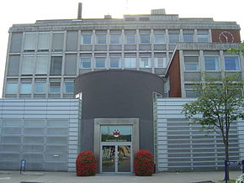
EPC experiences Denmark – PP5
EXAMPLE
From Gate21
Sorø / Guldborgsund / Gribskov / Hvidovre / Ringsted municipalities
Key figures and experiences
Investments, guarantee, achieved savings
Range of EE measures including deep renovation
Tender process (e.g. use of example buildings)
    Award criteria adapted to building owners goals
Soft measures, user awareness drives, focus on
indoor climate result in goodwill
Focus on partnership and cooperation
Notes:
Seem to view the preparation parts of the projects as joint ventures and teamwork
Denmark – all kind of municipal buildings – schools, sport, town halls et.

Slide 21
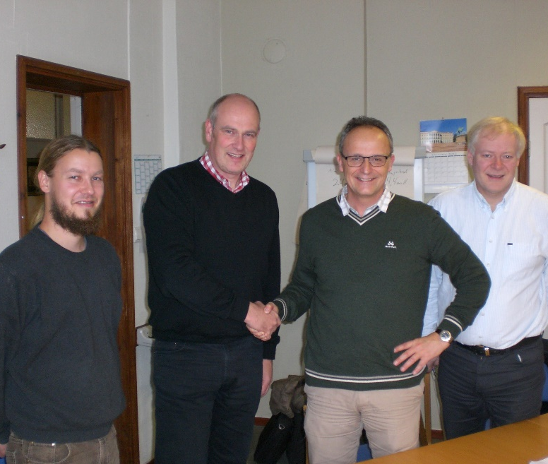
EPC project examples:
Danish project with partnership in phase 1
Norwegian project based on cooperation
Notes:
Town municipality - 27 013 inhabitants
Good cooperation between good people with a competence and a solution-oriented mindset.

Slide 22
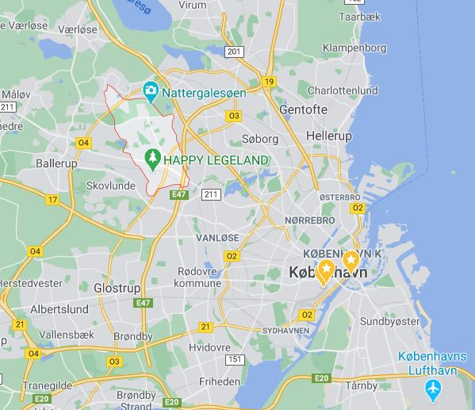
EPC in Herlev Municipality, Denmark
Public Procurement in 2013
100 % financed by client
Investment approx. 16,12 mio. EUR
96.000 m2 - 85 % of the municipal building stock
Split into 4 pools of buildings – one pool executed in the years form 2015 - 2019
28 buildings (schools, sports centre, swimming pool, skating rink, kindergartens, library and cultural building) and traffic lights at roads owned by the municipality
40 % savings guaranteed – approx 5 GWh/year
Simple pay back time 25 years
Guarantee period of 5 years
Notes:
Herlev is a suburb in Greater Copenhagen and an administration center in Herlev municipality in Denmark. It has 28,756 inhabitants (2019).

Slide 23
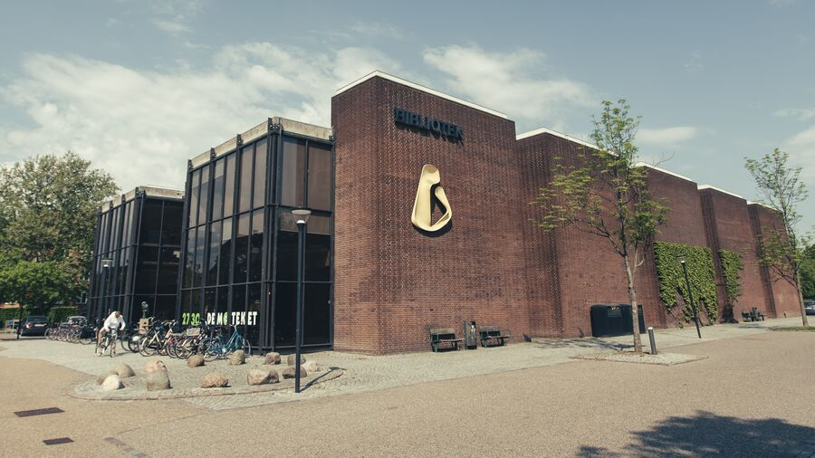
Why initiated?
Reduce maintenance gap with a focus on both technical installations and building envelope
  long simple pay back time
Upgrade building management system to support the daily operation
Reduce energy consumption
Improve indoor climate
Partnership in phase 1
Public library renovated with new window facades and new light

Slide 24
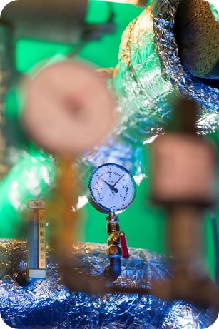
Implemented measures
New windows in most of the buildings
New or upgraded energy efficient ventilation systems in schools and sports facilities (halls, swimming pool, skating rink)
New or upgraded lighting
New energy efficient boilers
Building Management System (BMS) in all buildings
Insulation of building envelope
26 new traffic lights
Training of technical operation personal
Different small measures like replacement of pumps, technical insulation, optimization of technical installations.
Notes:
Will not go in detail, but note the 30 km of wells that was drilled in bedrock mountain within a short time period.
Variety of measures – heatpumps central for saving targets

Slide 25
Experiences - municipal viewpoint
When the going gets tough . . . . .
Delayed implementation
  Finding of environmentally hazardous
  Interfaces to other renovation projects in same building which delayed the project
Changes in project manager both on Client side and at the ESCO
  Loss of knowledge and decisions taken prior in the project – means a lot of revisiting the measures and changes and time to re-establish the partnership
  The documentation from the first years were not good enough – focus in the last part on improved documentation and more structure
The existing energy management system had monthly energy data and many not valid energy data. This is not sufficient in an EPC project
The calculated savings were lower than savings in the first years – mostly because of many mistakes in the energy data going back to the beginning and a lot of changes in the use of buildings
Notes:
great satisfaction with the measures implemented
In 2016 the guaranteed savings were achieved
HB= EE coordinator
EPC has always been profitable for the municipality

Slide 26
BMS – is this builing automation system or energy management system?
Experiences - municipal viewpoint
The partnership saved the project . . . . .
Good dialogue in the project period with focus on finding solutions - despite new people, delays and bad data quality
New baselines were established and recalculation of the guaranteed saving
Great satisfaction with the implemented measures - a long pay back time made it possible to have better solutions
BMS implemented in all building helps operate the building more efficient – e.g. when in Corona lock down it was much easier to “set the building in stand by”
The partnership in phase 3 focus not on guarantee but on finding more energy savings and helping the operation
The municipality implemented a new energy management system with automatic energy data each hour parallel to the EPC project.
Notes:
In 2016 the guaranteed savings were achieved
HB= EE coordinator
EPC has always been profitable for the municipality

Slide 27
EPC in Kongsberg municipality, Norway
Open tender procedure
100 % financed by client
11 years contract duration
70.000 m2 - 70 % of the municipal building stock
36 buildings (schools, city hall, kindergartens, nursing homes)
36 % savings guaranteed –6,35 GWh/year (6,25 mill E/y)
Contractual guarantee upheld between 90% and 110% of calculated result
    Appx 200 EE measures in one year while buildings were used as customary
    Implemented measures in 2013
Why?
  To reach climate and energy goals in SEAP
  Close maintenance gap
Notes:
A typical project
Average size municipality in central part of No

Slide 28
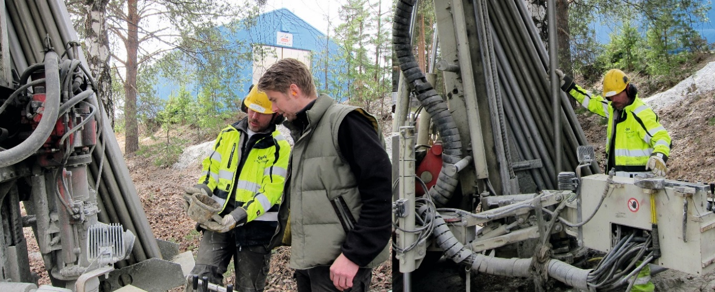
Investments
Total investment of 5,44 mill Euro (46 mill NOK)
Profitable ES measures covers costs of maintenance measures
Reduced maintenance budget by 23 MNOK
Notes:
A typical project
Average size municipality in central part of No

Slide 29
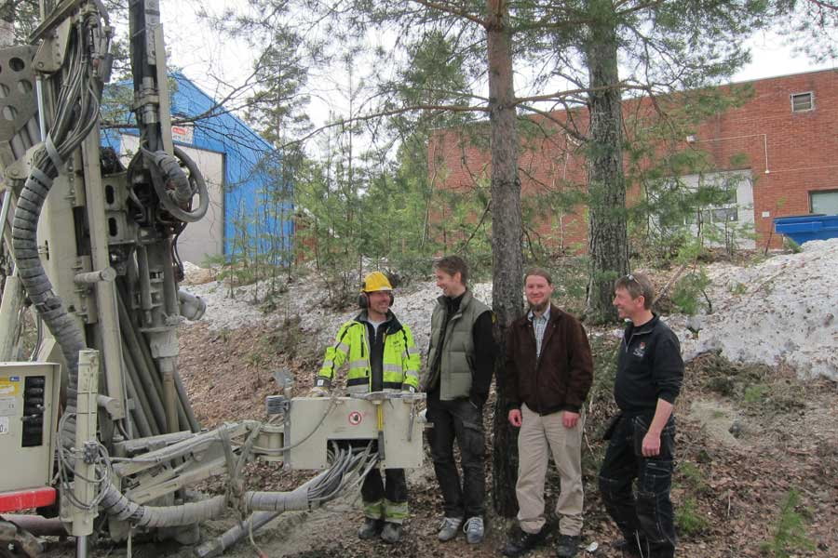
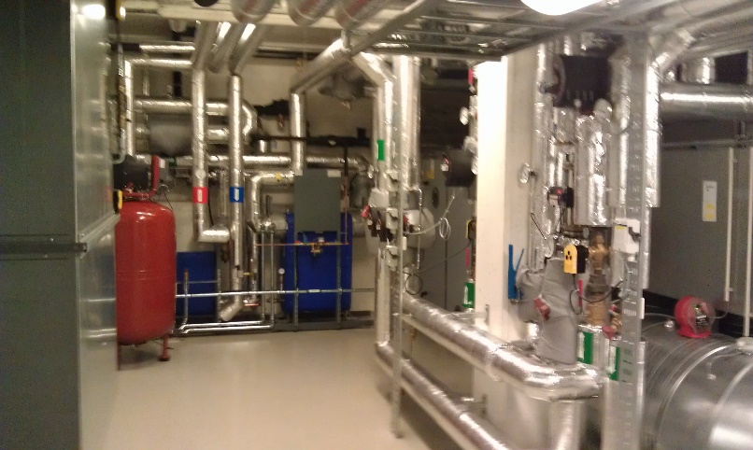
Implemented measures
Heat pumps
  14 geothermal heat pumps
  30 km of wells drilled in bedrock mountain
  Air/air/water heat pumps
Efficient ventilation systems
Lighting – control/LED
Energy monitoring system
Building automation
Insulation of building envelope
User trainings and training courses for schoolteachers
Notes:
Will not go in detail, but note the 30 km of wells that was drilled in bedrock mountain within a short time period.
Variety of measures – heatpumps central for saving targets

Slide 30
Experiences - municipal viewpoint
When the going gets tough . . . . .
Delayed implementation
  Too late in winter to get full effect
The first two years savings were lower than guaranteed
Energy audit to establish final energy savings each year
The difference between calculated savings and the actual savings conversed into money by a predefined rate
Amount transferred to EPC-client without delay or legal action
Guaranteed savings met the next years
Saves between 5 – 6 mill NOK each year (600 – 700.000 Euro/y)
“The guarantee works!”
Hallvard Benum, Kongsberg municipality
Notes:
In 2016 the guaranteed savings were achieved
HB= EE coordinator
EPC has always been profitable for the municipality

Slide 31
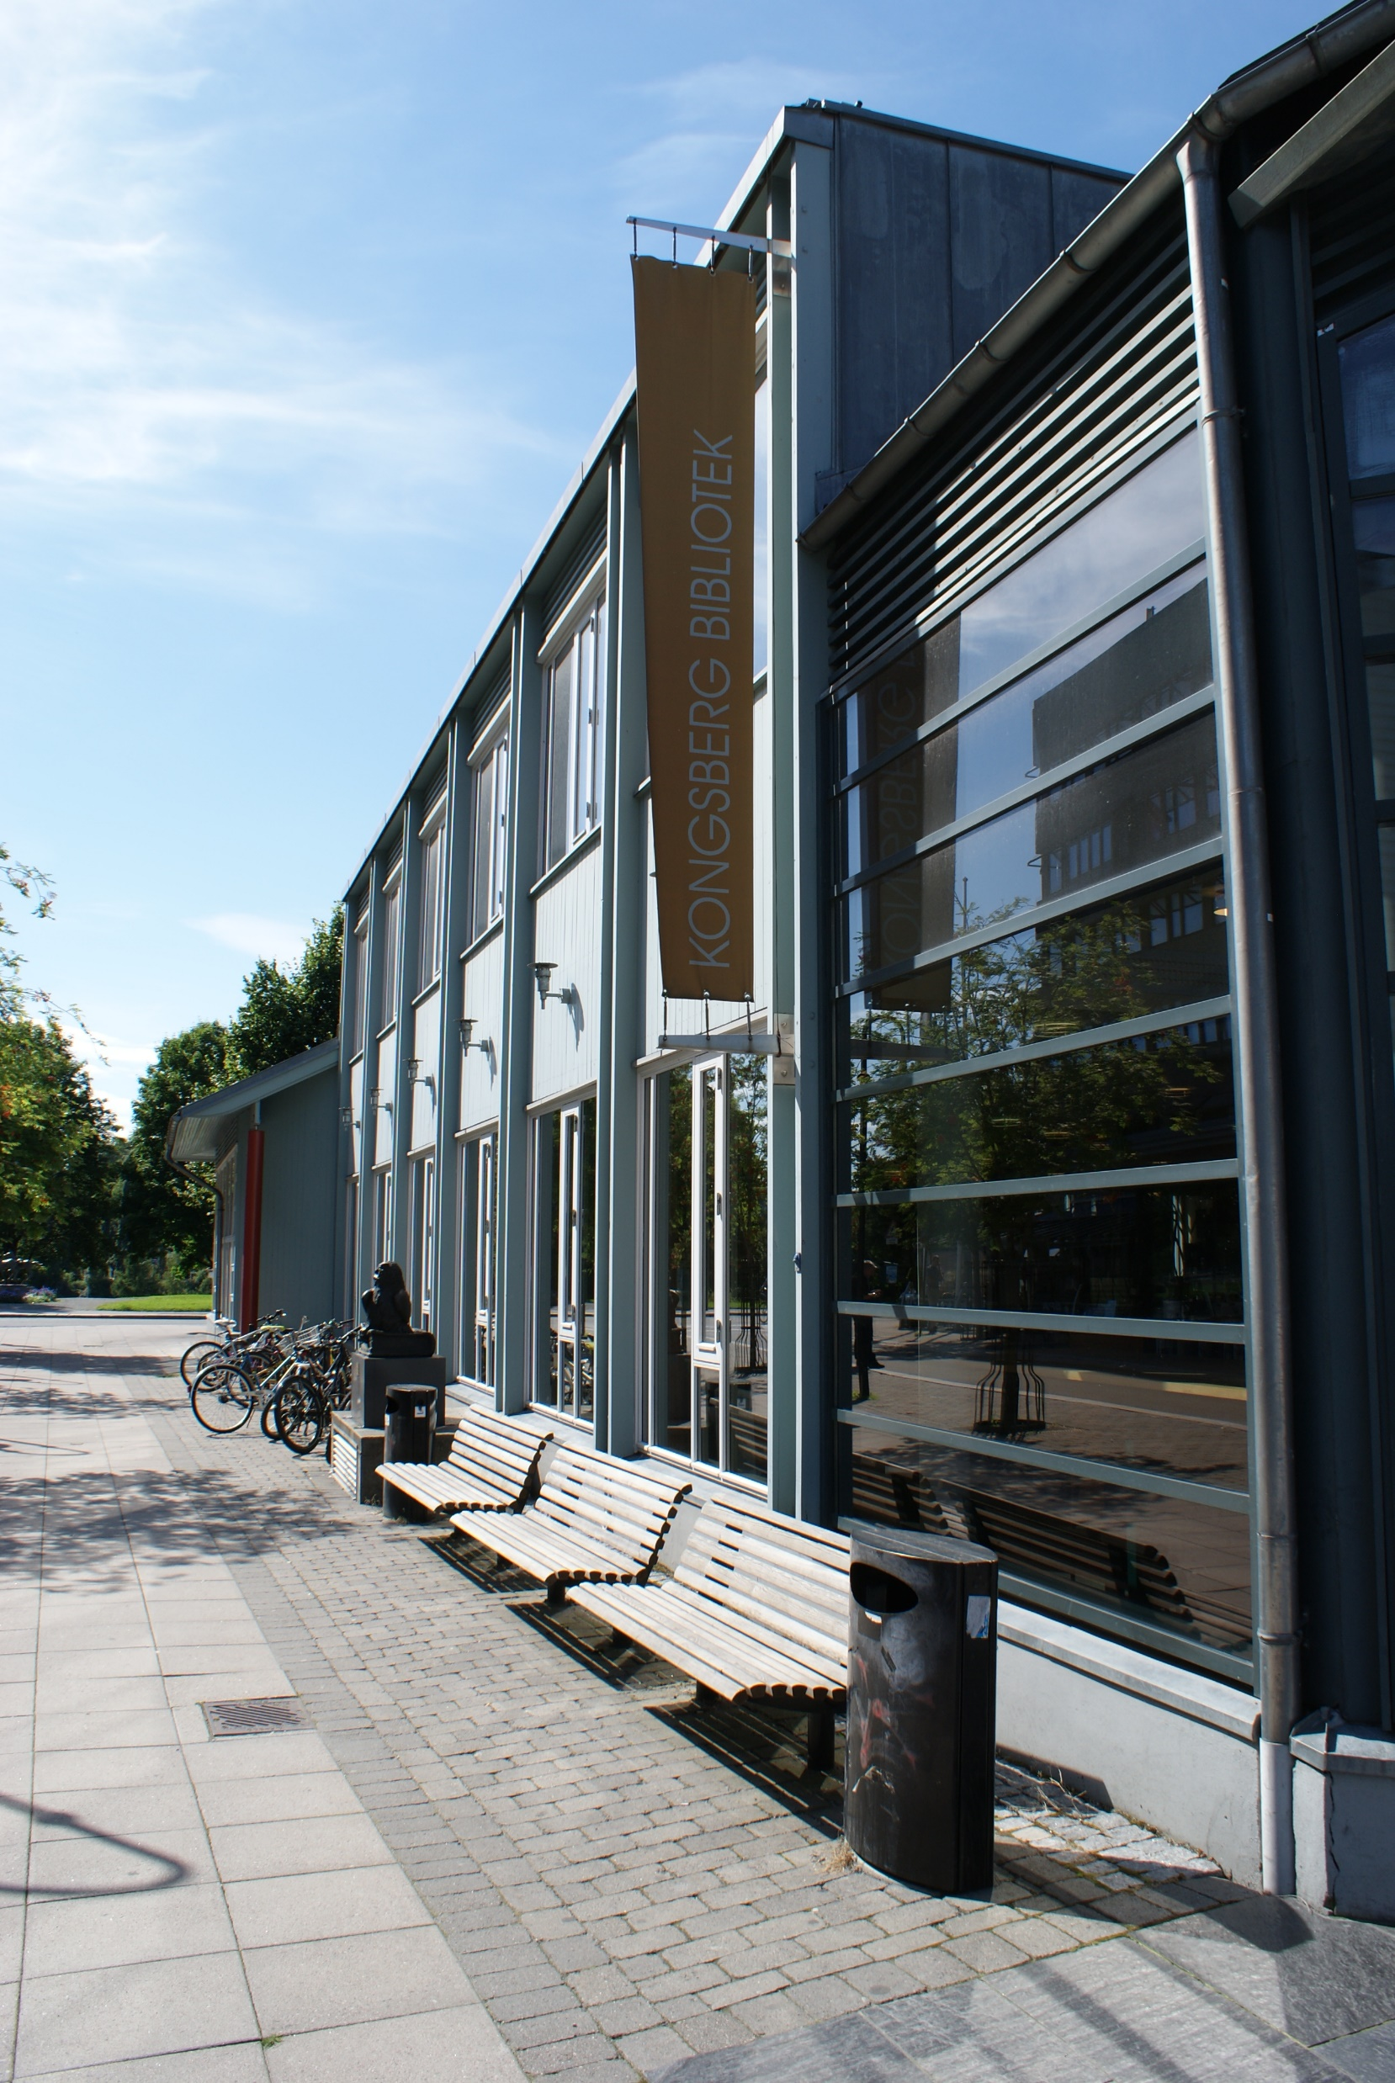
Results
Climate statement 2018 Kongsberg municipality (report 07.06.2018)
Energy consumption reduced by almost 40 % from 2001 – 2017
  10 M kWh, or 10 GWh
  Consumption of electricity reduced by 8 GWh
  Consumption of heating oil reduced by 2,5 GWh
Specific consumption from 400 kWh/m2 to 150 kWh/m2
  Reduction of almost 62 % compared to 2001
Notes:
Total results achived where EPC has been a crucial part – but not the only reason.
Rapport utgitt 07.06.2018: "Det totale energiforbruket har i 2017 sammenliknet med 2001 blitt redusert med nesten 40 %, omtrent 10 millioner kWh, eller 10 GWh. Mye av grunnen til denne reduksjonen kommer av redusert forbruk av elektrisitet på omtrent 8 GWh, men også en betydelig reduksjon i bruken av fyringsolje på omtrent 2,5 GWh.
I tillegg har det spesifikke forbruket gått ned fra nesten 400 kWh/m2 til 150 kWh/m2 i 2017. Dette tilsvarer en reduksjon på nesten 62 % sammenliknet med 2001."
I rapporten brukes TWh – men rettet til GWh

Slide 32
Agenda
EPC training
3. Recent market status
  Success factors and barriers

Slide 33
Status of the EPC market
EPC is a well-documented and tested EE model in Europe
  In use for the last 10-15 years in the Nordic Countries
  Polish EPC market is emerging
  The EPC model is still not well known in Estonia, Latvia and Lithuania
The EPC models is beneficial for the public owner
Large saving potential and possibilities for growth
Stagnating or strained EPC market situation in the public sector
A potential for further development
Notes:
Modernise technical systems of buildings through a specialised Energy Service Company (ESCO)
Bring a new model to install EE measures and possibility of funding through future benefits
Enjoy guaranteed cost savings through reduced energy consumption with no or little own investments
Strongly reduce the CO2 emissions of the buildings
Catch up with maintenance lag in public buildings
Reach goals in public energy and climate action plans (SEAPs)
Outsource EE tasks to professionals for performance-based remuneration
Barriers
No designated legal framework for EPC in partner countries
Lack of knowledge and knowledge asymmetries customer - ESCO
Lack of good practice examples and documented results (especially in Estonia, Latvia, Poland)
Lack of trust in the model
Complexity of the model/concept
Lack of facilitators (initiating and development of tender documentation)
Complexity of public procurement laws
Too good to be true?
In Nordic countries 2015

Slide 34
E4B EPC experiences – Key figures
Notes:
I find it interesting to compare the projects – these are average figures and some average numbers where that makes sense. In all projects they save energy – in some cases the ESCOs have been too optimistic in their guarantee. Poland is an exception where the ESCOs seem to be overachieving – at least in these EPC cases, but also in the 9 cases we left out of this comparison. What seems to be the case is that the more backlog on maintenance, the easier to achieve the guarantee – which makes sense.
I find the numbers for Denmark especially interesting – they have larger projects, usually longer projects (some unusual short guarantee times has reduced the average in this table, but the payback time is often more than 20 years) and very high investments. The share number of buildings give some indication on the size of these projects.

Slide 35
References and supporting documentation
Six Norwegian EPC municipalities and their experiences, EFFECT4buildings/Hedmark County Council, 2019 (https://docs.wixstatic.com/ugd/ca1352_e4964578726044beade7b9459eaf3f98.pdf)
Ny gjennomføringsmodell for EPC, WSP/Caverion/LinKon, financed by the Norwegian energy agency, Enova SF, 2019 (https://www.wsp.com/nb-NO/prosjekter/ny-gjennomforingsmodell-for-epc-prosjekter)
Granskning av EPC-avtal, Sverige 2017 (https://byggdialogdalarna.se/wp-content/uploads/2017/07/Rapport_EPC_aug_2017_.pdf)
Kartläggning av barriärer som bromsar EPC-marknadens utveckling, Sverige 2018 (https://eef.se/wp-content/uploads/2018/03/Jennifer_Palen_TRITA_ITM_EX_2018_24.pdf)
EPC Summit in Finland for the Nordic and Baltic countries, February 2018 – Motiva (https://www.motiva.fi/ajankohtaista/tapahtumat/tapahtuma-aineistot/energiatehokkuus/capacity_building_workshop_on_energy_services_and_epc_14.2.2018)
Market report on EPC in the Nordic Countries, Nordisk Ministerråd – 2016 (http://norden.diva-portal.org/smash/record.jsf?pid=diva2%3A900555&dswid=8807)
Market report on EPC in Europe, guarantEE – 2016 (https://guarantee-project.eu/wp-content/uploads/2016/12/guarantEE_EU_EPC_Market_Report.pdf)
Market report on EPC in Norway, guarantEE – 2017 (https://guarantee-project.eu/no/wp-content/uploads/sites/11/2016/11/D2.2-guarantEE-Market-Report-NORWAY-25.11.2016.pdf)
ESCO I Danske kommuner, Denmark 2013
ESCO & OPP, Denmark 2013
Notes:
See EPC Guide for links to the various references

Slide 36
Common sucess factors
Large documented saving potential
  Savings of 18 – 50 % in public buildings (Nordic Countries 2015)
Reduce maintenance budgets
Secures investments
The guarantee important for municipalities with limited budgets
Economy of scale - bundling
Helps reach ambitious energy and climate targets fast
Why is EPC not implemented all over public sector?
Notes:
Other success factors
Modernise technical systems of buildings through a specialised Energy Service Company (ESCO)
Bring a new model to install EE measures and possibility of funding through future benefits
Enjoy guaranteed cost savings through reduced energy consumption with no or little own investments
Strongly reduce the CO2 emissions of the buildings
Catch up with maintenance lag in public buildings
Reach goals in public energy and climate action plans (SEAPs)
Outsource EE tasks to professionals for performance-based remuneration

Slide 37
Common Barriers
No designated legal framework for EPC in partner countries
EE and EPC not set as clear goals in local/regional climate and energy plans
Lack of knowledge and knowledge asymmetries building owner/ESCO
Lack of good practice examples
Lack of trust in the model and/or the ESCO (Too good to be true?)
Lack of cooperation in start up and planning phases (Phase 0 and 1)
Lack of facilitators (EPC experts' phase 0, 1)
Complexity of the model/concept
Complexity of public procurement laws
Seen as competition to inhouse solutions
  Attitudes (job pride and trust)
  Competent BOs want to keep control over own building mass and technical solutions
Notes:
These are the main reasons some municipalities are reluctant or afraid to start up with EPC.
Barriers – other barriers
Defining/documenting baseline data and *performance details of existing building – when incorrect guaranteed savings might be hard to achieve
No designated legal framework for EPC in partner countries
Lack of knowledge and knowledge asymmetries customer - ESCO
Lack of good practice examples and documented results (especially in Estonia, Latvia, Poland)
Lack of trust in the model
Complexity of the model/concept
Lack of facilitators (initiating and development of tender documentation)
Complexity of public procurement laws
Too good to be true?
In Nordic countries 2015

Slide 38
EPC experiences Denmark
Some already mentioned barriers are not equally common in Denmark
Soft measures more common
User awareness
Focus on indoor climate result in goodwill
Teamwork and teambuilding
Contract based partnership and cooperation
Notes:
Seem to view the preparation parts of the projects as joint ventures and teamwork
Denmark – all kind of municipal buildings – schools, sport, town halls et.

Slide 39
Agenda
EPC training
  4. Main development needs

Slide 40
Main development needs
Allocation of more time to develop and follow up the EPC project
Better cooperation and/or partnership between building owner and ESCO
      Focusing on cooperation, interaction and building trust
Equalize differences in expertise between customer and supplier
      Use of skilled EPC facilitator / EPC expert
      Openness and cooperation
      Open book, agreed mark-up/profit margins, etc.
Consider options to lower transaction costs
      Equally important both for customer and supplier

Slide 41
Main development needs (cont.)
Improvement of templates for tender and contract documents
  Award criteria reflecting overall goal of the building owner
  Improvement of quality requirements - technical, process, cooperation skills, project management
Risk assessment analyses (e.g. bank guarantee)

Slide 42
Pitfalls and possible solution - tender phase
1. Profitability weighs high
Solution: New award criteria to ensure the interests of the building owner
2. Guarantee on savings of buildings that are not inspected/analysed
Solution: Guaranteed savings of selected examples buildings in the offer
Notes:
1. Motivates providers to guarantee a very high (unrealistic) savings percentage for a low investment. This has led to the contractors offering a "package" of measures that are not desired by the building owner, and which is also not realistic that will achieve the promised savings.
Low ordering competence, and little knowledge of NS 6430
2. This is how the competition is traditionally conducted today. The building owners have often not provided enough information about the building portfolio to make it possible to give the right price and savings.

Slide 43
Pitfalls and possible solutions – cont.
3. Requirements in the tender that cannot be met
Solution: Award criteria and goals of the building owner coordinated
4. Performance requirements that will limit cooperation in Phase 1
Solution : Partnership contract for the whole duration of Phase 1
5. Wrong choice of EPC facilitator/consultant
Notes:
3. For example: The building owner wants a payback period of about 10 years, but also wants 50% of the investment to go to building EE measures.
4. For example: There are requirements that the project should cost a maximum of 25 million, and then it turns out that the best result is obtained if you spend 30 million
5. It is important to choose a consultant who has experience from carrying out similar projects, and who has good references.

Slide 44
Tender content - novelty aspects
Prequalification - liquidity and competence requirements
All ESCOs performs bid analysis on selected buildings, following a given template
The measures described in the tender analyzes form the basis for the measures to be prepared for the remaining building stock in the phase 1 portfolio
Described qualities in the offer are passed on to measures in the same category for remaining buildings in the portfolio.
  This also applies to the cost level of measures and savings
Following the conclusion of a contract for phase 1, the tenderer shall present calculations for all measures stated in the tender analyzes.
Notes:
estimated savings shall be the same for similar measures in the rest of the portfolio.

Slide 45
Assessment of experiences and results
Most suggestions for improvement focus on phase 0 (tender) and phase 1 (analyses)
Critical choices and decision are made early
Decisions and actions in phase 0 and 1 form the basis for failure and/or success in phase 2 (implementation) and 3 (guarantee)
There is a need for :
Improvement of tender preparation and content in phase 0
Improvement of cooperation/partnership in phase 1
Notes:
We start with the latter, since it represents the greatest change and will also influence the changes needed in the preparation of the tender preparation and content!!

Slide 46
Agenda
EPC training
  5. Partnership contracts
Notes:
We start with the latter, since it represents the greatest change and will also influence the changes needed in the preparation of the tender preparation and content!!
To «sell» the new/adapted implementation model for EPC you should also be able to present the contract based partnership and how it can be implemented in an EPC project.

Slide 47

Partnership contract
The partnership model is based on a phase divided contract
The partnership has a common development phase before the turnkey contract for implementation is entered into
Phase 1 shall be utilized to:
Agree on the partners' goals and prioritising
Reduce insecurity
Achieve mutual understanding for the deliveries
Agreements on concrete solutions and technical product choices
Notes:
The choice of a partnership contract will influence the changes needed in the preparation of the tender preparation and content!!

Slide 48
Partnership contract phase 1
BP1
BP2
Together
Building owner
ESCO
PHASE 0
INITIATION/TENDER
EPC EXPERT/FACILITATOR
PHASE 1
ANALYSES AND DEVELOPMENT
PHASE 2/3
IMPLEMENTATION AND GUARANTEE
Notes:
An official turnkey enterprise standard is an important tool, but if you exclude the initial chapter, most of the standard is about how to solve conflicts that might arise. A partnership contract is about avoiding getting into conflicts.
Facilitator might be involved in all phases….
A partnership contract is not merely about openness on investments and budgets, but states an intention to cooperate, interact in an open and honest manner in order to create an atmosphere of trust in all phases of the project, and especially in the phase where the basis for the project is created.

Slide 49
Official turnkey standard
An official turnkey enterprise standard is an important tool, but if you exclude the initial chapter, most of the standard is about how to solve conflicts that might arise.
A partnership contract is about avoiding getting into conflicts.

Slide 50

What is the partnership about?
Contract based cooperation (new template)
EE measures in all buildings
Quality of measures, products and technical solutions
Economy – open book – no secrets
All documents available for both parties
ESCO provide analyses with agreed mark-up
  Project development report (new template)

Slide 51

Trust and respect
There will always be different goals regarding implementation of a project
The customer wants as much as possible for the money
The supplier wants to make a profit
BUT
Common goals and rules are possible
Requires mutual understanding and respect for the other parties' reasonable goals
Mutual instruments to succeed
Openness between parties
Confidential treatment in negotiations
Trust among the parties
Notes:
Competence and expertise often change places at the table. The supplier might be the customer tomorrow or visa versa.
Another important aspect is that people and competence change places at the table over the years. A building owner can be a former ESCO employee and an EPC project leader can have experience from working for a building owner. Openness and trust and respect for the other parties' reasonable goals should be very natural.

Slide 52

The speed of trust
Notes:
It ends up being about human relations. The parties will have to wish each other well. That is the backbone of every relationship – also business relationships.

Slide 53
Agenda
EPC training
  6. New implementation model for EPC

Slide 54
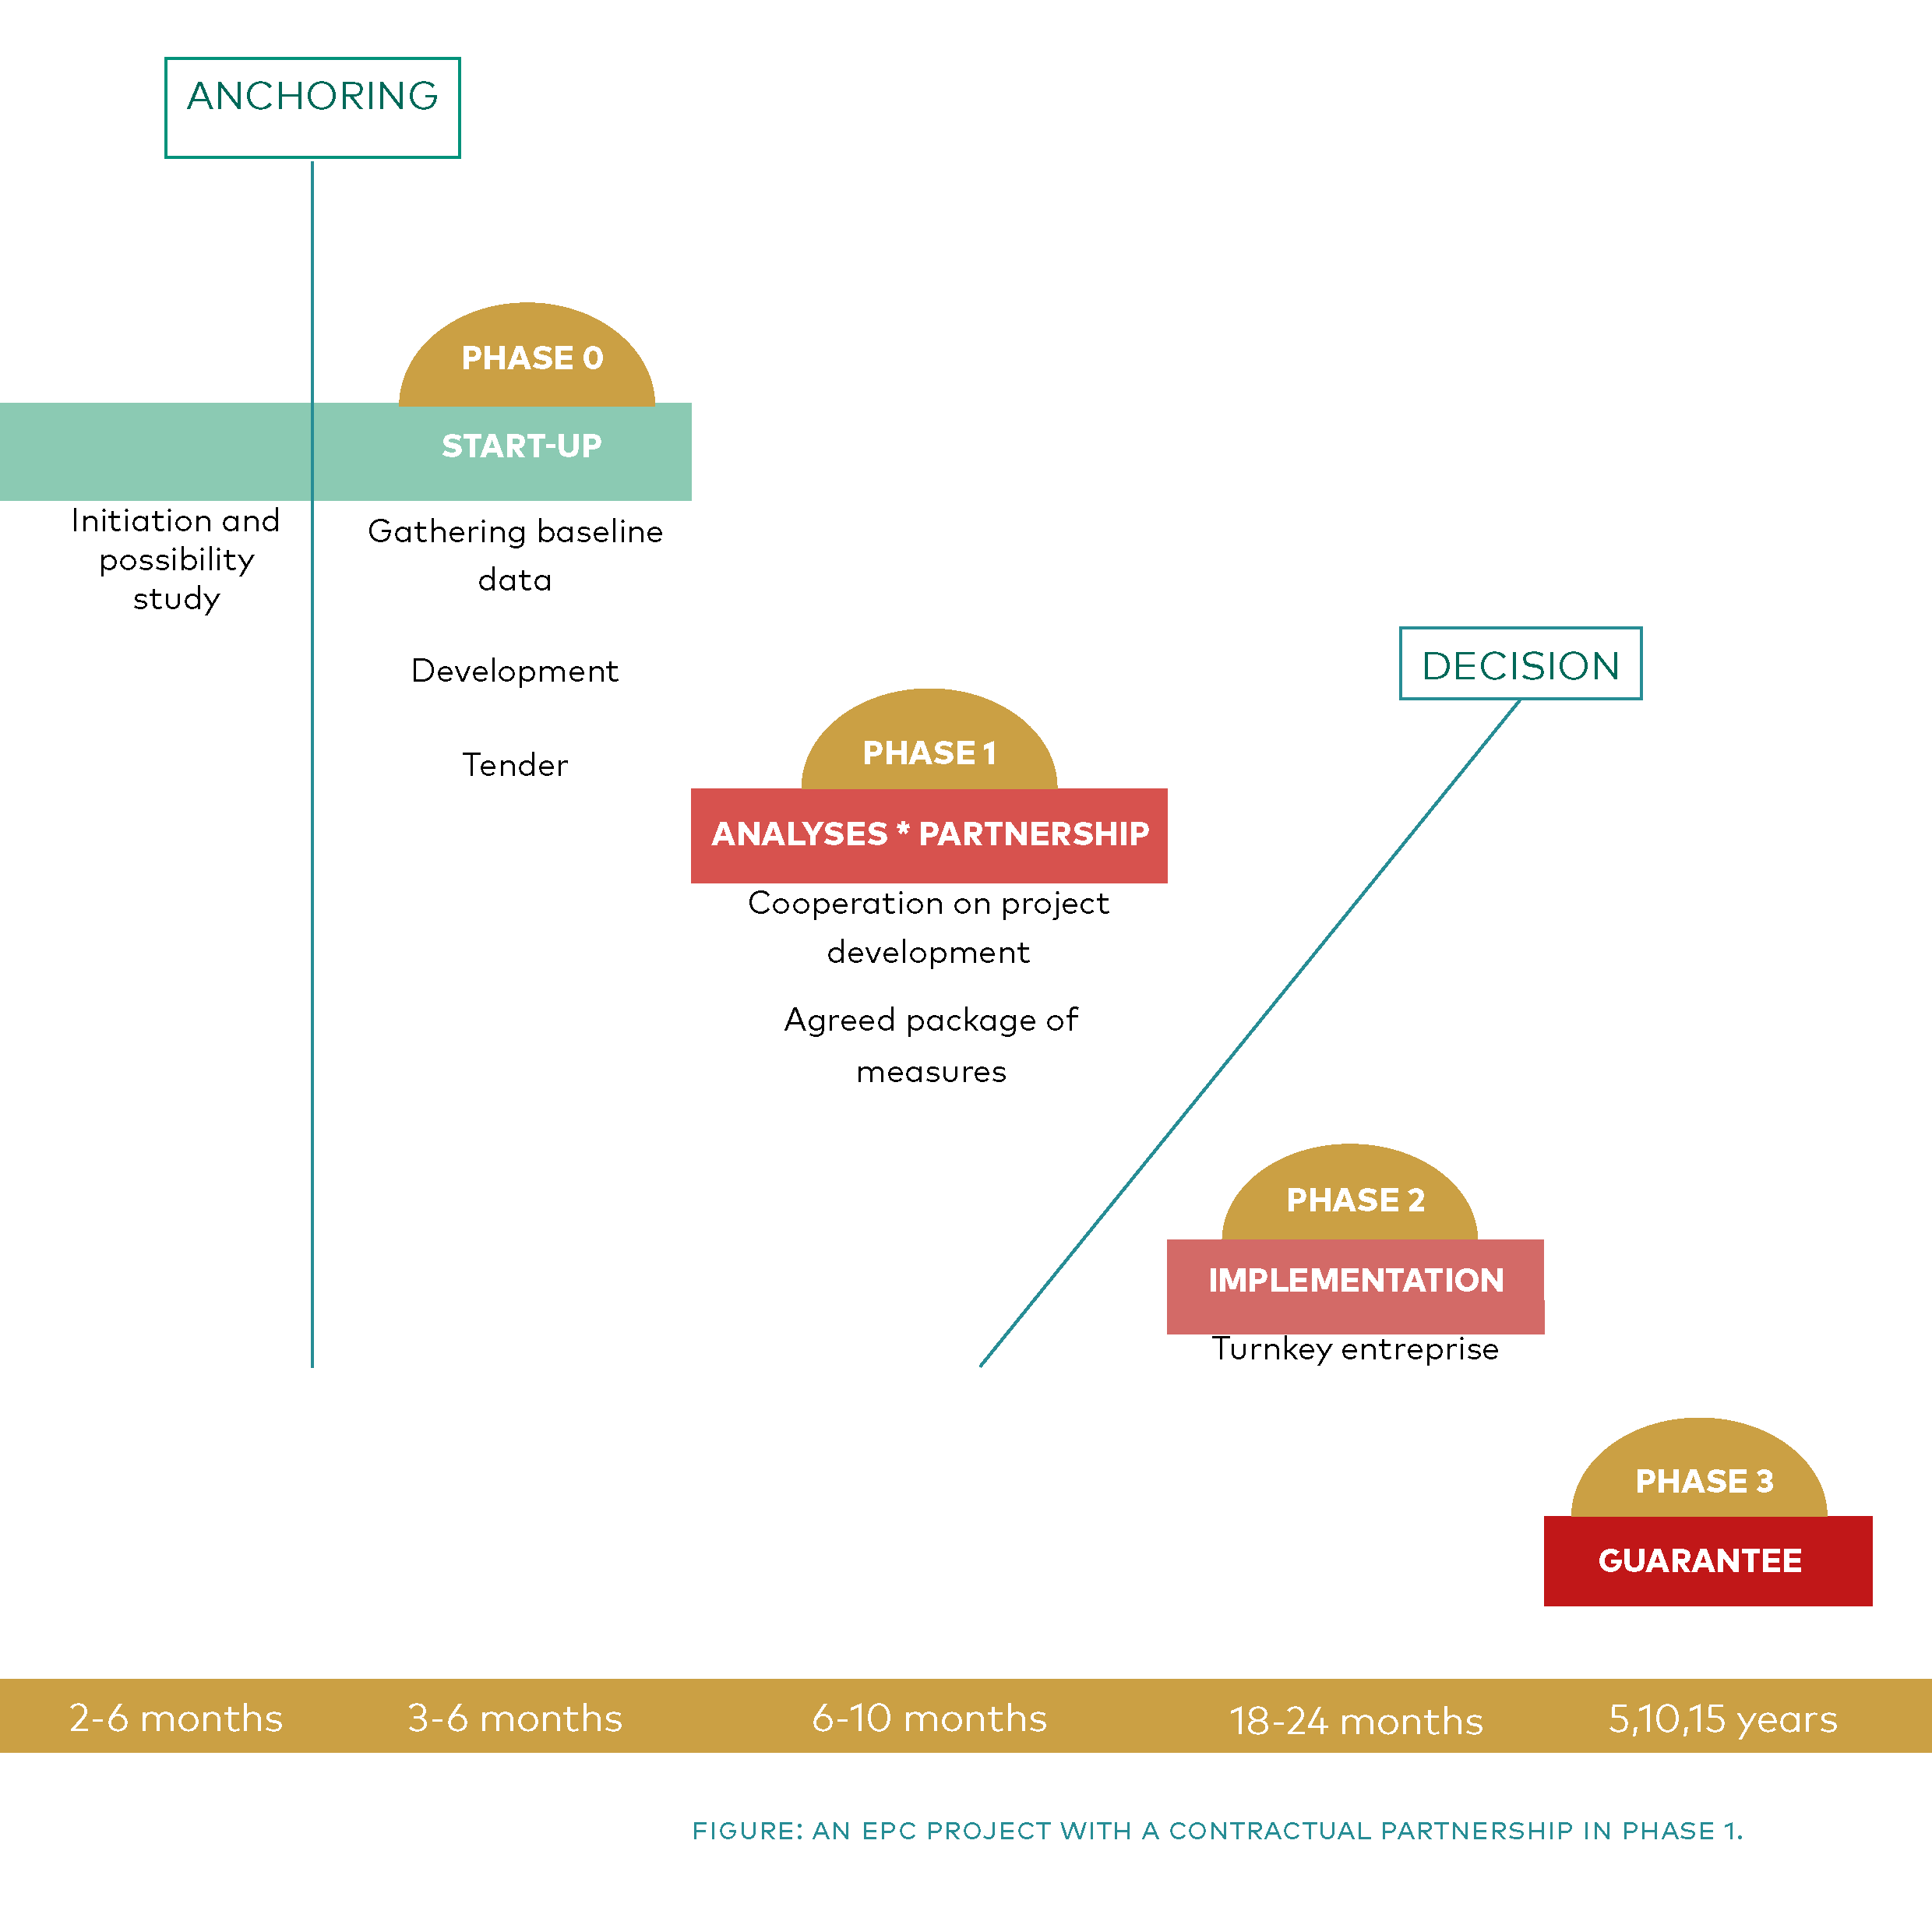
EPC with partnership in phase 1
Notes:
Most suggested improvements are focusing on the first two phases of the EPC process, the start-up and tender phase (0) and the energy analyses and project development phase (1). These phases include critical choices and decisions that form the basis for failure or success in the implementation (2) and guarantee (3) phase. Hence the two first phases are emphasised.

Slide 55
Phase 0 – before starting up the project
Is EPC desirable?
Political will, internal will
High energy costs
Need for upgrades
Energy savings not primary goal (might call for an MSC project)
Is EPC viable?
Is there enough saving potential in the buildings?
Is it achievable?
Capacity and resources
Is it worth investing in?
Expected budget, savings, payback time and other benefits
? ! ?
Notes:
Overselling is seldom a good idea. It is more trustworthy to aknowledge that EPC is not desirable or even viable for everybody and all public buildings.
MSC – Multiservice Contract – includes/adds non-energy services such as operation, maintenance, lighting, indoor air quality, temperature, noise, esthetical values and well-being issues in the investments

Slide 56
Tender preparation
1. Knowledge of EPC and implementation models
    Ownership in own organization
    EPC presentation by neutral advisor?
2. Get assistance from EPC faciliator (EPC expert)
    National register of qualified EPC facilitators?
Notes:
COS system – Central Operation System – EMS – Energy Monitoring System
The need for building owners to get deep knowledge about the building stock and identify goals for the project during phase 0 is emphasized. The building owner must devote resources to the project, and it is important that there is a sense of ownership to the project, both in the administration and preferably politically. Then the work on finding the right supplier can begin. At this stage, it is recommended with assistance from advisers with expertise in EPC processes and interaction- an EPC facilitator.

Slide 57

Tender preparation (cont.)
1. Which buildings should be included?
2. Baseline data
    Drawings, construction years, areas
    Technical facilities, operating hours
    Maintenance plans, required upgrades
    Is there any asbestos / radon in any of the buildings?
    Protected or historic buildings?
3. Determine sample buildings
    Choice of sample building for the tender (1-3 representative buildings)
4. Special wishes and qualities?
    Identify quality requirements (e.g: SOS, EMS, district heating, indoor climate requirements, etc.)
Notes:
COS system – Central Operation System – EMS – Energy Monitoring System
The recommended procurement process starts with a pre-qualification of 3-5 suppliers, where implementation skills and relevant experience are among the qualification requirements. The qualified suppliers then compete by delivering a proposal containing energy efficiency analysis of 1-3 representative sample buildings. These analyses are prepared according to a specific template, and investments and savings are summed up. The total net present value of these measures, and the associated cost of phase 3, is considered as one of several award criteria. Other suggested award criteria besides price, calculated savings (both energy use/kWh and effect/kW) and net present value, are; technical quality, mark-up percentage and description of project understanding. The weighting of the award criteria must be in accordance with the customer's goals and expectations for the project.
Price cannot be the criteria with highest weight if the building owners’ overall goals are to close maintenance gaps and include deep renovation measures.

Slide 58
The Tender
New templates:
The following are examples adapted to the new implementation model
Tender document for procurement of EPC supplier (example)
    Novelty aspects as described; new award criteria, example buildings etc.
Contract terms for Phase 1 the analyses phase with contract-based partnership
  Appendixes to contracts
Contract terms for Phase 3 the guarantee phase
Notes:
Drafts of template for tender and contract documents
Låter som bra tools!
Checklist sounds like a one-pager. If it is more than that with recommendations and explainations så borde det nog kallas guidelines. Men vi kan prata mer om dessa ord när vi ses!

Slide 59
Phase 1: Parntership
Contract based partnership agreement
"Open book" - no "secrets"
The measures are found and described together
End up with a unified project development report
Both parties own the documentation
Everyone happy and want to move on
The energy ESCO is still responsible for the design at all stages

Slide 60
Phase 2: Implementation
Phase 3: Saving guarantee
Based on contract terms in national standards for turnkey enterprises
Agreement on all measures - both price, function and quality
Leads to little additions and changes
Implement measures determined in Phase 1
The duration of Phase 3 is determined in Phase 1
The contractor guarantees the energy savings

Slide 61
Agenda
EPC training
  7. The tangible EPC toolbox
  Guide and Guideline
  EPC presentation and training material
  Templates and model documents
Notes:
Concrete and tangible tools that you can share and hand out to the public building owners and that they can make use of. The idea is that they will be able to start an EPC project with the help of these tangible tools!

Slide 62
Tangible tools
EPC Guide and Guideline for start-up of EPC projects
Description of new implementation model
How to start an EPC project
Adapted templates and model documents
Tender documents, contracts, etc.
EPC Presentation
Training kit (material)
Notes:
The EPC Toolbox is devieded in three sorts of contents: 1) Guide and Guideline – 2) Presetentation and 3) Templates and model documents
Disclaimer: The templates and model documents are thoroughly elaborated but should be adapted to national laws and regulations and verified by national legal counsel / lawyer in each country. It must be pointed out that all the template must be adapted to each project, so that the customer's goals and expectations for the project are best taken care of.
What are the saving potential in public sector in your country?
In Norway the official number is 10 TWh saving potential in exisiting public buildings
Tänker du dig en liten diskussion här? Vi kommer att ha mentimeter för att svara på frågorna på slide (feedback) men förutom hur deltagarna värderar planerade verktyg så kan det ju absolut vara intressant att även diskutera hur vi får fart på EPC. Kanske avsluta med det?

Slide 63
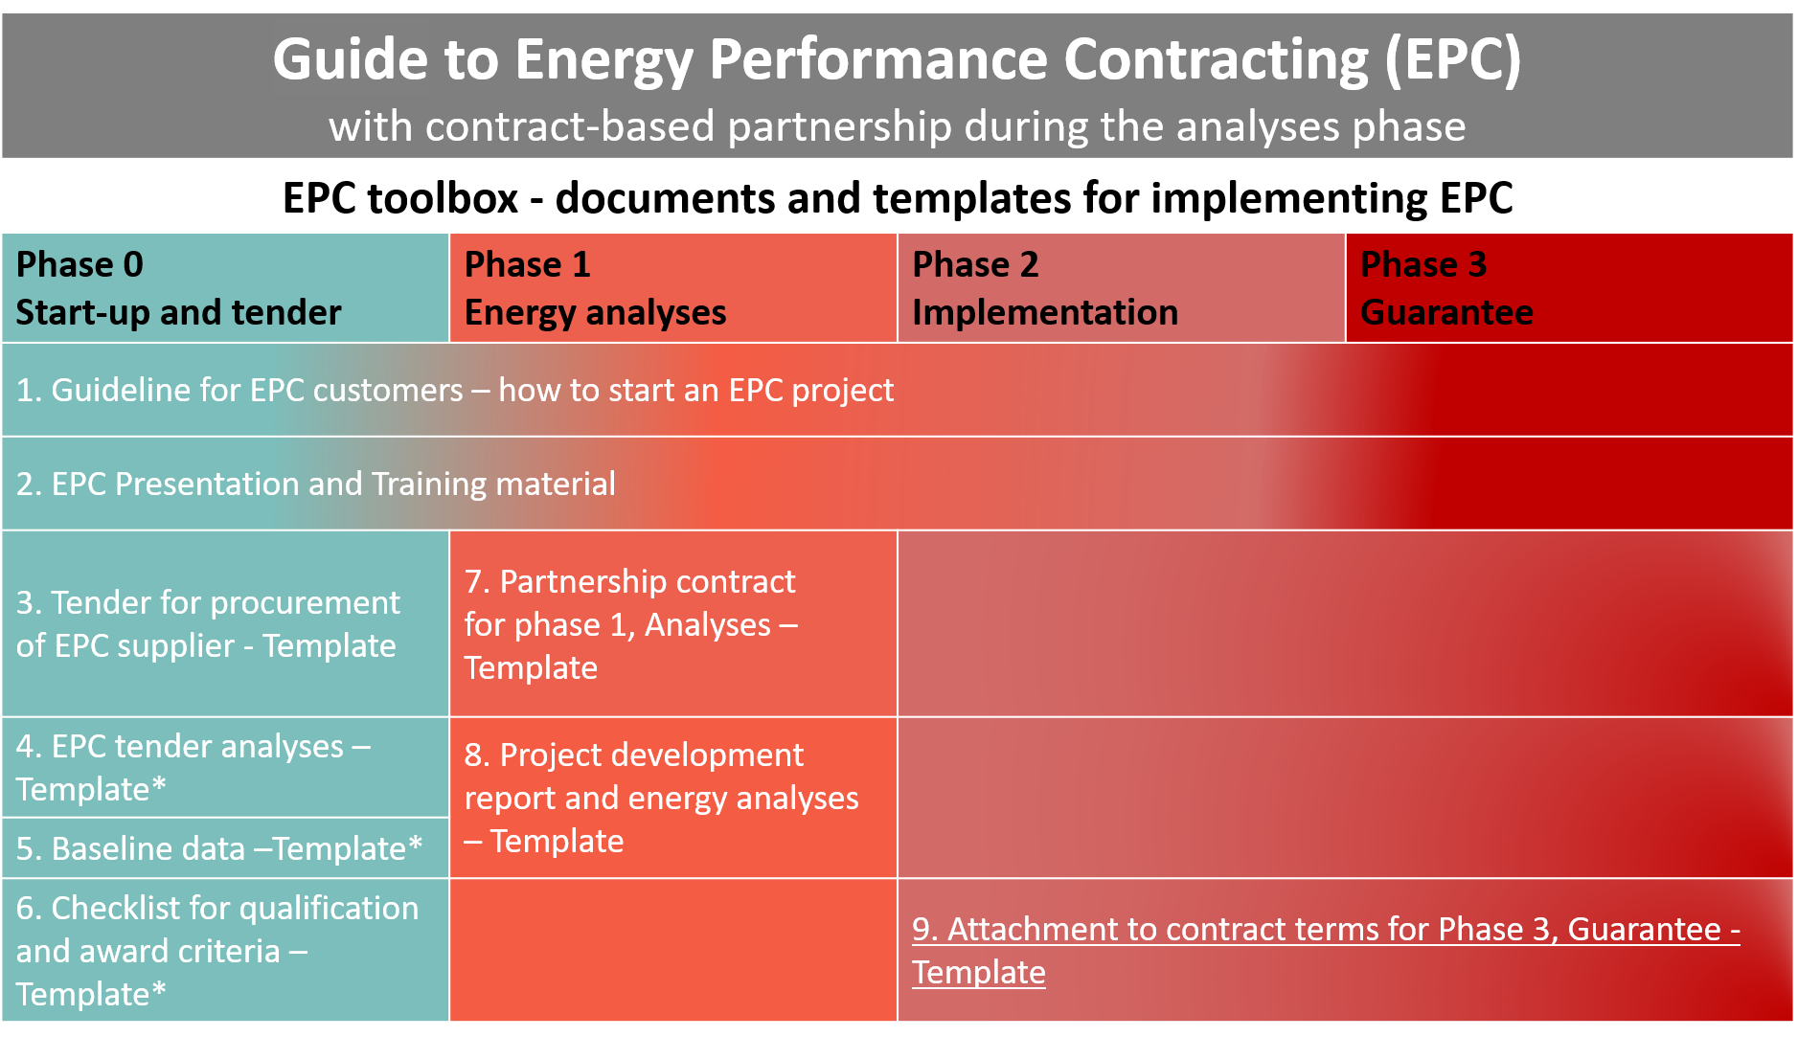

Slide 64
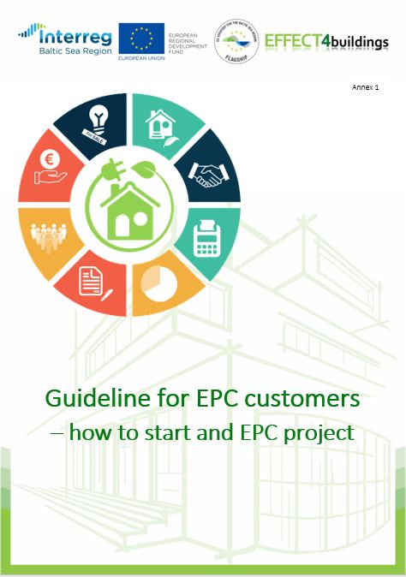
1 - Guideline for EPC customers
  Guidance on how to start an EPC project
  Necessary preparation
  The procurement process - who does what when
  Available grant schemes
  Available templates and model documents
  Necessary knowledge about own buildings and consumption data
  What types of consultants / advisors can help with what
  Laws and regulations
  Limitations and bonds to be clarified (DH, IT, indoor climate, radon, …)
Notes:
Step-by-step guide on how to start and EPC project
A short guideline for building owners laying out the first steps of an EPC project and a presentation that can be used for introduction of EPC in own organisation has been developed. Templates for tender documents and associated annexes for the announcement of an EPC tender are also parts of the toolbox. New elements have been added to take consideration of the findings and to ensure fair balance between the customer and the EPC supplier.

Slide 65
Content of EPC Guideline
About the Guideline
What EPC is
  Traditional implementation
  New implementation model with partnership in phase 1
When to choose EPC
  When is EPC the rigth choice and when it is less relevant
Anchoring in the organisation
  The importance of internal anchoring among decisionmakers and politicians
Procurement of EPC
  EPC-facilitator
EPC toolbox
Financial support and financing
Useful links and information about EPC
Notes:
Dynamisk – si ifra om dere finner feil eller mangler, så vil vi vurdere endringer og tillegg
A short guideline for building owners laying out the first steps of an EPC project and a presentation that can be used for introduction of EPC in own organisation has been developed. Templates for tender documents and associated annexes for the announcement of an EPC tender are also parts of the toolbox. New elements have been added to take consideration of the findings and to ensure fair balance between the customer and the EPC supplier.
Finland har kjøpt og oversatt norsk Standard for EPC

Slide 66
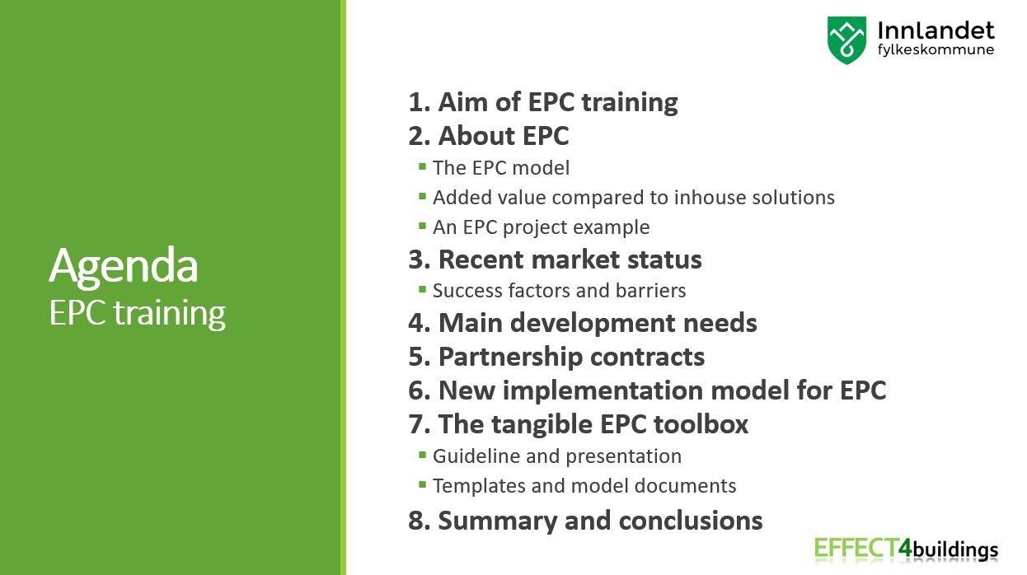
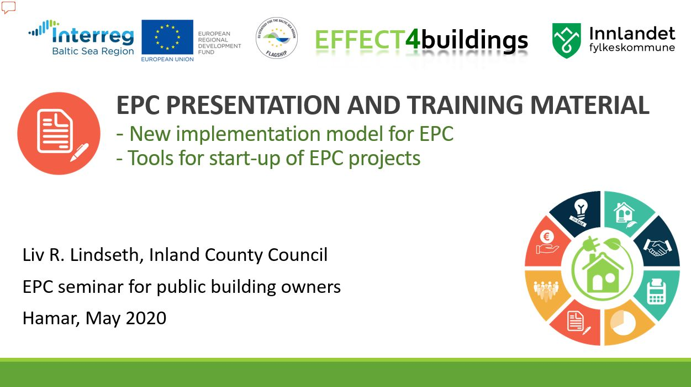
2 - EPC Presentation and training material
  An aid to:
  Increase knowledge and trust in EPC
  Anchor the EPC among decision makers and politicians
  Select sections depending on the target group
Notes:
Velg og vrak!
Denne presentasjonen er ikke ment å holdes fra start til slutt. Velg hvilke deler og seksjoner du vil bruke, avhengig av målgruppen og formålet med presentasjonen.
- ment som grunnlag for en opplæring, et seminar eller andre presentasjoner av EPC og den nye gjennomføringsmodellen med kontraktsbasert partnerskap i fase 1 - analysefasen. Det kan oversettes og brukes - hele det eller deler av det - når det arrangeres opplæring blant målgruppen - lokale og regionale offentlige bygningseiere.
Deler og lysbilder som kun er beregnet på trenere er merket med «For trenere» - Trenere kan være eksterne eller interne trenere.

Slide 67
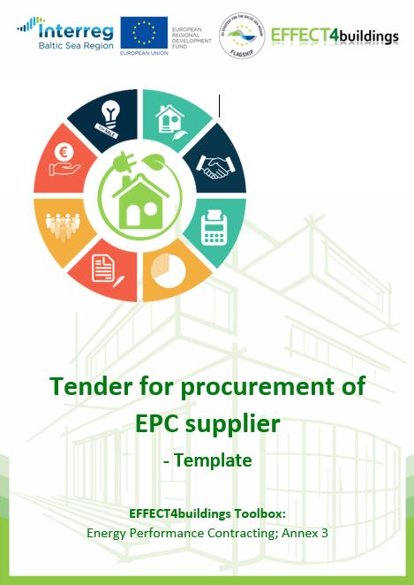
3 – EPC Tender – template
Some adaptations compared to templates for traditional implementation
    Pre-qualification of EPC-providers
    Tender analyzes of selected buildings according to common template
    Offered quality and cost level for measures continued to measures in the same category in the rest of the building portfolio
    Proposals for new award criteria and weighting
    Adapted for interaction in phase 1 analysis phase
Simple user instructions
  Disclaimer
  Important information in the margins
  Must comply with national laws and guidelines
  Should be reviewed by a lawyer / adapted to national procurement laws in each country
  The document is a template and must be adapted to conditions in each individual project
Notes:
Enkel brukerveiledning
Viktig informasjon i margene (som for konkurransegrunnlaget)
Må tilpasser nasjonale lover og retningslinjer
Bør gjennomgås av advokat / tilpasses nasjonale innkjøpslover i hvert enkelt land
Dokumentet er en mal og må tilpasses forhold i hvert enkelt prosjekt
Prequalification - liquidity and competence requirements
All ESCOs performs bid analysis on selected buildings, following a given template
The measures described in the tender analyzes form the basis for the measures to be prepared for the remaining building stock in the phase 1 portfolio
Described qualities in the offer are passed on to measures in the same category for remaining buildings in the portfolio.
This also applies to the cost level of measures and savings
Following the conclusion of a contract for phase 1, the tenderer shall present calculations for all measures stated in the tender analyzes.

Slide 68

7 – Partnership contract for phase 1, Analyses –Template
What is agreed upon?
  The parties agree to actively contribute to a positive, constructive and solution-oriented way of working
  The open book principle applies - all relevant documents are available to both parties
  Results in a project development report with agreement on fixed prices and end date for completion of the project
Simple user instructions
  Disclaimer
  Important information in the margins
  Must comply with national laws and guidelines
  Should be reviewed by a lawyer / adapted to national procurement laws in each country
  The document is a template and must be adapted to conditions in each individual project
Notes:
Basert på dette introduserer vi TOOLBOX-dokument nr. 7
Åpen bok-prinsippet brukes til fase 1, analysefasen. Dette betyr at alle relevante dokumenter fra energientreprenøren og alle underentreprenører, rådgivere og leverandører er tilgjengelige for bygningseiernes representanter i denne fasen. Byggeierens dokumentasjon og underliggende beslutningsunderlag er tilgjengelig for energientreprenørens representanter.
Teknisk, økonomisk, beregning av besparelser, basisdata - alt betyr alt.
Disclaimer:
Always ensure compliance with the country's procurement laws. Although this document is thoroughly elaborated, it should be adapted to national laws and regulations and verified by national legal counsel / lawyer in each country before launching the tender. This document is a template that must be adapted to each project, so that the customer's goals and expectations for the project are best taken care of.
w to use the template: Similar to the EPC tender document – important information in the margins and it must be adapted to national laws, regulations and project contiditons

Slide 69
The other templates
  Attachments to tender and contract template
Not significantly changed compared to traditional implementation
  4 - EPC tender analysis
  5 - Basic data
  6 - Checklist for answered qualification and award criteria
  8 - Project development report and energy analysis
  9 - Supplement to agreement document for phase 3, the guarantee phase
Some changes
  Simple user instructions
  Information about the connection between the documents / templates

Slide 70
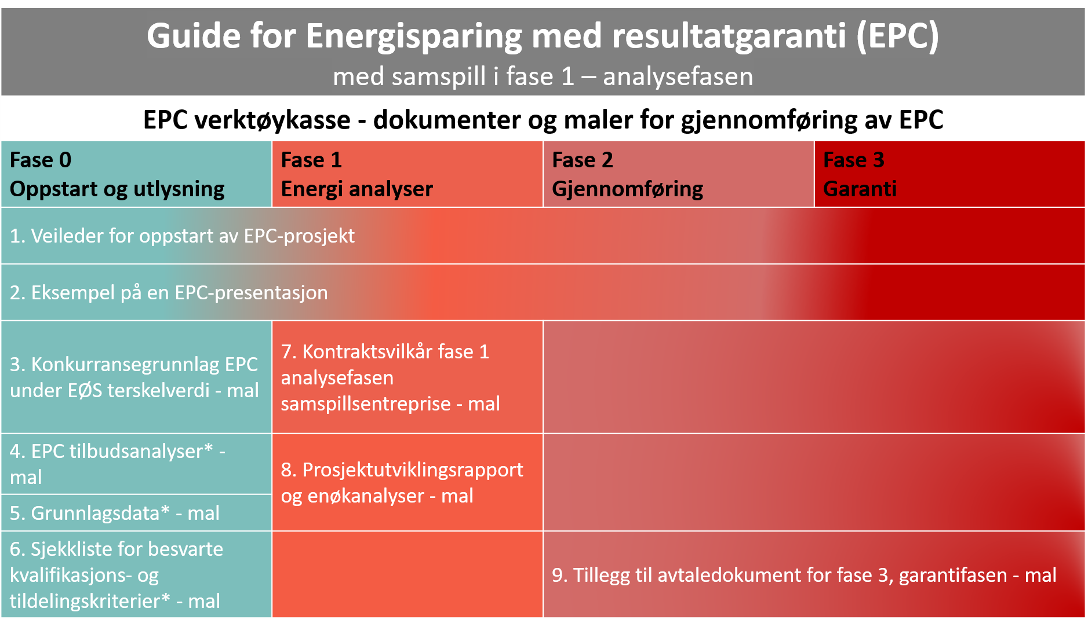
Notes:
The overall goal has always been increased use of EPC!
The Guide is the main description and the toolbox is the attachments to it,
See www.effect4buildings.se

Slide 71
Agenda
EPC training
    8. Summary and conclusions

Slide 72

Summary
Problem
    Too complicated
    Lack of knowledge
    Even less knowledge of different ways of implementation
    Lack of EPC facilitators
    Little access to customized templates and tender documents
    Need for increased balance and flexible contract models
    Lack of documented results and success stories
    Lack of knowledge on how to start the EPC process
Notes:
Rooted = means both the administration and politicians feel ownership to the project.

Slide 73
Reccomendations
What leads to increased use of EPC?
    Increased knowledge of EPC
    Ownership to the project in own administration
    Increased knowledge of possible models for implementation
    Knowledge of own savings potential
    Easy access to customized templates and tender documents
    Increased balance and flexible contract models
    Documented results and success stories
    Knowledge on how to start the EPC process
Recommendations
    More information and knowledge dissemination
Notes:
Rooted = means both the administration and politicians feel ownership to the project.

Slide 74
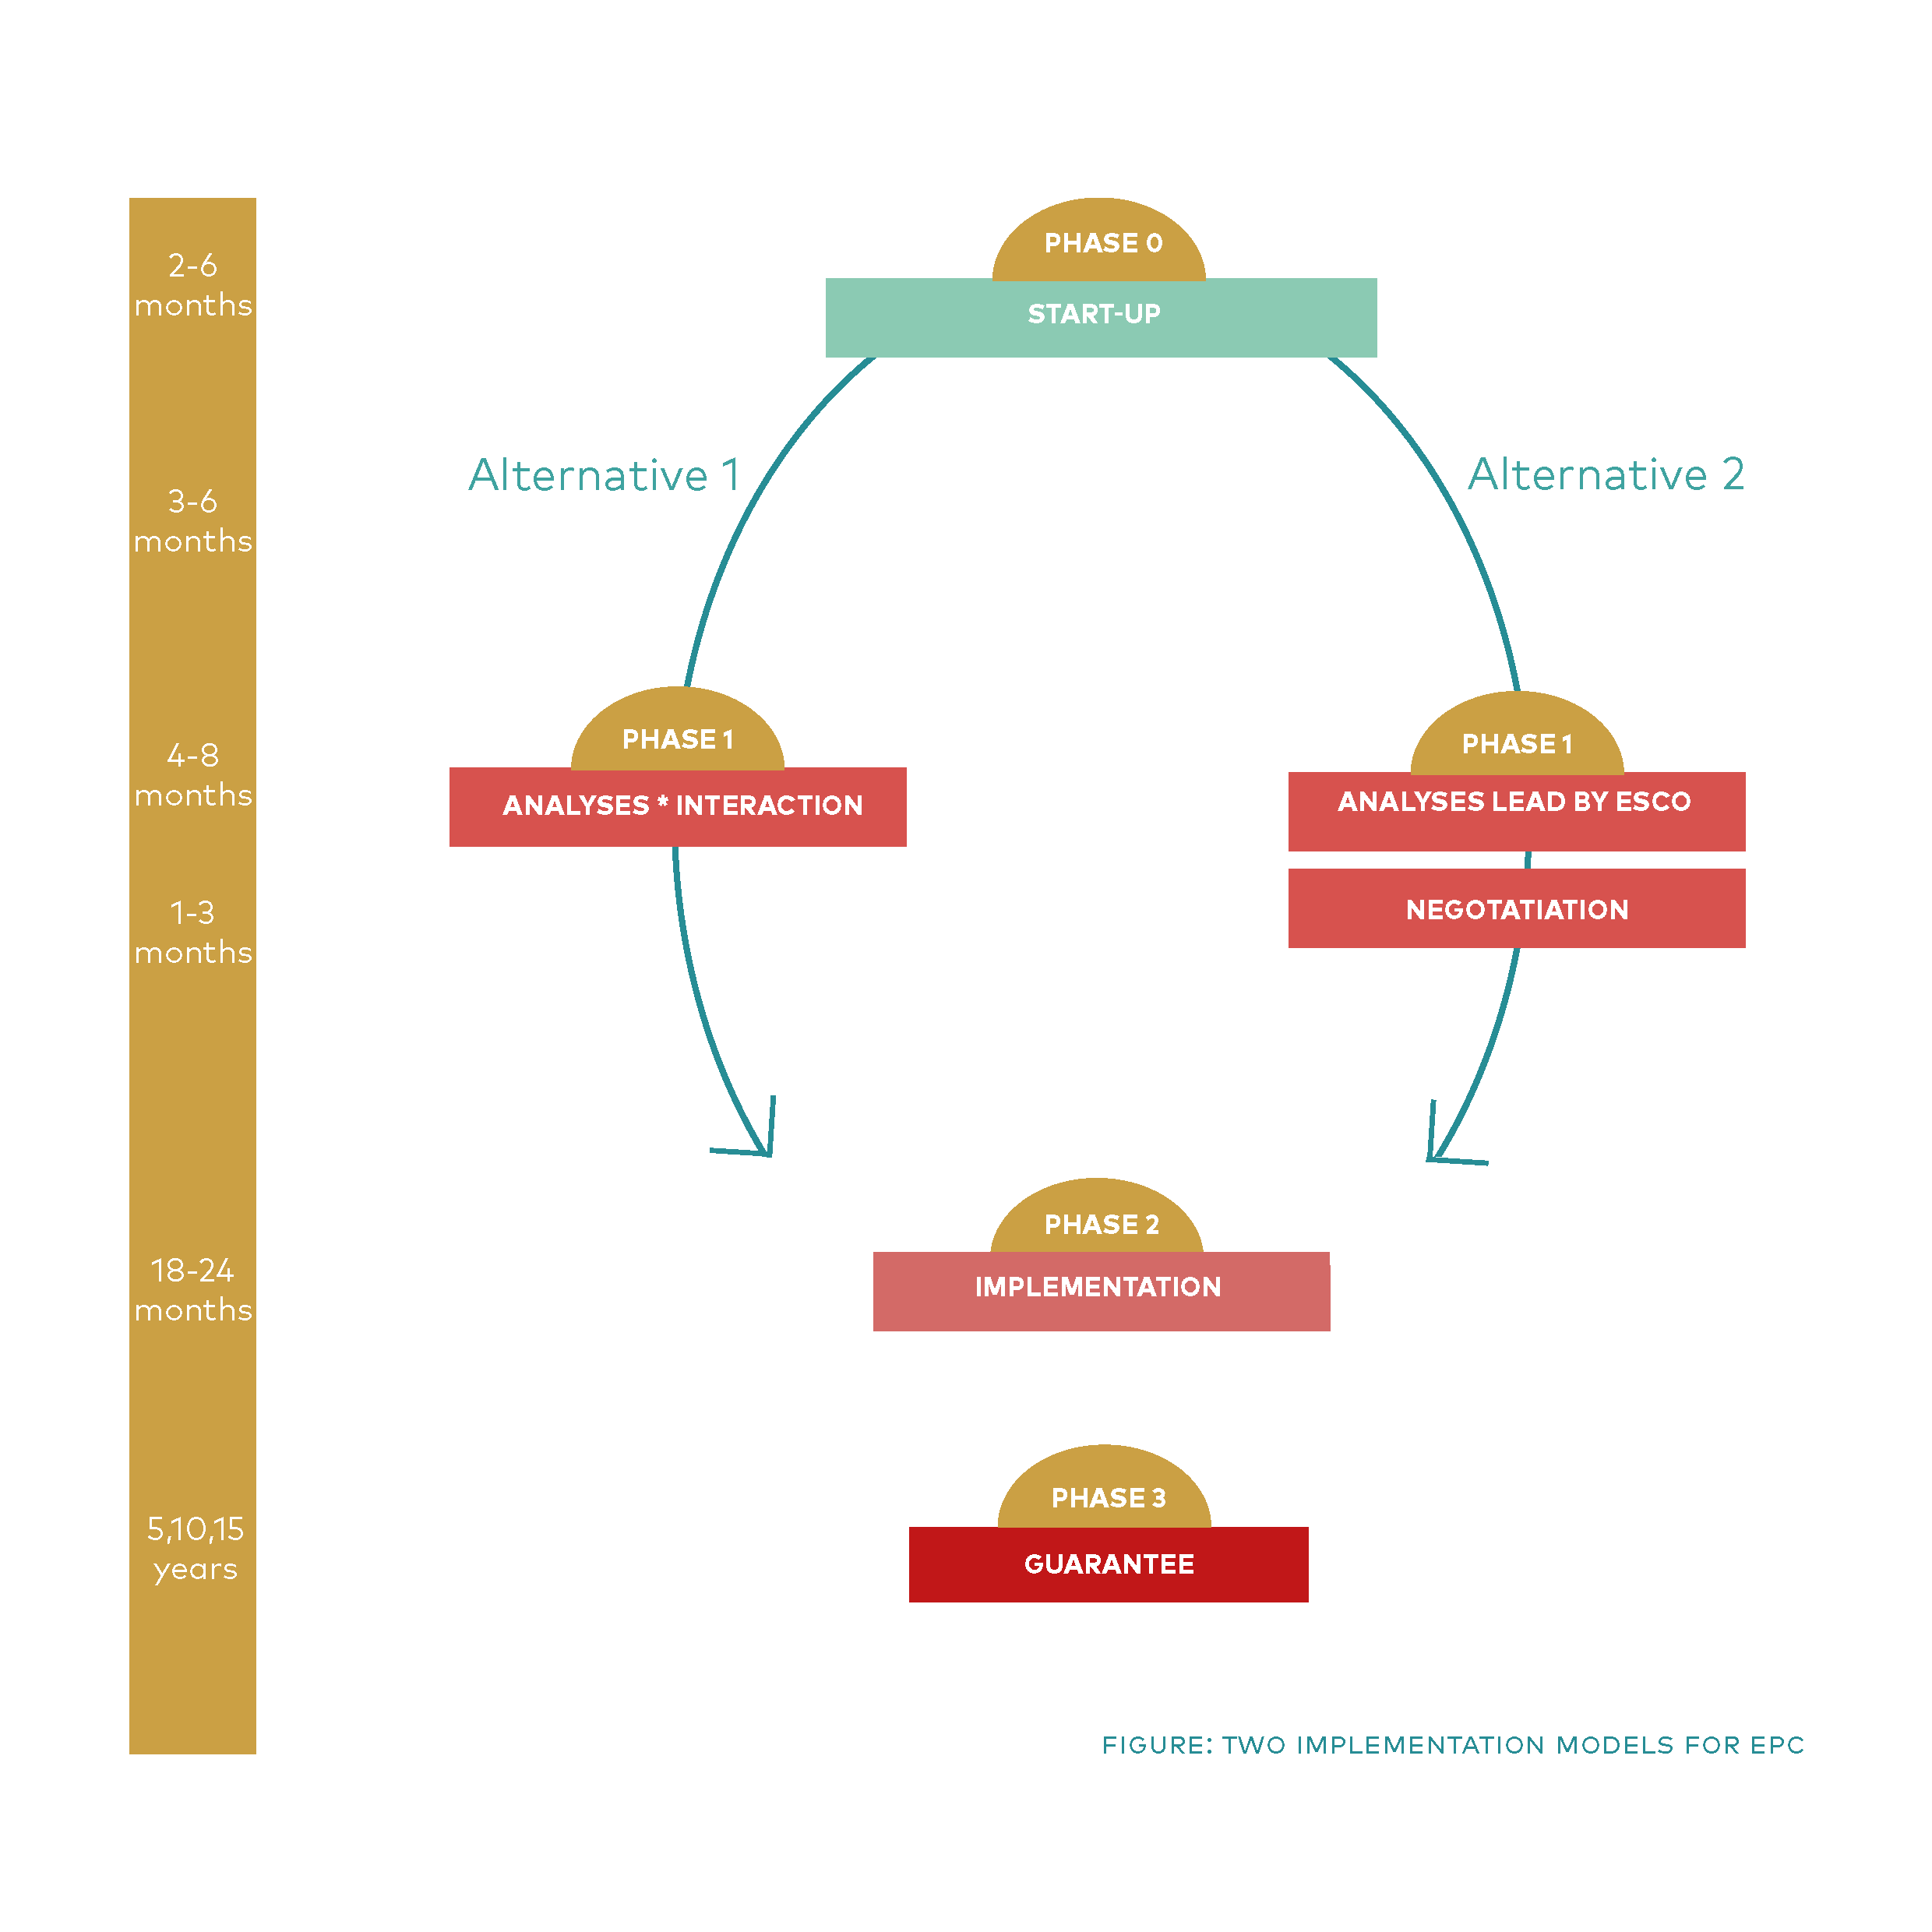
Several options – choose EPC
Notes:
Two implementation models – recommendations on which one to choose.
Alternative 1 is the New implementation model for EPC with partnership in phase 1
Alternative 2 is the traditional implementation model for EPC
Alternative 3 – A MIX of the two!! traditional implementation with comprehensive cooperation and new good practises
First: Initiation and possibility studies
Phase 0: Development phase - Gathering building data, basline information, development of tender,
Phase 1: energy analyses – in cooperation or controlled by ESCO – partnership will REPLACE negotiations
Phase 2: Turnkey enterprise

Slide 75
Contact
Liv R. Lindseth
Contracted by Inland County Council innlandetfylke.no/E4B effect4buildings.se liv@linkon.no
+47 95 22 04 82
EFFECT4buildings

Slide 76
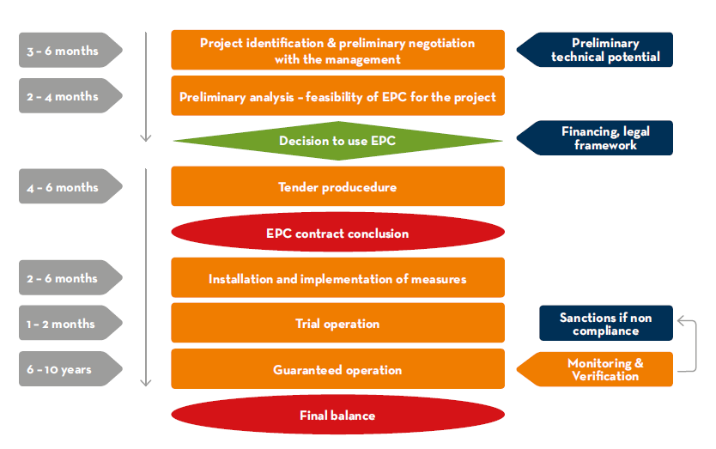
Time schedule of tendering procedure
Source: Transparense project (www.transparense.eu)
Notes:
Tentative time schedule – might absolutely vary from project to project

