Slide 1




BUNDLING
Training materal
EFFECT4buildings
Add a organisation logo.
Note: The Union Emblem (EU flag) shall have at least the same size (height or width), as this logo.
Name, Organisation
Event
Location, Date

Slide 2

Agenda for training event
-bundling
-TCM (Total Concept Method)
-TotalTool
1. General about training
2. General about bundling & TCM & TotalTool
3. Total Concept Method (TCM)
4. TotalTool
5. Examples and experience
  6. Additional material
    7. Summary / conclusions / discussions
Notes:
This is the agena structuring the training in the order I have found most practical. Changes might occur. Under each point I will present some examples of content. As the material is not yet finished there might be some overlapp in my presentation of examples..

Slide 3
Agenda for training event
-bundling
-TCM (Total Concept Method)
-TotalTool
1. General about training
  Purpose & advantages & goals
  To whom
Notes:
This is the agena structuring the training in the order I have found most practical. Changes might occur. Under each point I will present some examples of content. As the material is not yet finished there might be some overlapp in my presentation of examples..

Slide 4
Purpose & advantages & goals
  to help building managers and other relevant stakeholders to understand the idea of bundling / TCM / TotalTool
  to strengthen capability to take bundling / TCM / TotalTool in use, when preparing EE-investments
  to provide clear EE-investment calculations with TotalTool, which helps to find convenient funding option(s) for implementing phase
  to increase the implementation of energy efficiency measures by using bundling / TCM / TotalTool

Slide 5
Purpose & advantages & goals
  to clarify all details and principles, how to operate with TCM & TotalTool
  to justify the profitability of EE-investment by providing material with bundling / TCM / TotalTool
  to offer one more reasonable option, how the profitability of EE-investment can be evaluated and clearly presented
  to reach practical and measurable energy savings by implementing EE-investments with bundling / TCM / TotalTool
  to convince decision makers to start implementation phase of EE-activities based on profitability calculations provided by TotalTool

Slide 6
To whom
Bundling / TCM / TotalTool is for building managers and other stakeholders:
  who are planning energy efficiency investments
  who are trying to find optional methods to implement investments
  who are trying to calculate and compare the profitability of different measures
  who should be able to present and prepare plans for decision makers
  who should be able to clarify and justify further questions set by decision makers and other stakeholders

Slide 7
Agenda for training event
-bundling
-TCM (Total Concept Method)
-TotalTool
2. General about bundling & TCM & TotalTool
  Background
Notes:
This is the agena structuring the training in the order I have found most practical. Changes might occur. Under each point I will present some examples of content. As the material is not yet finished there might be some overlapp in my presentation of examples..

Slide 8
Background
Bundling as a tool is based on deep understanding of Total Concept Method and Total Tool. Bundling is a way to merge many smaller investments in to a bigger investment package. By bundling multiple measures, can be reached the better profitability / bankability to invest on a larger scale or make a deep renovation instead of a single energy efficiency solution.
Different kind of bundling methods
1) bundle energy efficiency measures in one building/project
2) bundle multiple EE acts of the same type in many building/locations to make investment big enough, ie street lighting, HVAC.
3) bundle multiple EE measures of different type in many buildings/locations
The reason to bundling small energy actions is to enlarge the overall project for reaching the minimum project size required in application for EU funding. In addition it is more effective project preparation regarding the technical and administrative management. It allows reducing of total project costs comparing to small separate activity implementation and gives the possibility to implement energy actions with longer payback time. Not only the most profitable ”low hanging fruits”, but also less profitable measures will be included. The profitability assessment in the Total Concept method is based on internal rate of return method. The requirement of IRR-value (internal rate of return) for the whole package shall be fulfilled.

Slide 9
Agenda for training event
-bundling
-TCM (Total Concept Method)
-TotalTool
3. Total Concept Method
  Steps
  Work process
  Preparations
  Step 1 / Step 2 / Step 3
  Conflict between expected vs. actual savings
Notes:
This is the agena structuring the training in the order I have found most practical. Changes might occur. Under each point I will present some examples of content. As the material is not yet finished there might be some overlapp in my presentation of examples..

Slide 10
Steps
Step 1 – Creating an action package
Step 2 – Carrying out the measures
Step 3 – Follow up

Slide 11
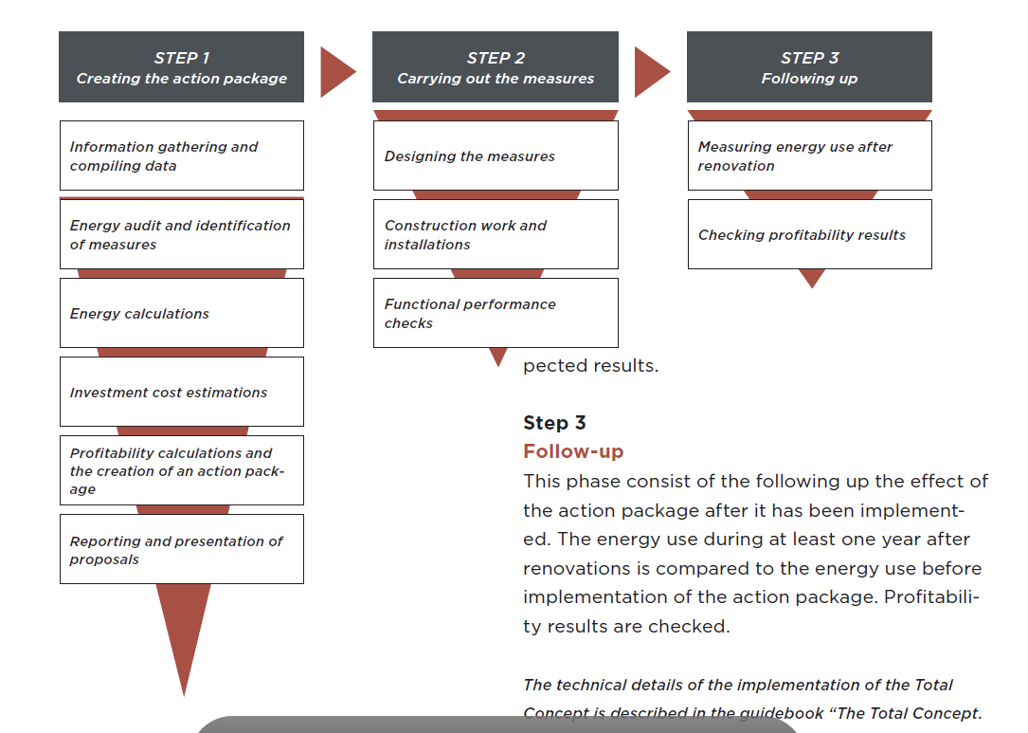
Work process

Slide 12
Preparations
Following issues shall be considered:
-what kind of energy renovation shall be carried out
-engage all relevant stakeholders
-determine the baseline for energy savings
-define an energy usage baseline / reference level. Final savings shall be compared to this.
Observe: check minimum requirements to be fulfilled in the building before any study of possible energy saving measures. The energy usage baseline is needed to be defined correctly. Furthermore the baseline may vary due to different regulations.

Slide 13
Step 1
Basic information of building
Energy audit and identification of measures
Investment cost calculation
Energy calculations
Profitability of the measures
Create an action package
Summary / report / suggestion -> to be presented for decision makers
(Observe: sensitivity analysis may be needed)

Slide 14
Step 2
Carrying out the measures, including:
  Planning and designing the measures
  Construction work and installations
  Functional performance checks

Slide 15
Step 3
Following up, including:
  Measuring energy usage
  Checking profitability results

Slide 16
Conflict between expected vs actual savings
In case of conflict between expected vs. actual results -> following issues shall be analyzed
do all technical systems work as planned (if not, corrective actions needed)
changes in operating conditions and/or use of the building since gathering basic information
difference between calculated / actual costs? Reason for that?
any other issues that could have affected the calculated energy savings (for ex. other works carried out at the same time and they were not connected to calculations)

Slide 17
Agenda for training event
-bundling
-TCM (Total Concept Method)
-TotalTool
4. Total Tool
  Before starting to use TotalTool
  Where to find the tool
  Other relevant material
  How to use TotalTool 1…14
Notes:
This is the agena structuring the training in the order I have found most practical. Changes might occur. Under each point I will present some examples of content. As the material is not yet finished there might be some overlapp in my presentation of examples..

Slide 18
Before starting to use TotalTool
-identify all the possible energy saving measures in the building
-define required investment cost
-calculate expected annual energy savings for each measure
    observe also the effects of individual measures to each other
-profitability requirement
    interest rate requirement given by owner of building
-also needed
    energy prices
    estimated energy price increases
    economic calculation periods for each measure, etc.

Slide 19
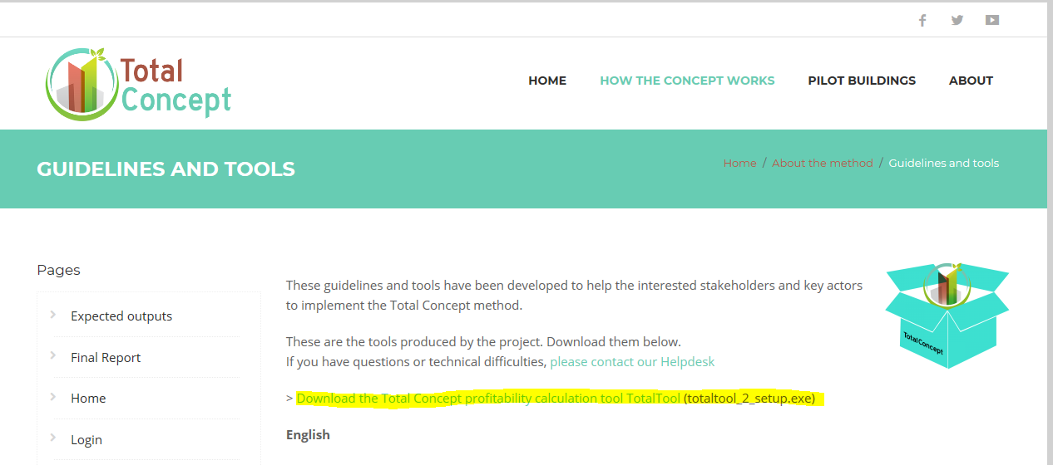
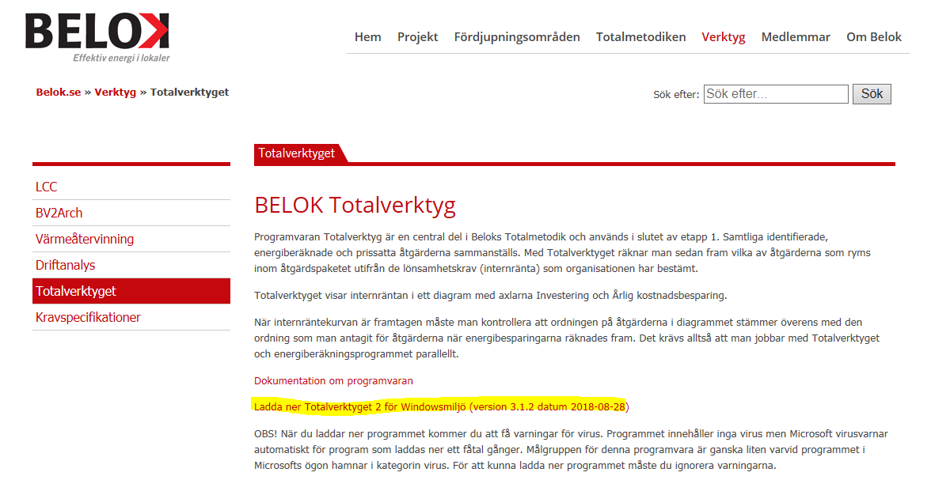
Where to find the tool?
-bundling a.k.a Total Concept
Method (TCM) & TotalTool
http://totalconcept.se/
TotalTool can be uploaded
here ---------------→
or here ---------------→
Obs! Access given by your
security organisation is needed!

Slide 20
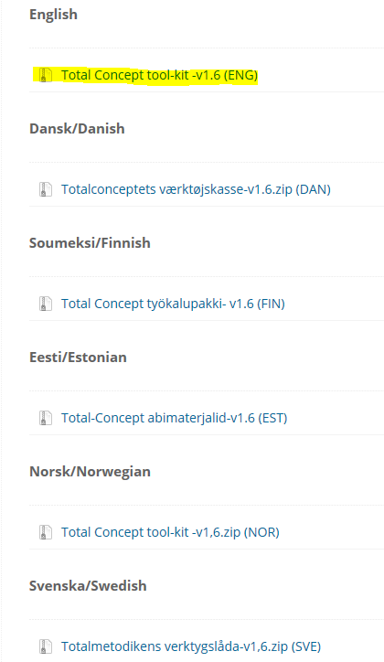
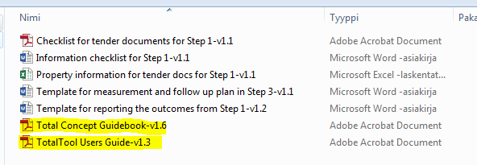
Other relevant material
-training material
available in several
languages
here ---------------→

Slide 21
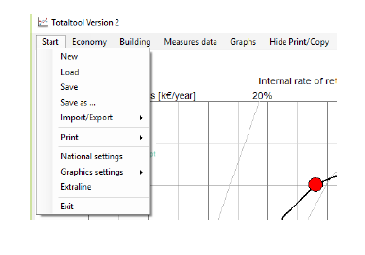
How to use TotalTool 1
From the drop down menu under Start you can also
-open previously saved files by choosing Load and
-save your files by clicking on Save or Save as.
-by choosing Import/Export you can also transfer data to/from the program.
-the language options can be changed by choosing National settings.

Slide 22
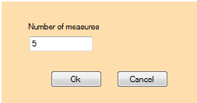
How to use TotalTool 2
Give the number of measures of your action package.
Observe, this is an editable value. You are always able to add or remove measures later.

Slide 23
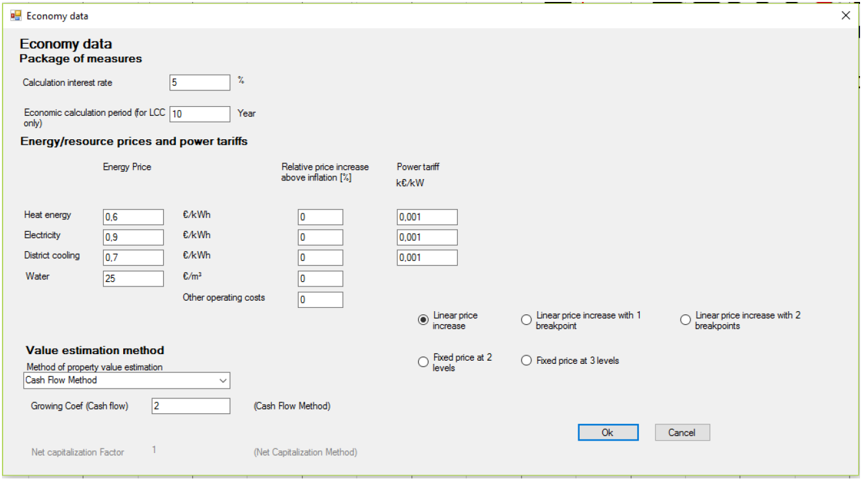
How to use TotalTool 3
Profitability requirements
Energy price including price increases
Economic calculation period

Slide 24
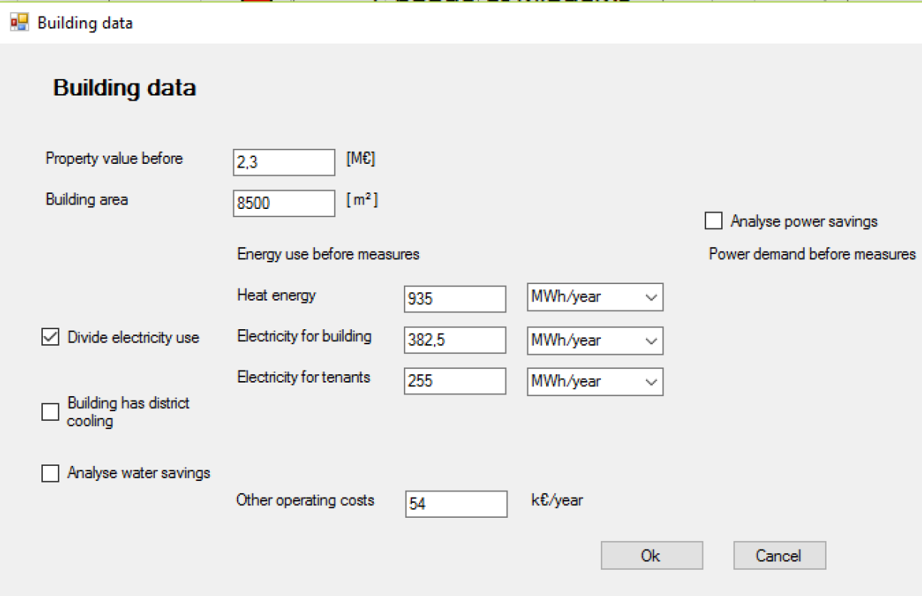
How to use TotalTool 4
The building area [m2]
Energy use before the measures (the baseline)
Power demand before measures
Other operating costs

Slide 25
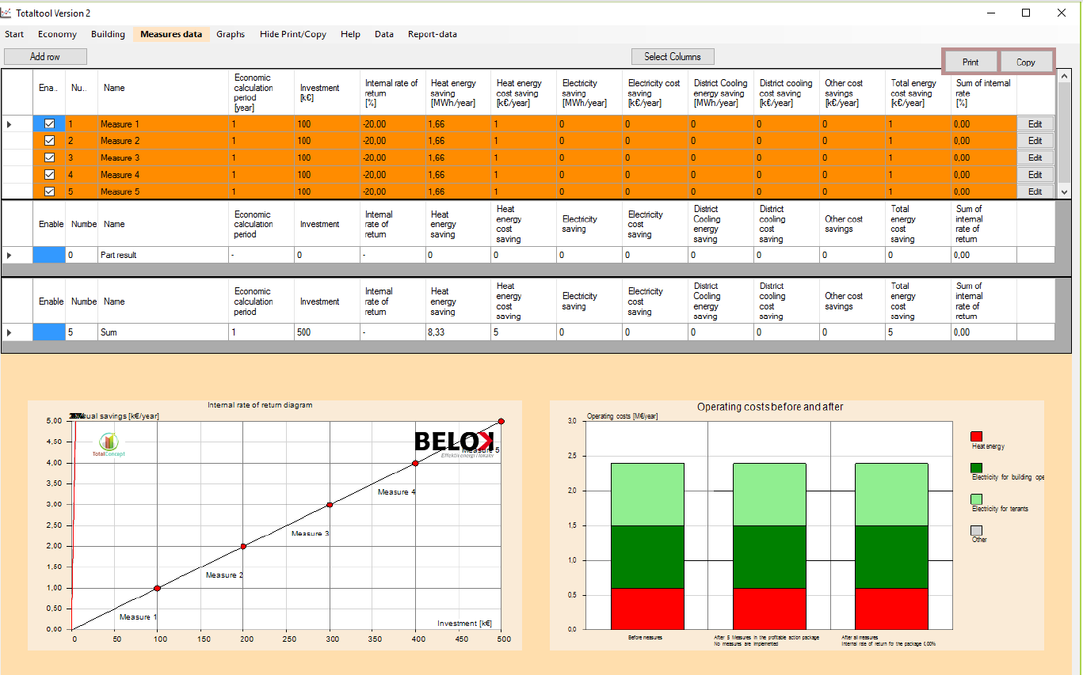
Add input data
How to use TotalTool 5

Slide 26
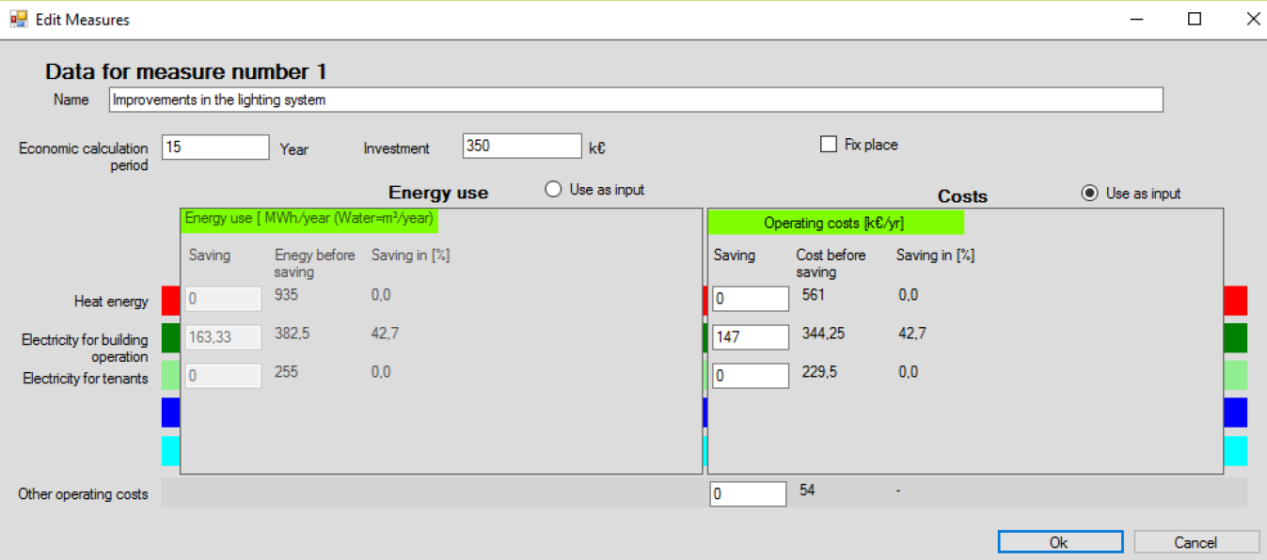
How to use TotalTool 6
Fill in all specified details

Slide 27
How to use TotalTool 7
In the Measures data menu by clicking the box in the first column “Enable” of the data table in Section 1 the specific measure is included to the action package calculation and shown on the results diagrams.
When unclicking the box the measure will be excluded from the calculations, but it still appears in the measures table.
To add a new measure, click “Add row”.
To delete a measure, first activate the measure by clicking on the first cell of the measure line (the line becomes blue) and then click “Delete measure”.
Now charts are available ->

Slide 28
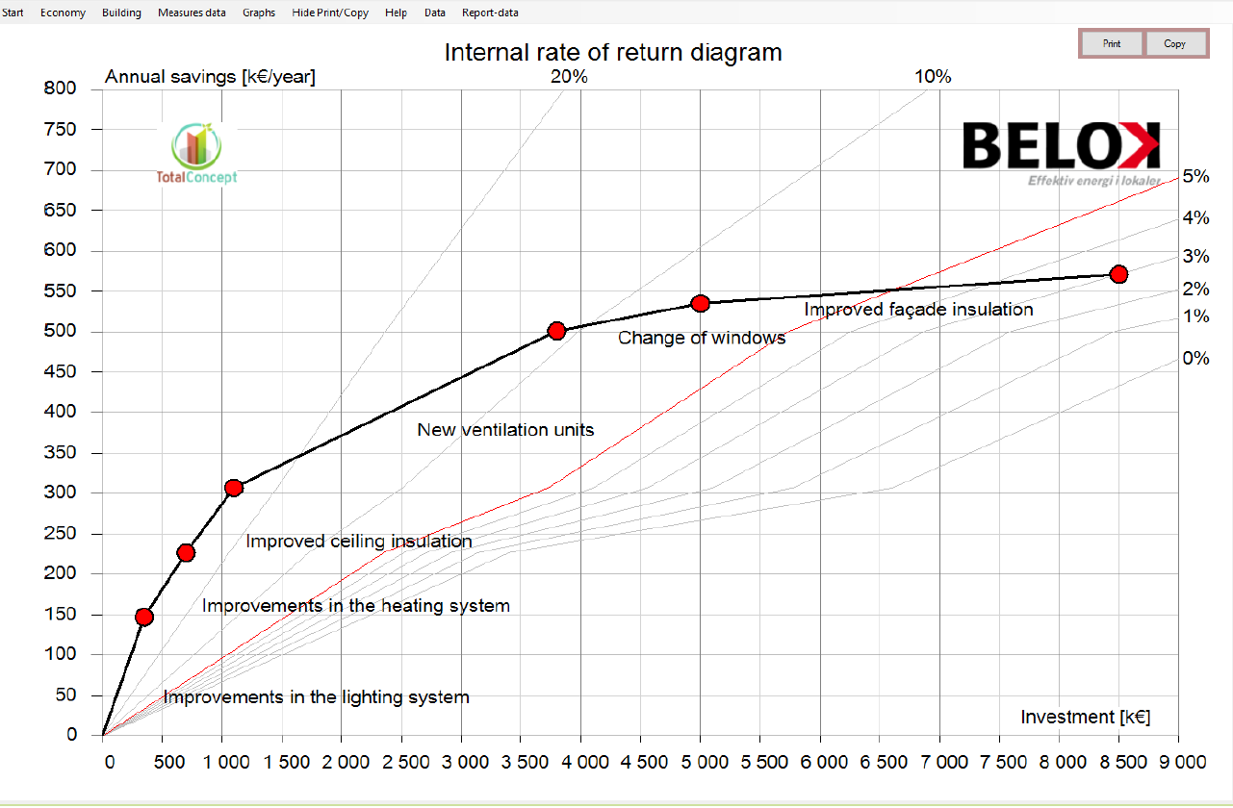
How to use TotalTool 8
Diagram presents the action package

Slide 29
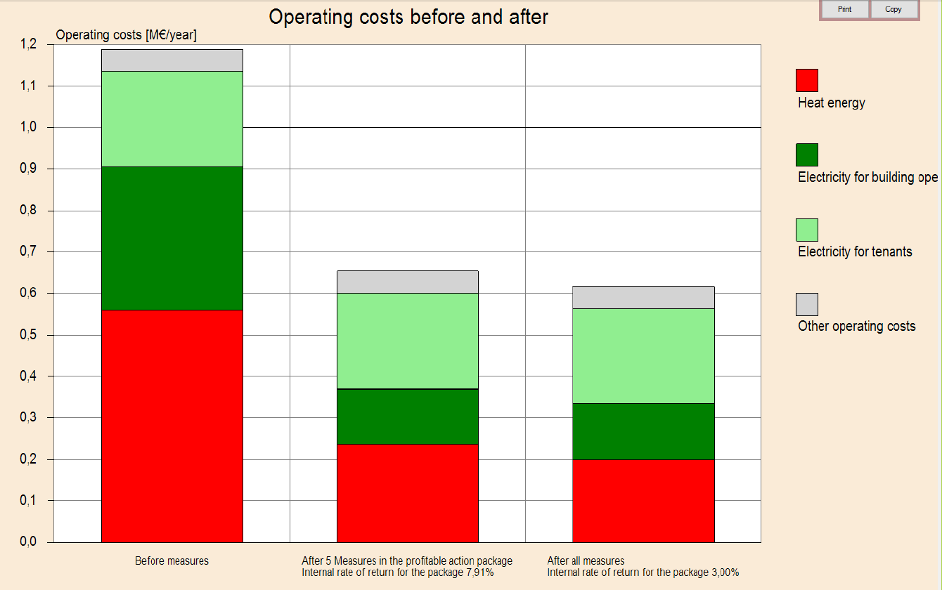
How to use TotalTool 9
Diagram presents the total annual operating costs before the action package (left bar) and after the action package (middle and right bar).
The results are given for two different cases:
- results with the action package that fulfills the profitability demand of the property owner (middle bar) and
- results with all measures that are selected as “Enable” in the Measures data table.

Slide 30
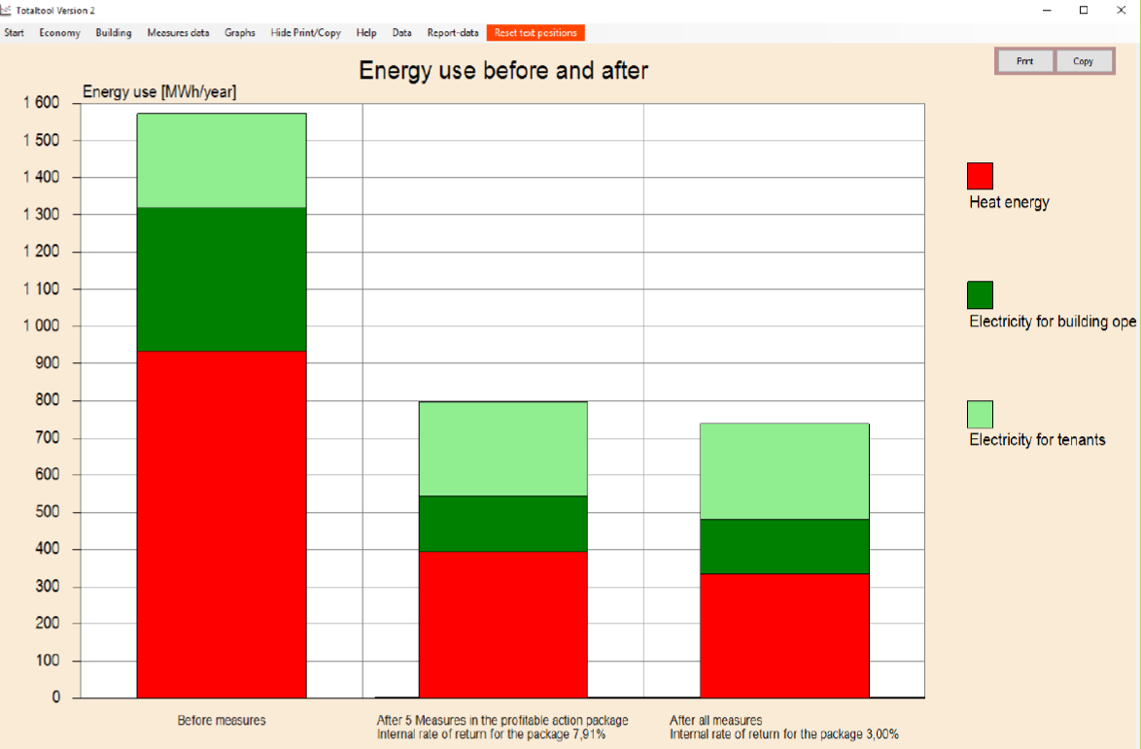
How to use TotalTool 10
Diagram presents the annual energy use before the action package (left bar) and after the action package (middle and right bar). The results are given for two different cases:
-results with the action package that fulfills the profitability demand of the property owner (middle bar) and
-results with all measures that are are selected as “Enable” in the Measures data table.

Slide 31
How to use TotalTool 11
Diagram presents the estimated property value before the action package (left bar) and after the action package (middle and right bar). The results are based on the selected calculation method in the input data field under Economy and
are displayed for two different cases:
- results with the action package that fulfills the profitability demand of the property owner (middle bar) and
- results with all measures that are selected as “Enable” in the Measures data table.

Slide 32
How to use TotalTool 12
Should internal rate of return of each individual measures be presented more clearly? At the moment only the IRR-summary of the chosen measures is presented clearly.
Building managers, decision makers and other stakeholders may be confused, how profitable each individual measures are in practice, if individual IRR’s are not presented.
At least the person presenting (or training) Total tool results, shall be prepared to tell all the details behind to charts and how results shall be interpreted.
Samples regarding this issue on the next two slides.

Slide 33
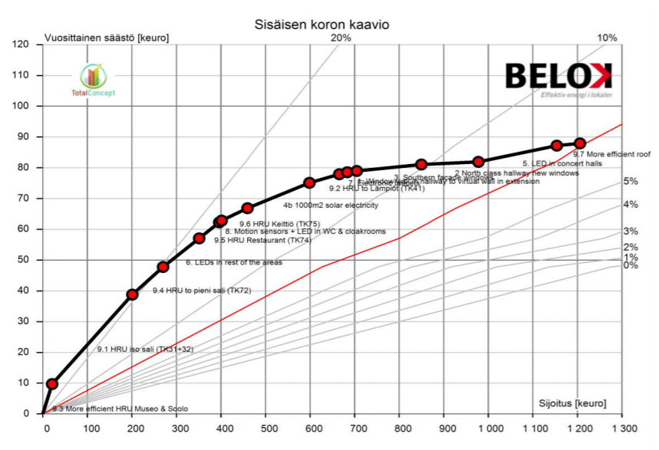
How to use TotalTool 13

Slide 34
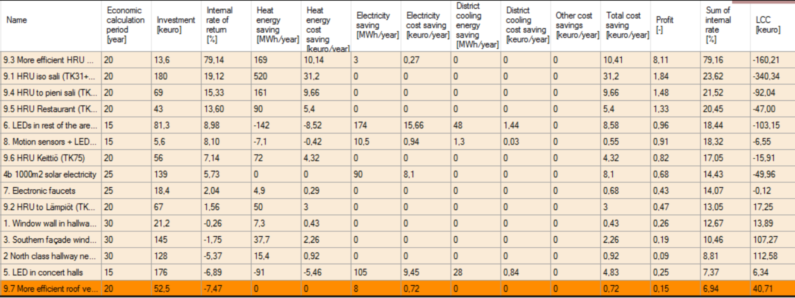
How to use TotalTool 14

Slide 35
Agenda for training event
-bundling
-TCM (Total Concept Method)
-TotalTool
5. Examples and experience
  Existing pilot sample cases
  Scorecard templates
Notes:
This is the agena structuring the training in the order I have found most practical. Changes might occur. Under each point I will present some examples of content. As the material is not yet finished there might be some overlapp in my presentation of examples..

Slide 36
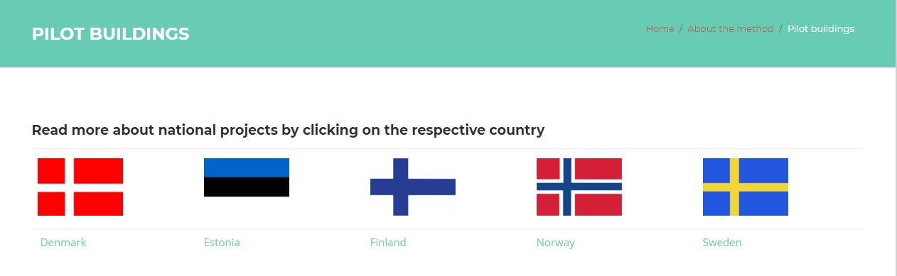
Existing pilot samples
http://totalconcept.se/method/pilot-buildings/
These can be used as exercise cases / work shop themes / also own cases for training purposes.

Slide 37
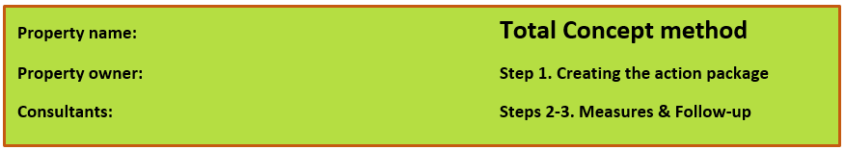
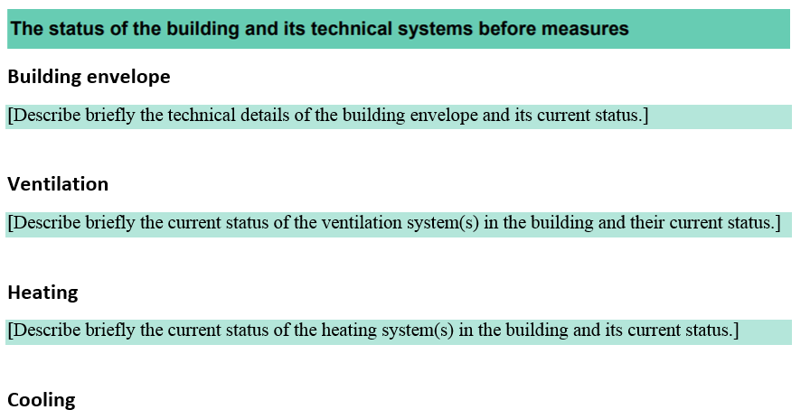
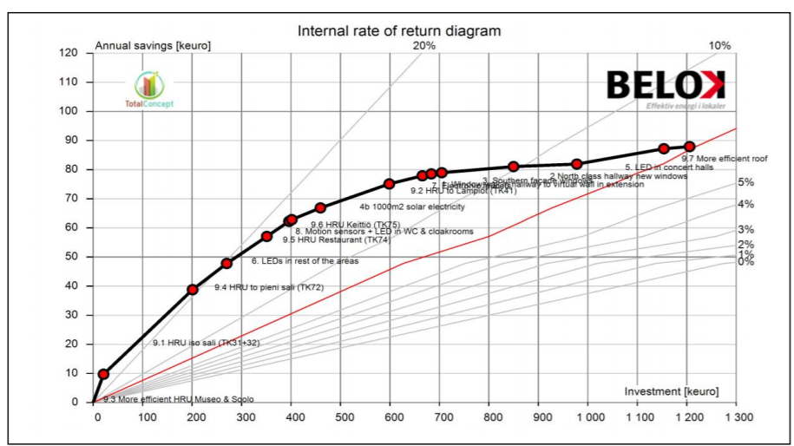
Scorecard templates
step 1 Baseline of energy consumption & creating the action package
step 2-3 Implementation of Measures & Follow-up

Slide 38
Agenda for training event
-bundling
-TCM (Total Concept Method)
-TotalTool
6. Additional material
  More detailed material
  Videos of TCM & TotalTool
Notes:
This is the agena structuring the training in the order I have found most practical. Changes might occur. Under each point I will present some examples of content. As the material is not yet finished there might be some overlapp in my presentation of examples..

Slide 39
Agenda for training event
-bundling
-TCM (Total Concept Method)
-TotalTool
7. Summary / conclusions / discussions
Notes:
This is the agena structuring the training in the order I have found most practical. Changes might occur. Under each point I will present some examples of content. As the material is not yet finished there might be some overlapp in my presentation of examples..

Slide 40
Contact
EFFECT4buildings
Full name
Organisation
Institution/Company
Phone:
E-mail:
Homepage:

