Slide 1
MSC toolbox
EFFECT4buildings
Louise Fich, Gate 21
02.06.20

Slide 3
Phase 0 – tools
Tool | Comments
1. Guideline for MSC phases and toolbox | Elaborates the MSC phases and model Overview of toolbox and how they relate to MSC phases 0-3
2. Guideline for MSC decision process | Similar exercises as training material MSC project characteristics, steps, framework
3. Content in and MSC procurement and performance requirements | Recommendations and points to pay attention to in the contract. NOT a tender template Examples of various types of performances requirements and pros and cons

Slide 4
Phase 1 – tools
Tool | Comments
4.1. Financial benefits of improved indoor environmental quality | Introduces tools from other projects Highlight the thinking in NEB as a driver for including other services than energy
4.2. Mapping and evaluation on eight parameters (2 documents – words + excel) | Template for questionnaire and excel tool developed in another project – targeted schools Experienced and measured parameters
4.3. Questionnaire for users on energy and indoor climate | Questionnaire for technical staff, all users and management
4.4. Mapping of indoor environmental quality in schools | Questionnaire template and template for technical mapping. Focus on schools
5. Guideline for planning of indoor climate in schools | Light, noise and air Mapping, planning, implementation and follow up
Tool 4
Notes:
Tool 4 – example of what it could be. Both technical measured but also surveys/questionnaire. Chose with objectives in focus and redo after execution of project to follow up on improvements.

Slide 5
Phase 1-3 – tools
Tool | Comments
6. Introduction to measurement and verification (phase 1-3) | Recommendations for a measurement and verification programme + tasks related to M&V
7. Introduction to verification during implementation | Introducing two methods: commissioning performance test
8. Performance Operation Test | Case orientated – recommendations for following up on performance from handover to one year inspection

Slide 6
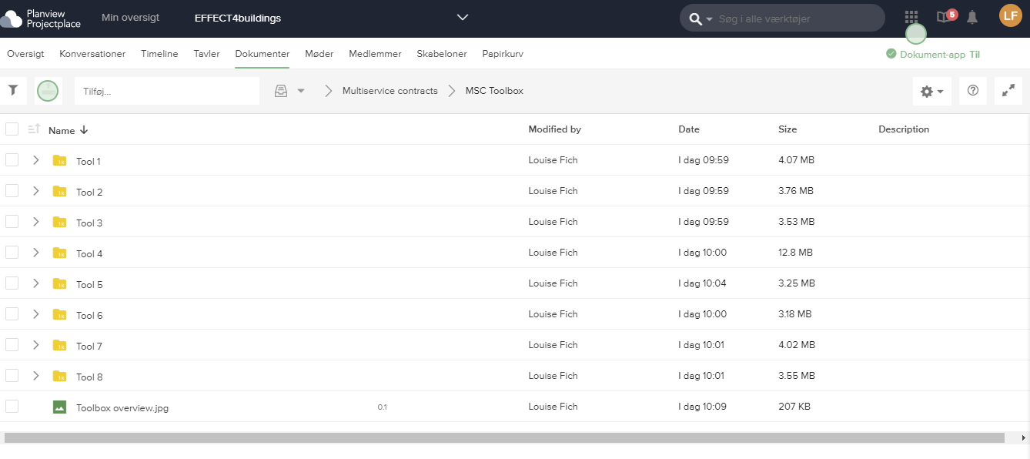
Toolbox: https://service.projectplace.com/#project/1431491357/documents/861107587

